Slide 1
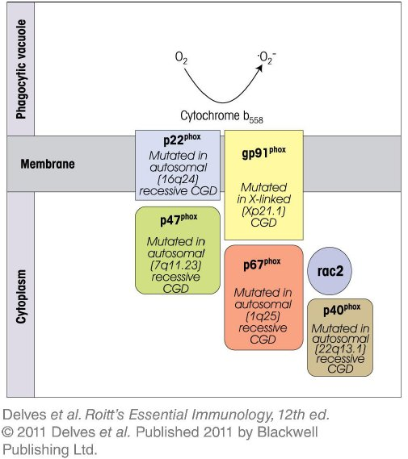
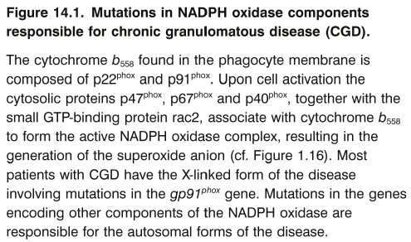
Chapter_14.indd 1
3/17/11 5:22 PM

Slide 2
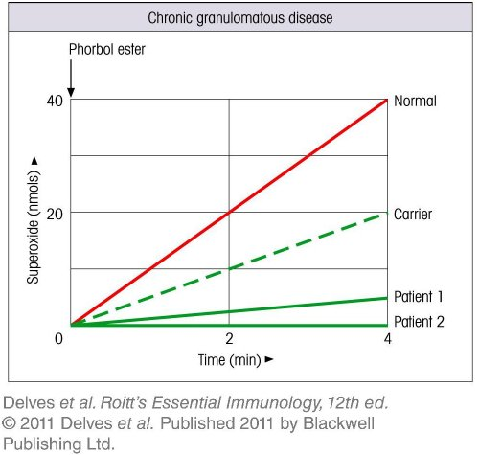
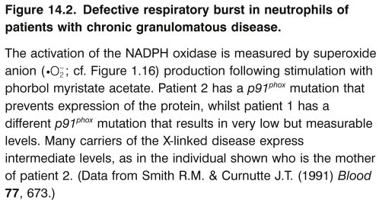
Chapter_14.indd 2
3/17/11 5:22 PM

Slide 3
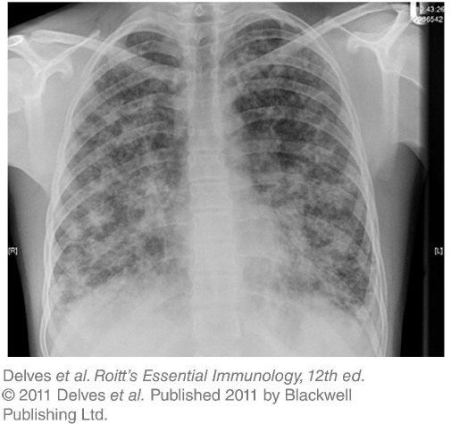
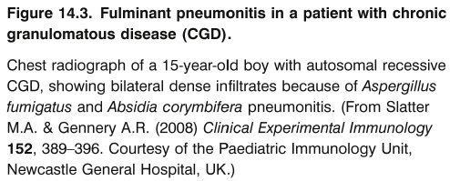
Chapter_14.indd 3
3/17/11 5:22 PM

Slide 4
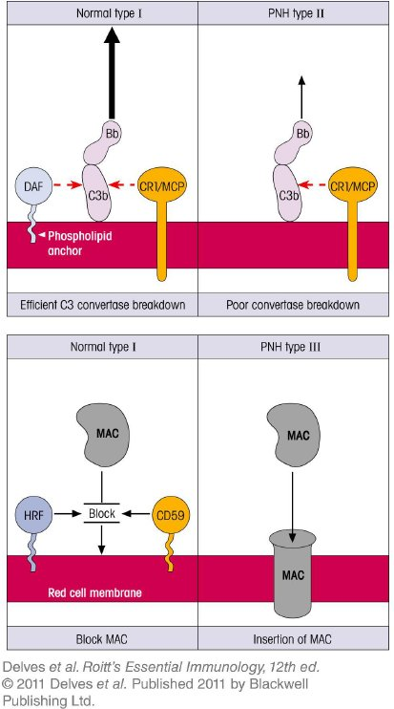
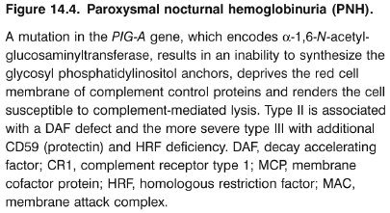
Chapter_14.indd 4
3/17/11 5:22 PM

Slide 5
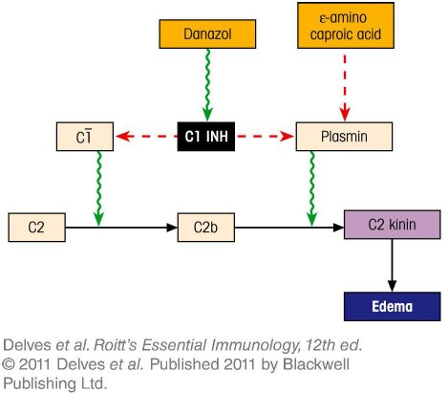
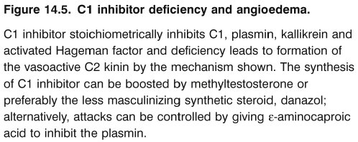
Chapter_14.indd 5
3/17/11 5:22 PM

Slide 6
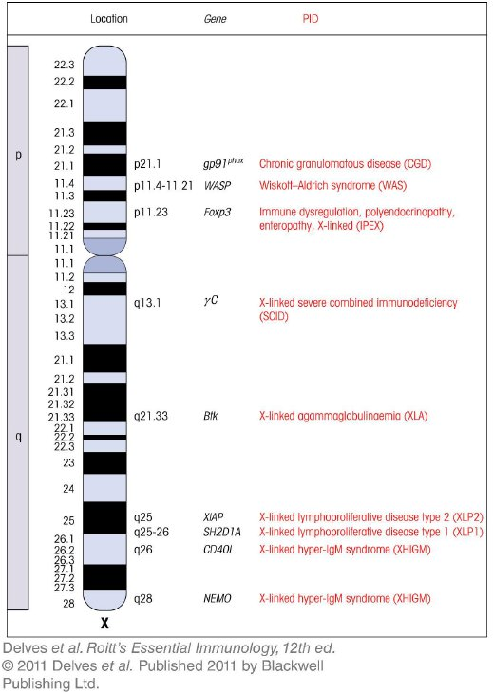
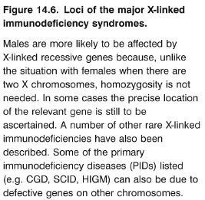
Chapter_14.indd 6
3/17/11 5:22 PM

Slide 7
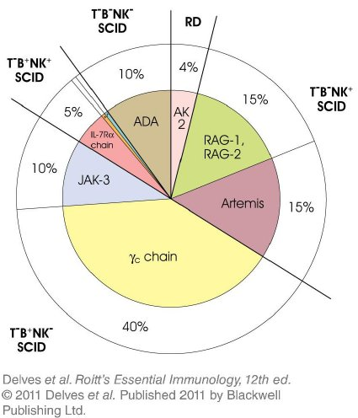
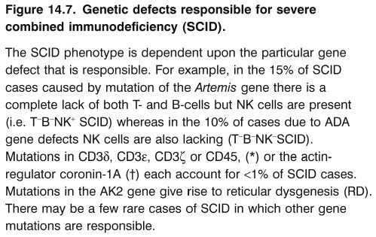
Chapter_14.indd 7
3/17/11 5:22 PM

Slide 8
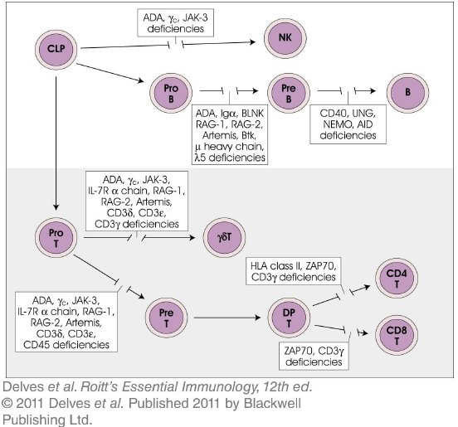
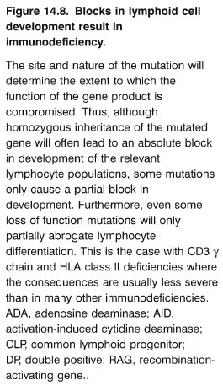
Chapter_14.indd 8
3/17/11 5:22 PM

Slide 9
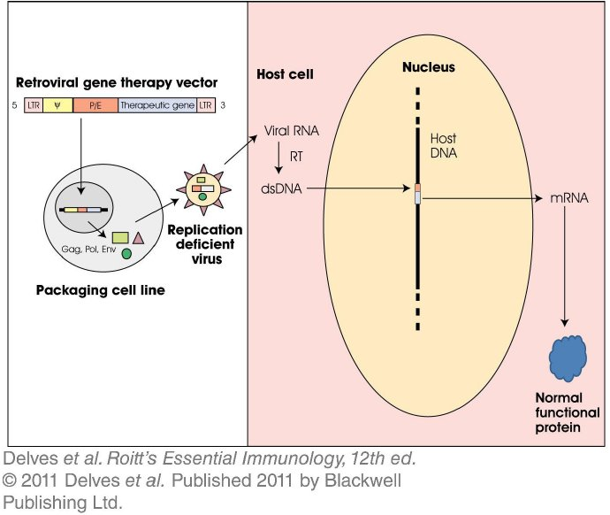
Chapter_14.indd 9
3/17/11 5:22 PM

Slide 10
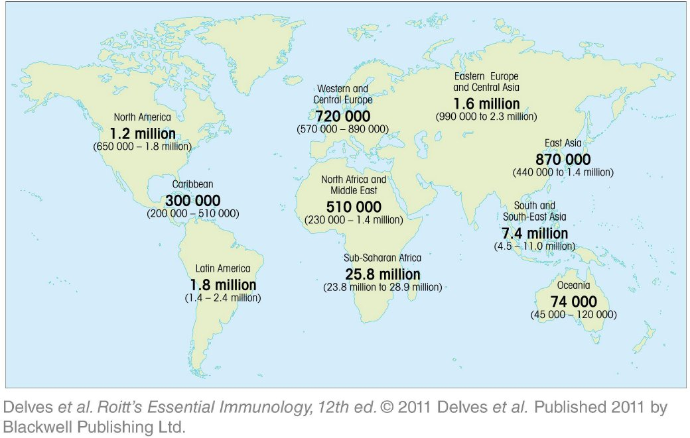
Chapter_14.indd 10
3/17/11 5:22 PM

Slide 11
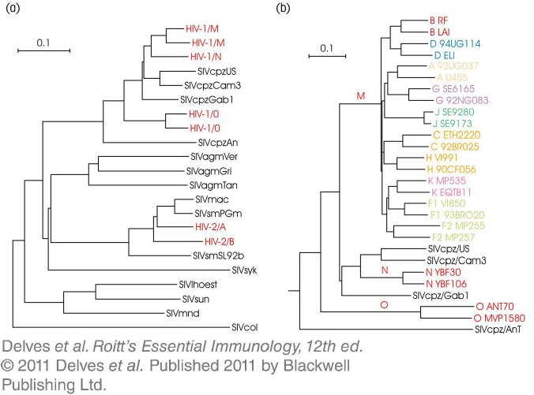
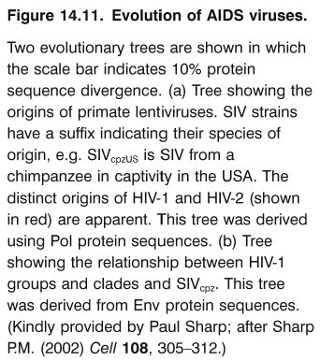
Chapter_14.indd 11
3/17/11 5:22 PM

Slide 12
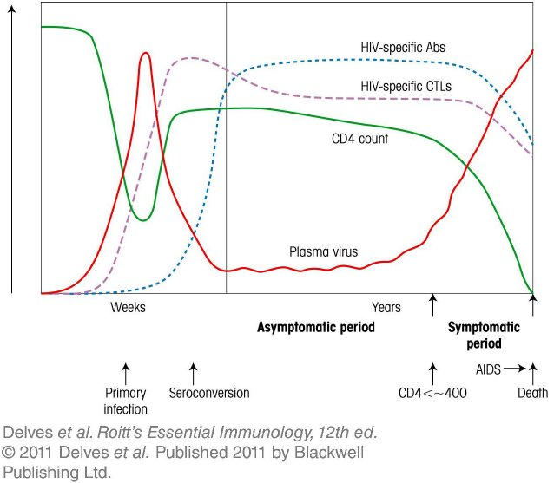
Chapter_14.indd 12
3/17/11 5:22 PM

Slide 13
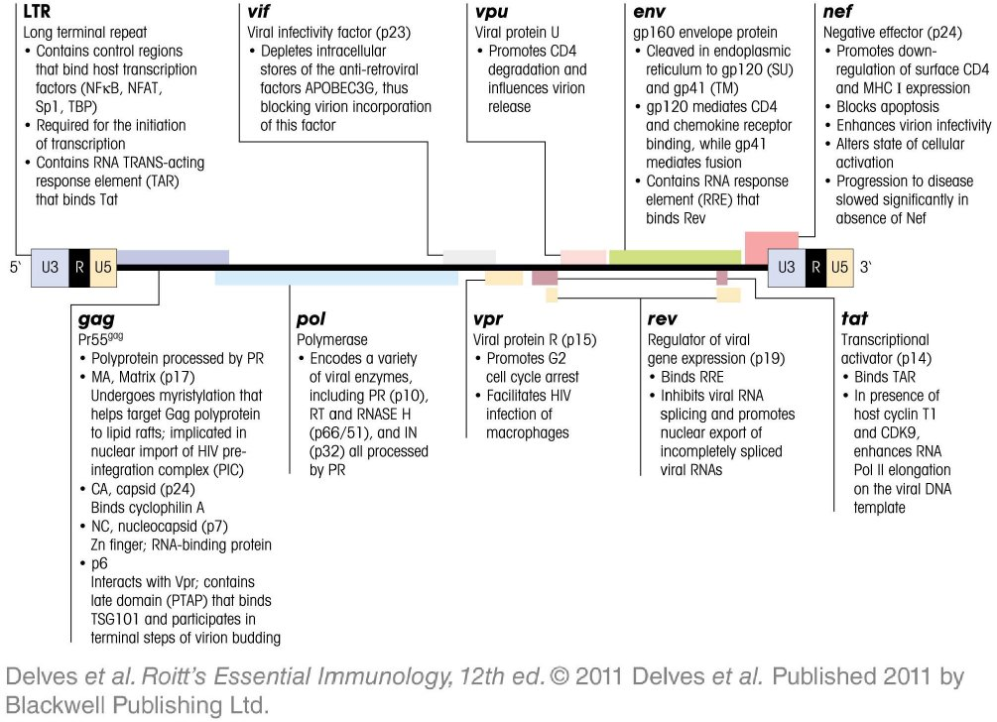
Chapter_14.indd 13
3/17/11 5:22 PM

Slide 14
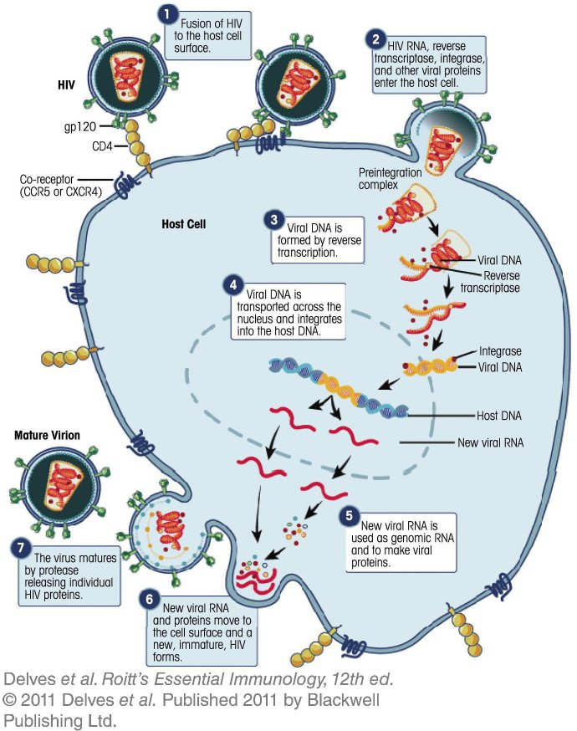
Chapter_14.indd 14
3/17/11 5:22 PM

Slide 15
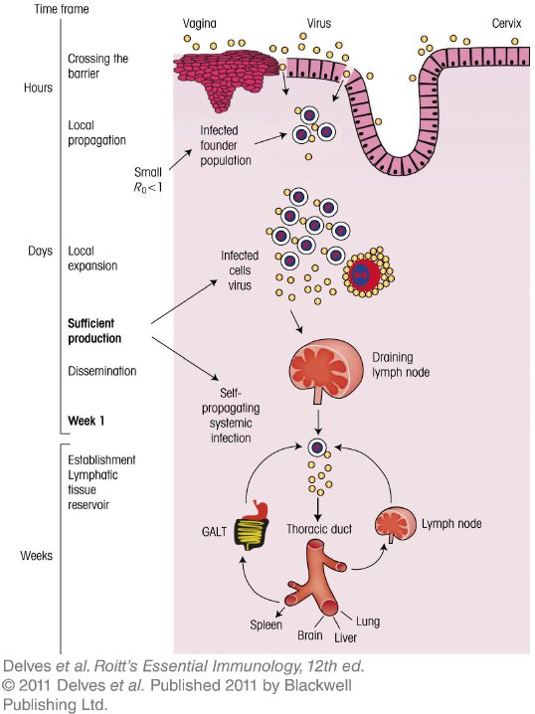
Chapter_14.indd 15
3/17/11 5:22 PM

Slide 16
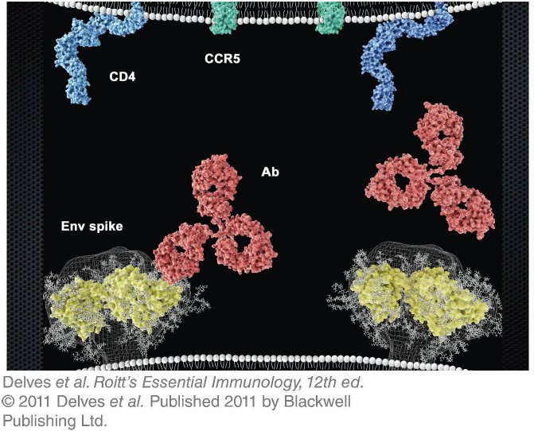
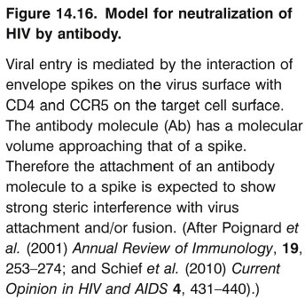
Chapter_14.indd 16
3/17/11 5:22 PM

Slide 17
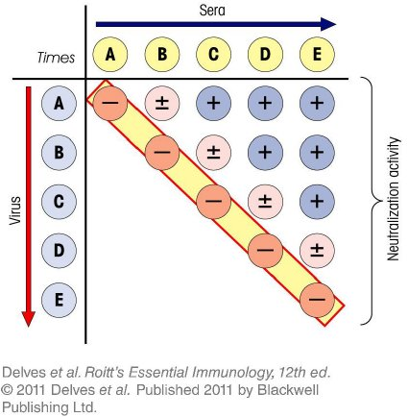
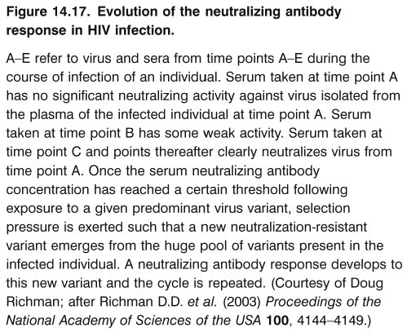
Chapter_14.indd 17
3/17/11 5:22 PM

