Slide 1
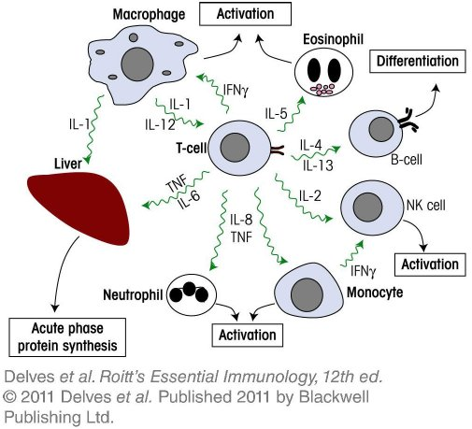
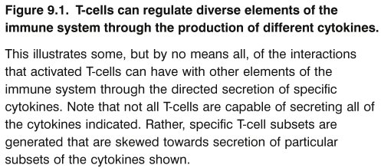
Chapter_9.indd 1
3/17/11 5:03 PM

Slide 2
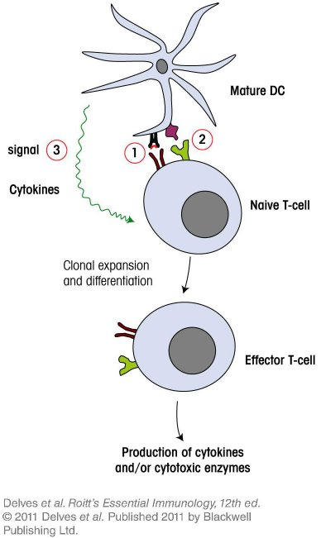
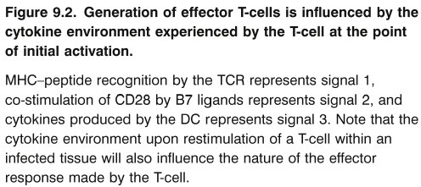
Chapter_9.indd 2
3/17/11 5:03 PM

Slide 3
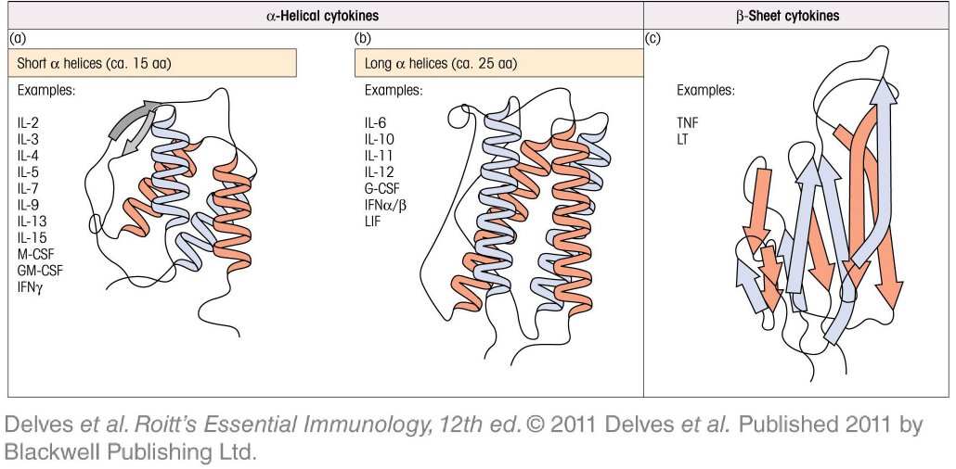
Chapter_9.indd 3
3/17/11 5:03 PM

Slide 4
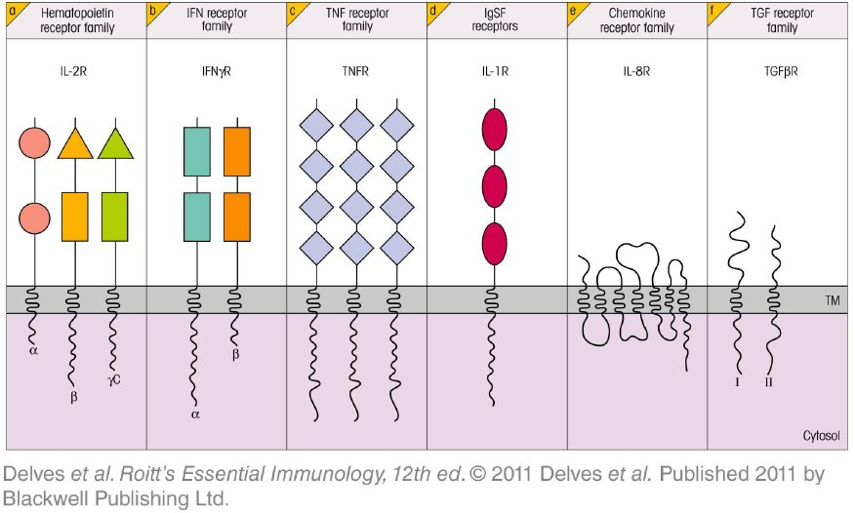
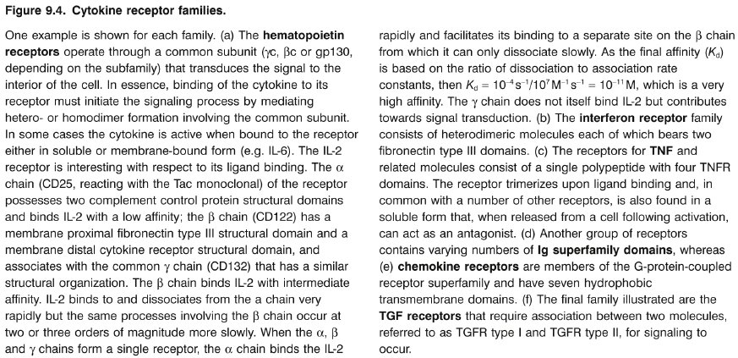
Chapter_9.indd 4
3/17/11 5:03 PM

Slide 5
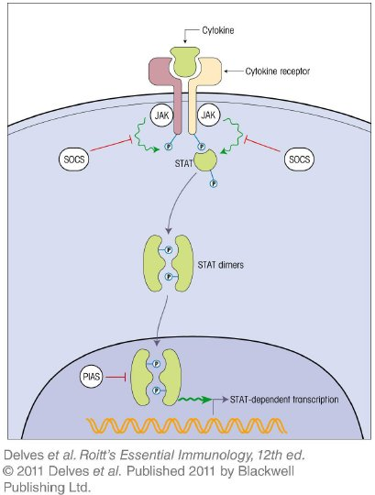
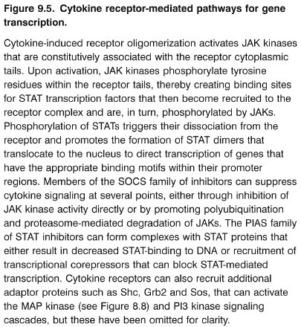
Chapter_9.indd 5
3/17/11 5:03 PM

Slide 6
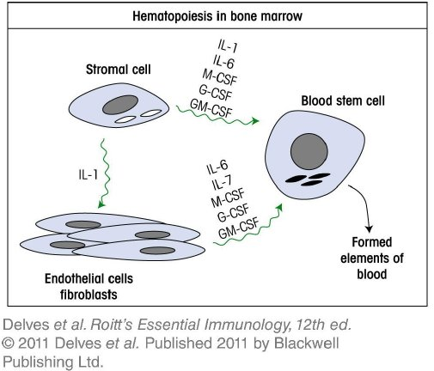
Chapter_9.indd 6
3/17/11 5:03 PM

Slide 7
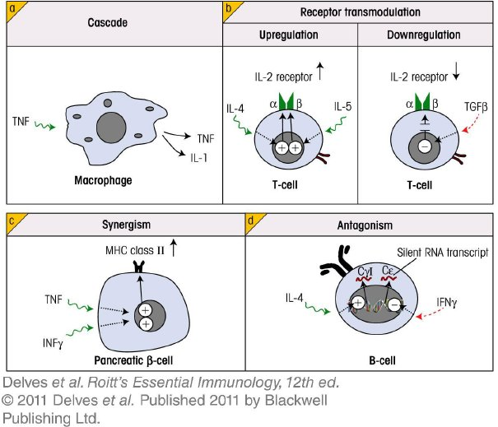
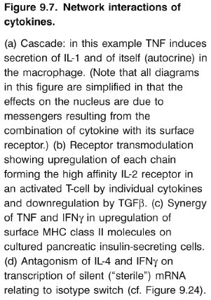
Chapter_9.indd 7
3/17/11 5:03 PM

Slide 8
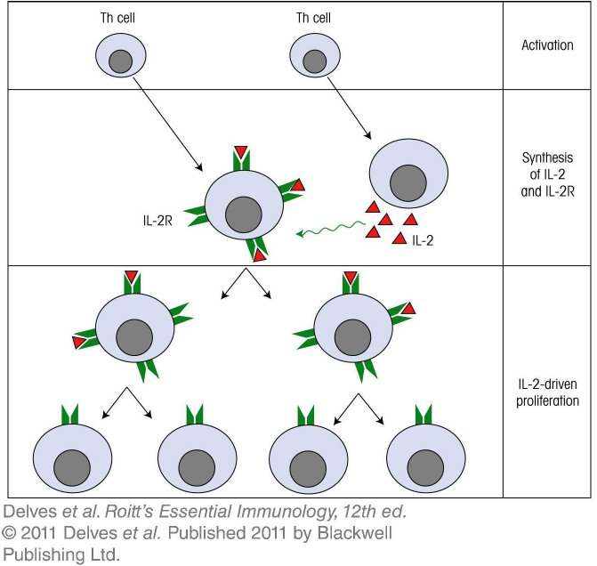
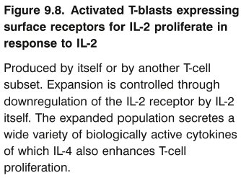
Chapter_9.indd 8
3/17/11 5:03 PM

Slide 9
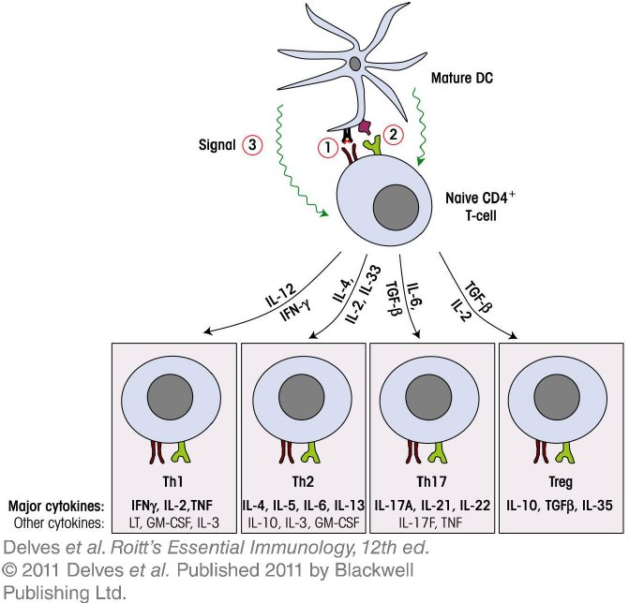
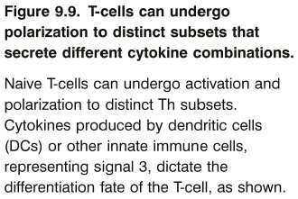
Chapter_9.indd 9
3/17/11 5:03 PM

Slide 10
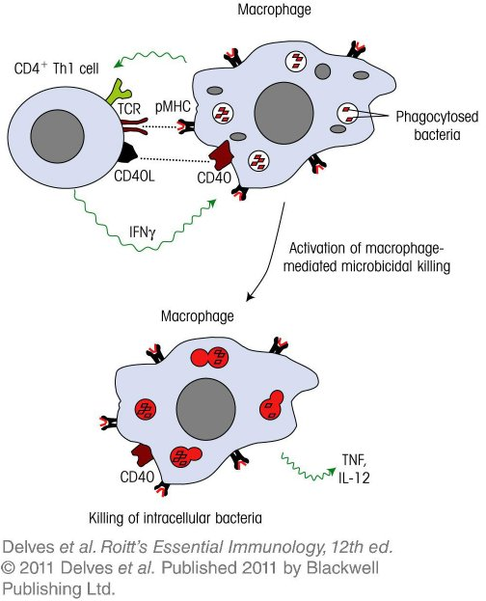
Chapter_9.indd 10
3/17/11 5:03 PM

Slide 11
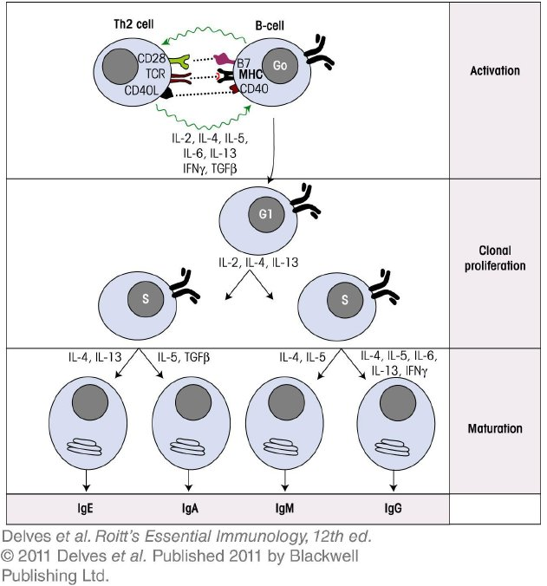
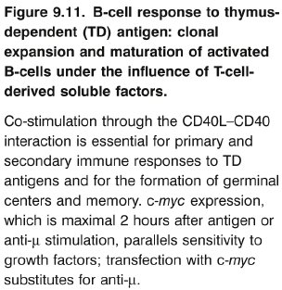
Chapter_9.indd 11
3/17/11 5:03 PM

Slide 12
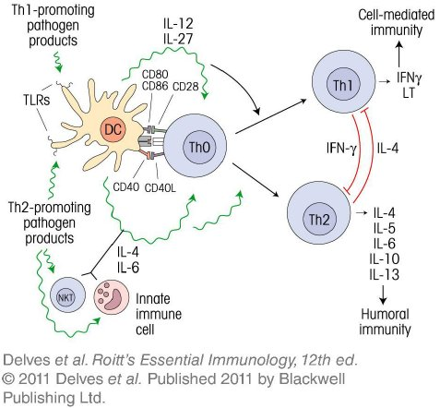
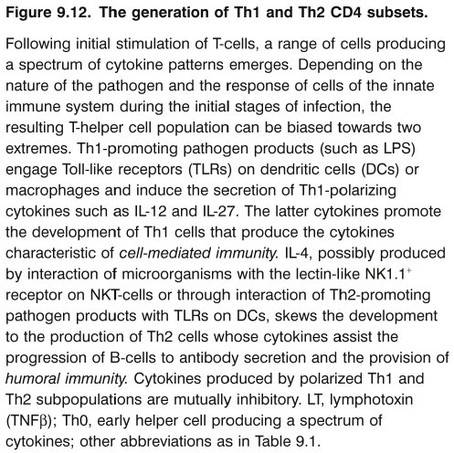
Chapter_9.indd 12
3/17/11 5:03 PM

Slide 13
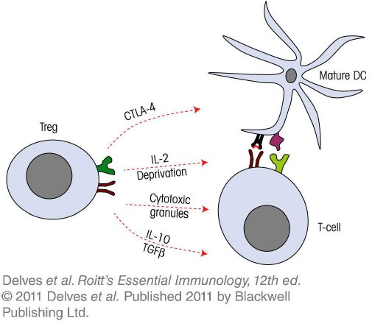
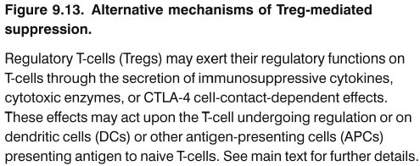
Chapter_9.indd 13
3/17/11 5:03 PM

Slide 14
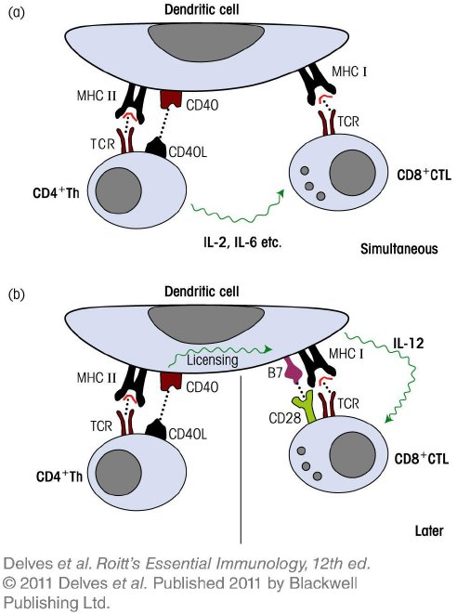
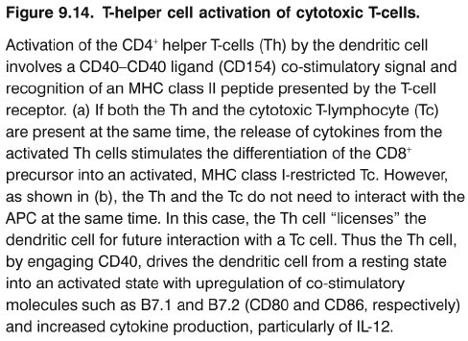
Chapter_9.indd 14
3/17/11 5:03 PM

Slide 15
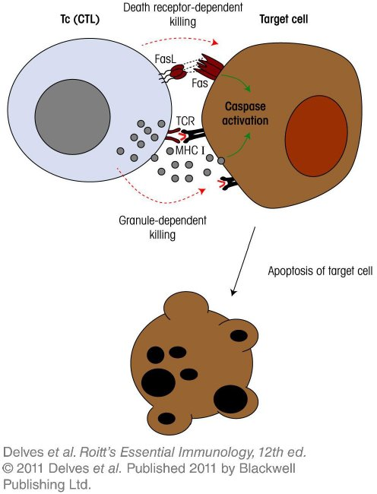
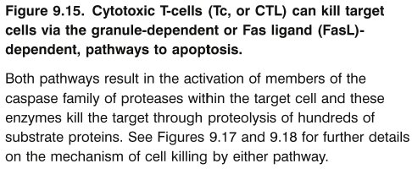
Chapter_9.indd 15
3/17/11 5:03 PM

Slide 16
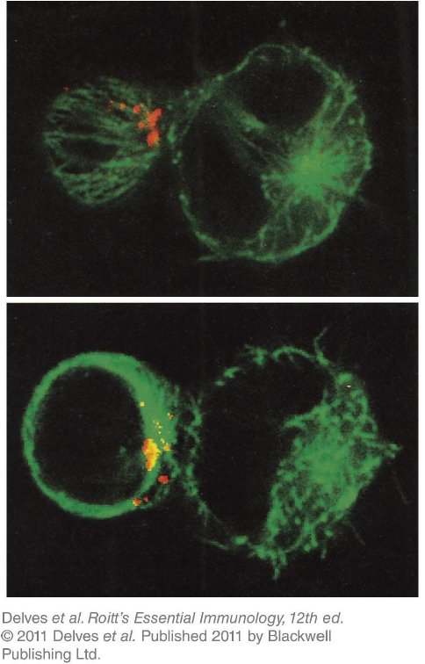
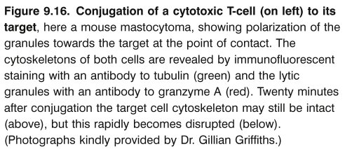
Chapter_9.indd 16
3/17/11 5:03 PM

Slide 17
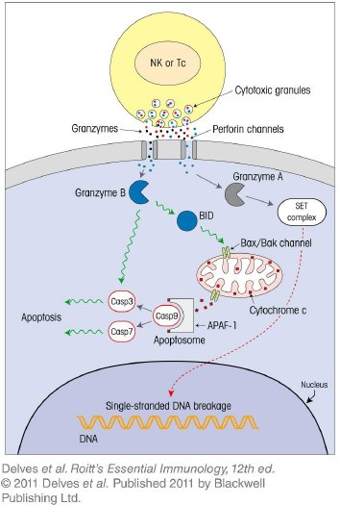
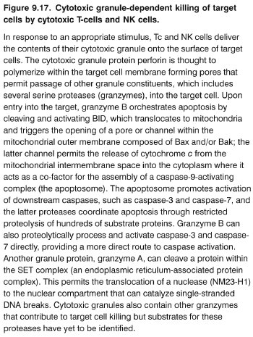
Chapter_9.indd 17
3/17/11 5:03 PM

Slide 18
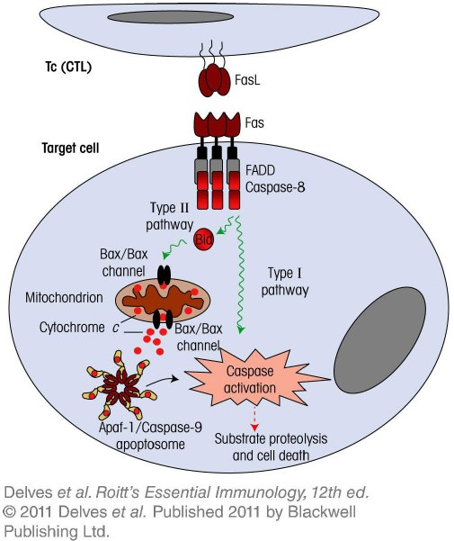
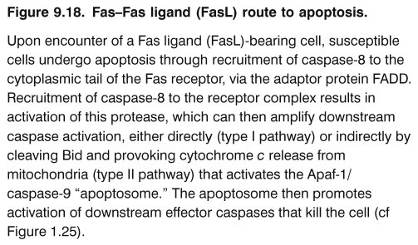
Chapter_9.indd 18
3/17/11 5:04 PM

Slide 19
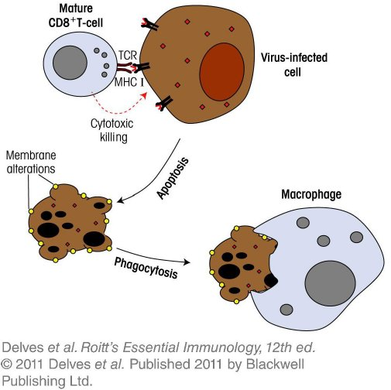
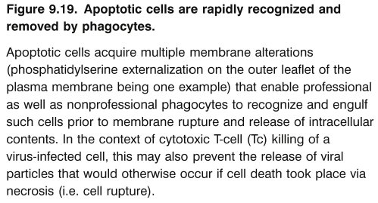
Chapter_9.indd 19
3/17/11 5:04 PM

Slide 20
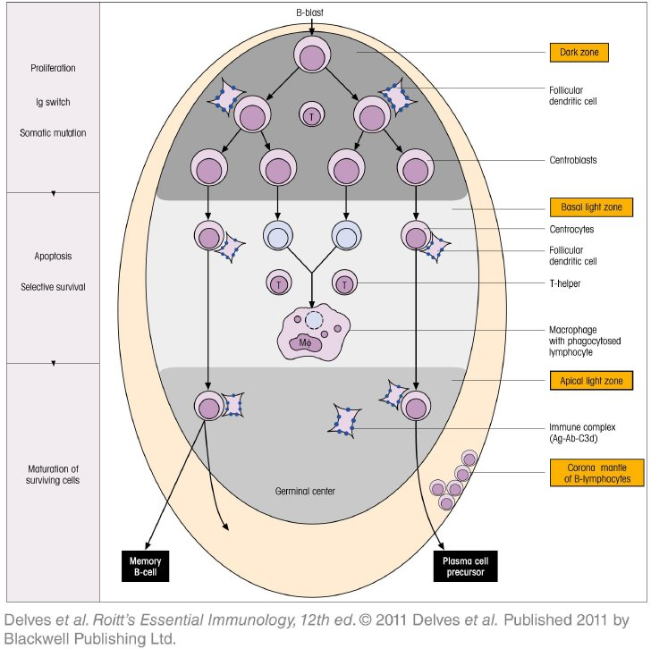
Chapter_9.indd 20
3/17/11 5:04 PM

Slide 21
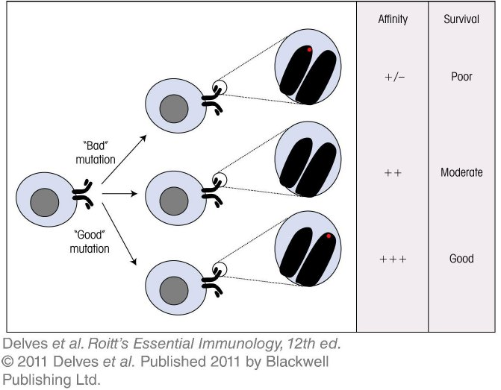
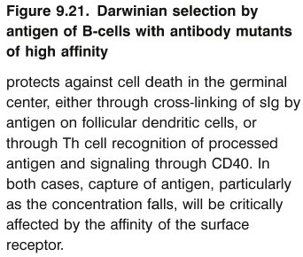
Chapter_9.indd 21
3/17/11 5:04 PM

Slide 22
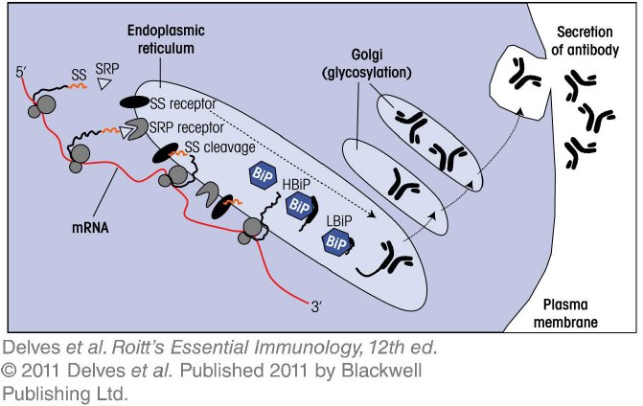
Chapter_9.indd 22
3/17/11 5:04 PM

Slide 23
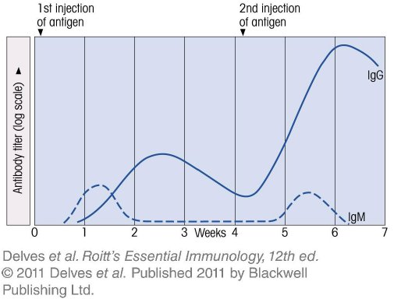
Chapter_9.indd 23
3/17/11 5:04 PM

Slide 24
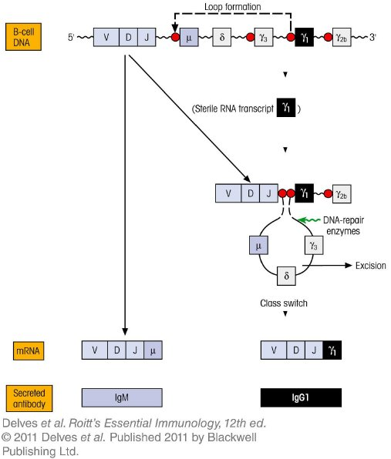
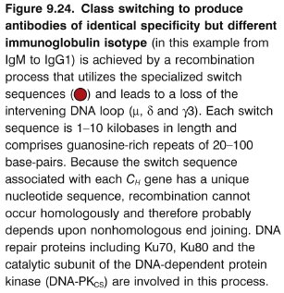
Chapter_9.indd 24
3/17/11 5:04 PM

Slide 25
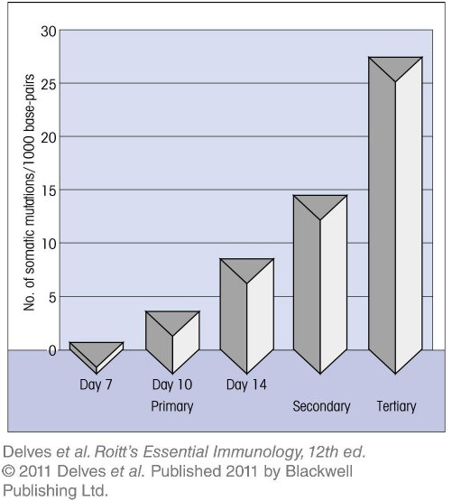
Chapter_9.indd 25
3/17/11 5:04 PM

Slide 26
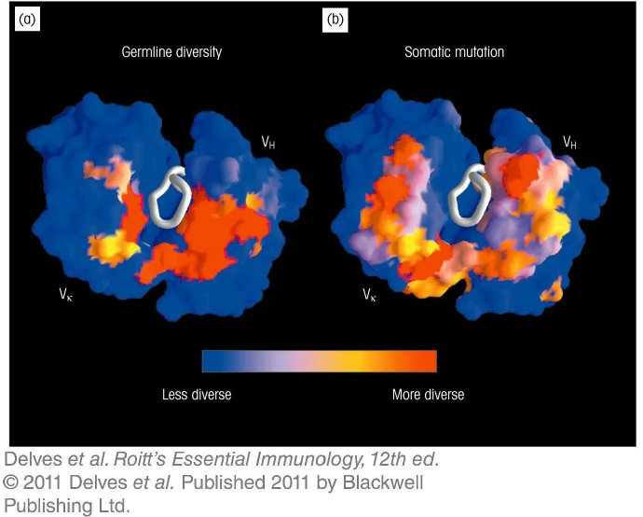
Chapter_9.indd 26
3/17/11 5:04 PM

Slide 27
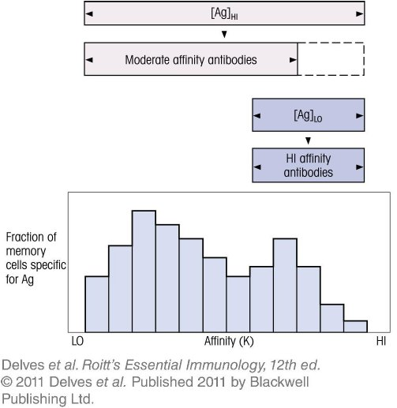
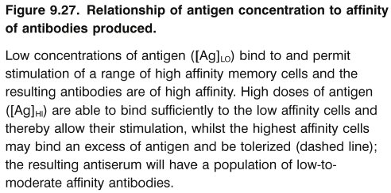
Chapter_9.indd 27
3/17/11 5:04 PM

Slide 28
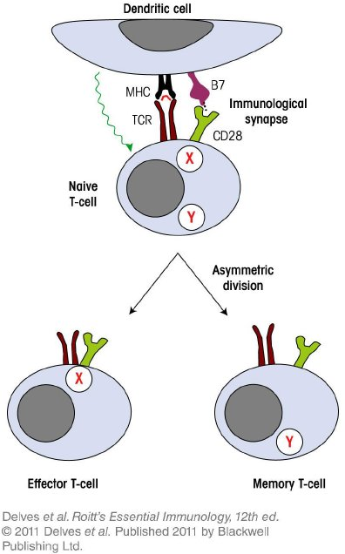
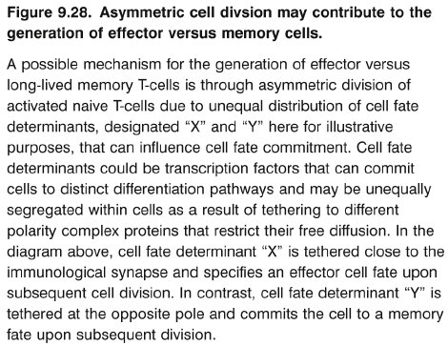
Chapter_9.indd 28
3/17/11 5:04 PM

Slide 29
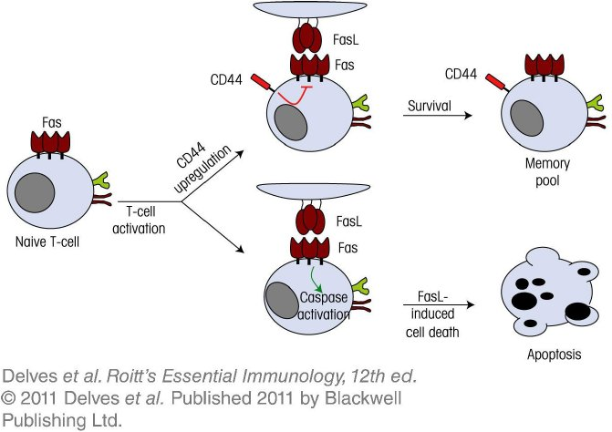
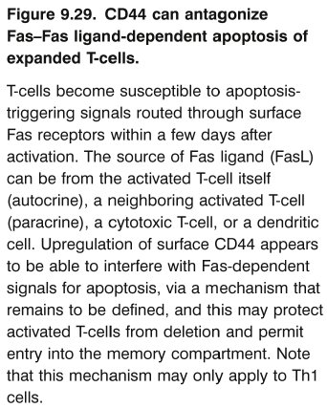
Chapter_9.indd 29
3/17/11 5:04 PM

Slide 30
Chapter_9.indd 30
3/17/11 5:04 PM

Slide 31
Chapter_9.indd 31
3/17/11 5:04 PM

