Slide 1
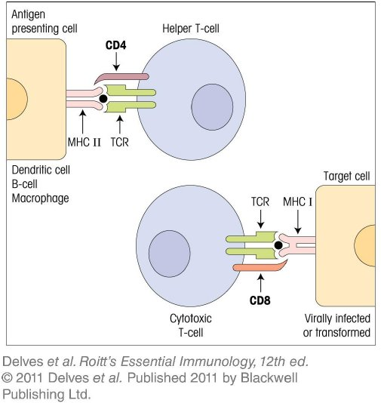
Chapter_8.indd 1
3/17/11 4:59 PM

Slide 2
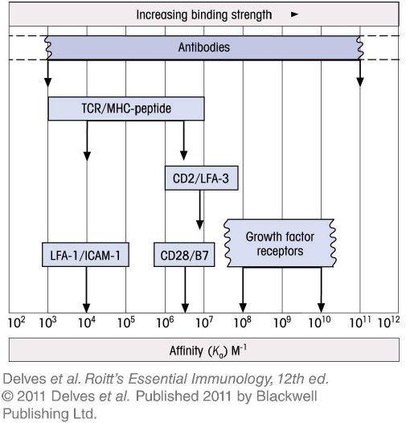
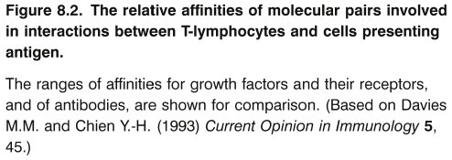
Chapter_8.indd 2
3/17/11 4:59 PM

Slide 3
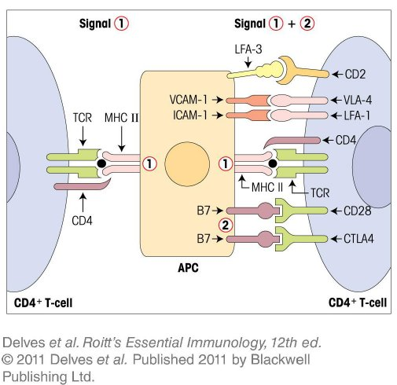
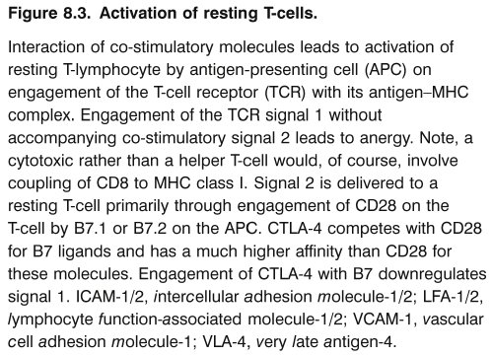
Chapter_8.indd 3
3/17/11 4:59 PM

Slide 4
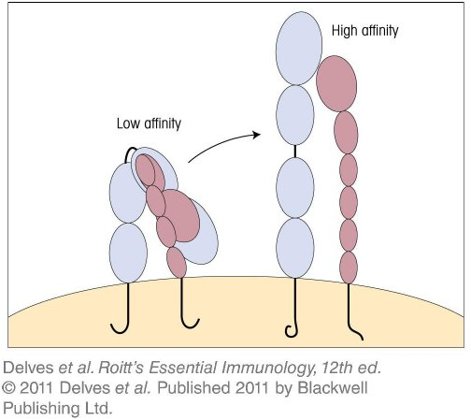
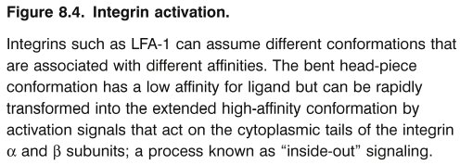
Chapter_8.indd 4
3/17/11 4:59 PM

Slide 5
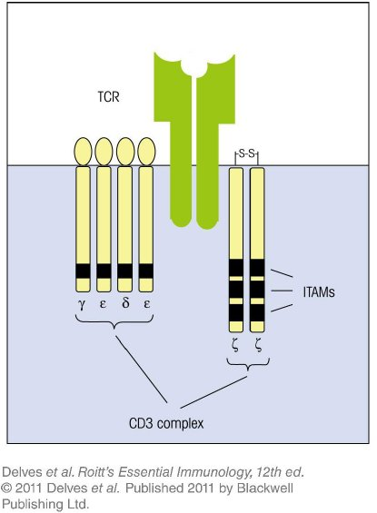
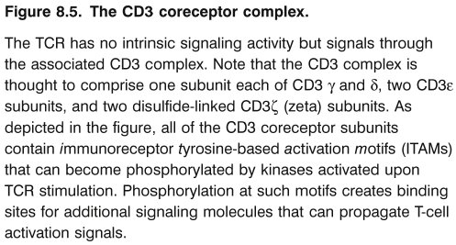
Chapter_8.indd 5
3/17/11 4:59 PM

Slide 6
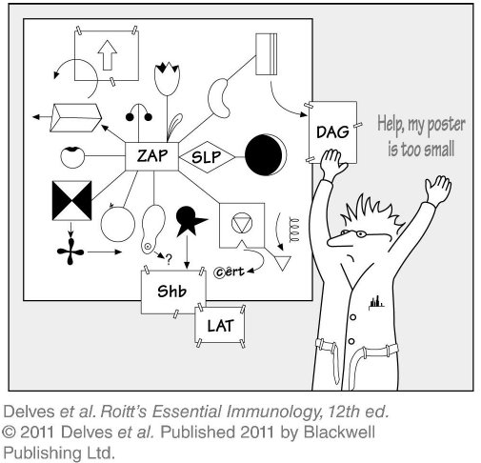
Chapter_8.indd 6
3/17/11 4:59 PM

Slide 7
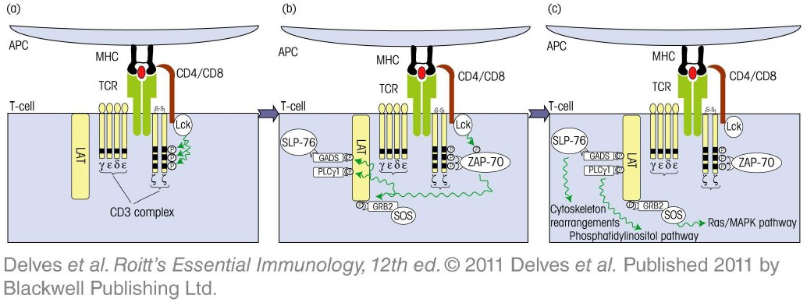
Chapter_8.indd 7
3/17/11 4:59 PM

Slide 8
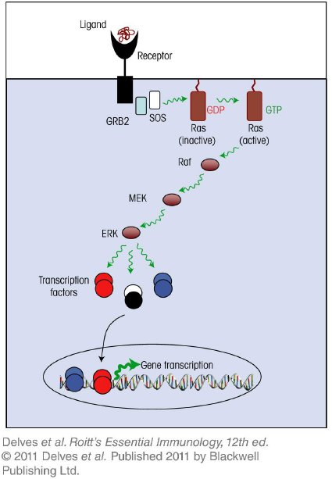
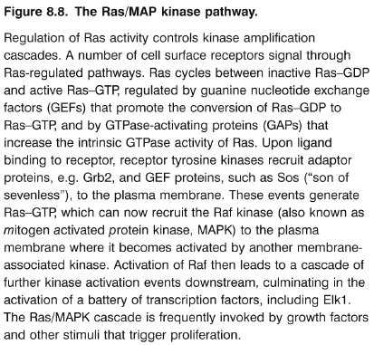
Chapter_8.indd 8
3/17/11 4:59 PM

Slide 9
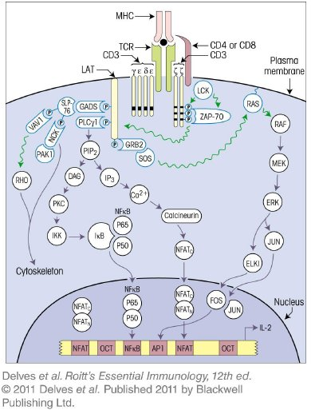
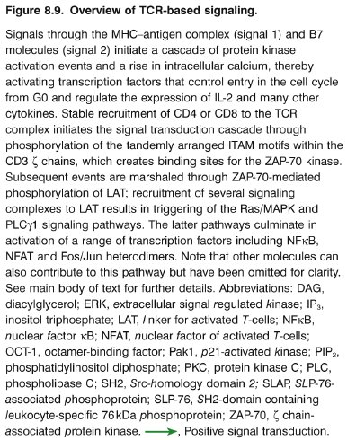
Chapter_8.indd 9
3/17/11 4:59 PM

Slide 10
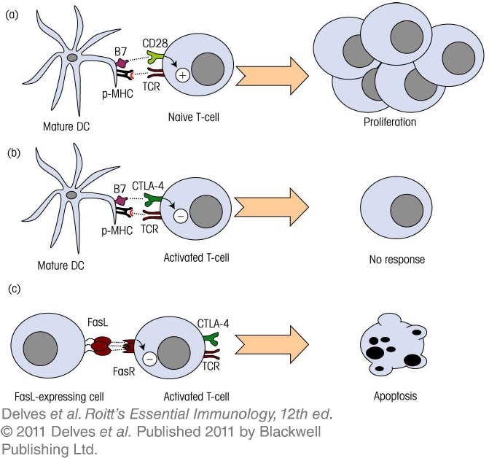
Chapter_8.indd 10
3/17/11 4:59 PM

Slide 11
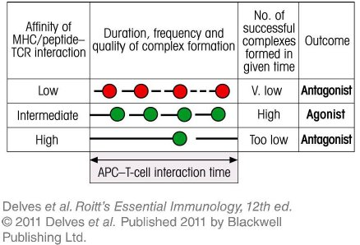
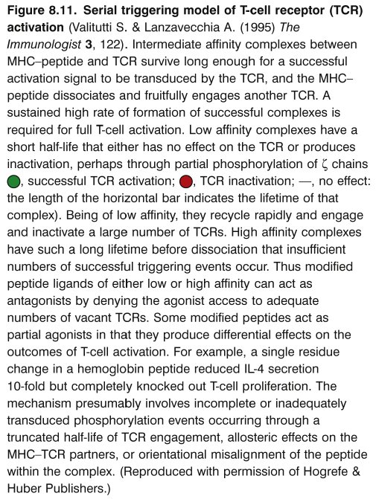
Chapter_8.indd 11
3/17/11 4:59 PM

Slide 12
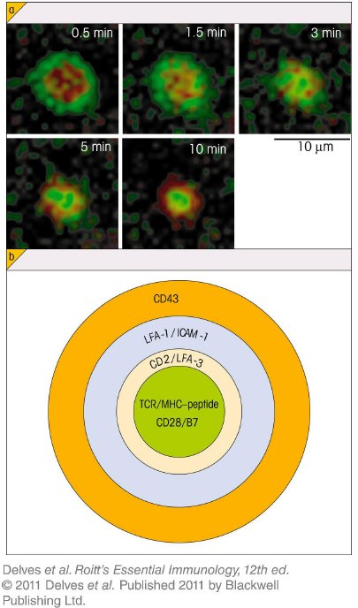
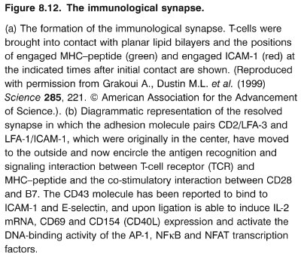
Chapter_8.indd 12
3/17/11 4:59 PM

Slide 13
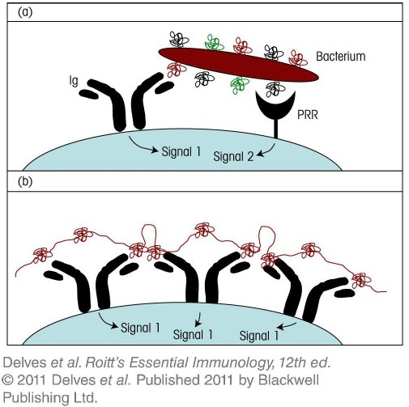
Chapter_8.indd 13
3/17/11 4:59 PM

Slide 14
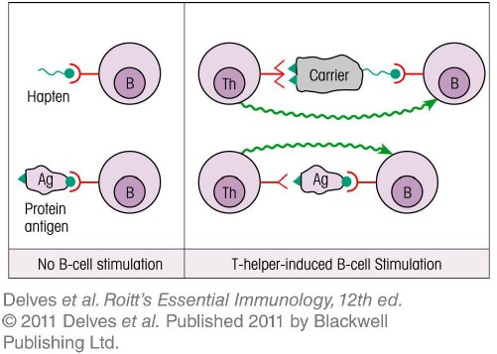
Chapter_8.indd 14
3/17/11 4:59 PM

Slide 15
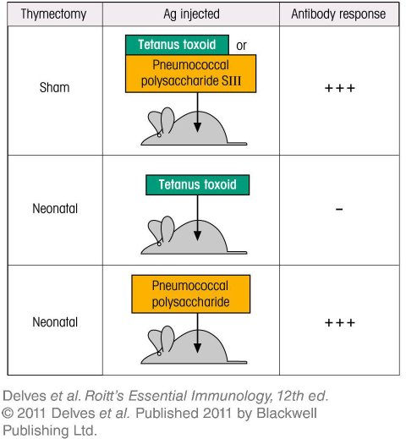
Chapter_8.indd 15
3/17/11 4:59 PM

Slide 16
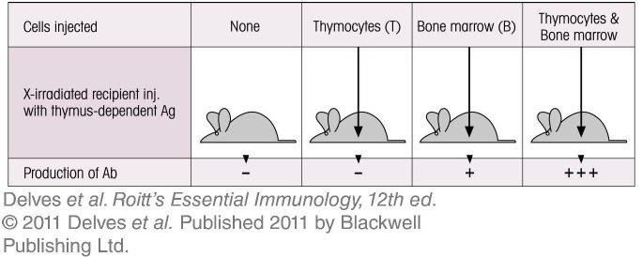
Chapter_8.indd 16
3/17/11 4:59 PM

Slide 17
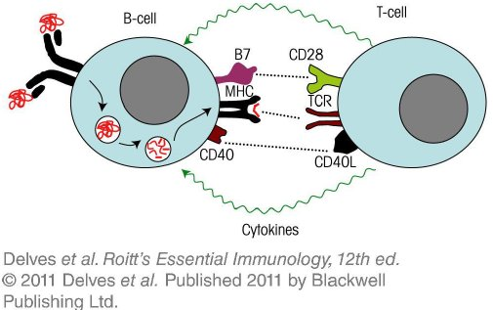
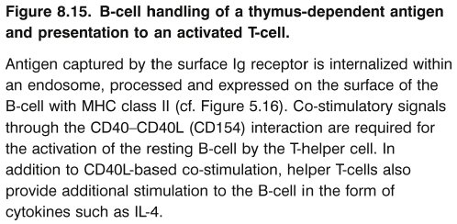
Chapter_8.indd 17
3/17/11 4:59 PM

Slide 18
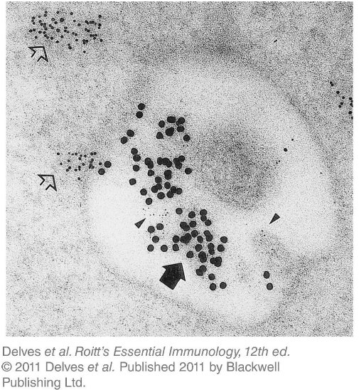
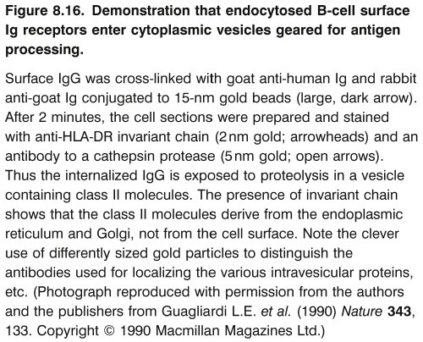
Chapter_8.indd 18
3/17/11 4:59 PM

Slide 19
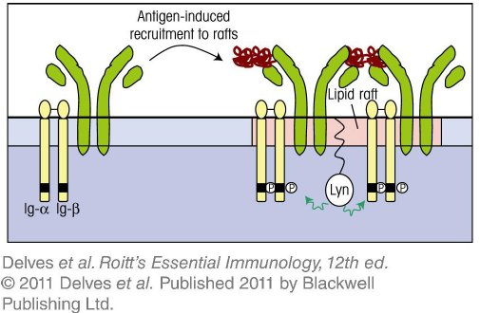
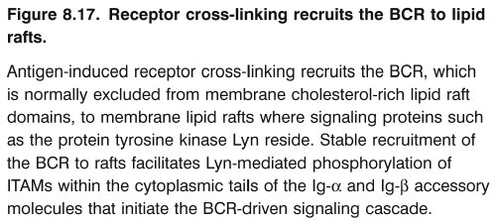
Chapter_8.indd 19
3/17/11 4:59 PM

Slide 20
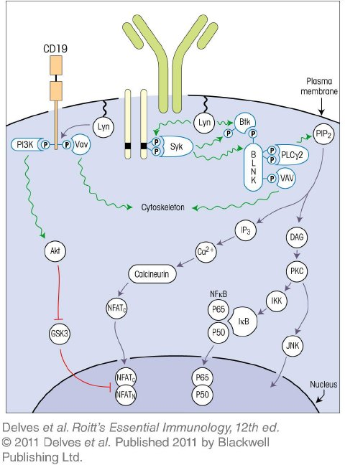
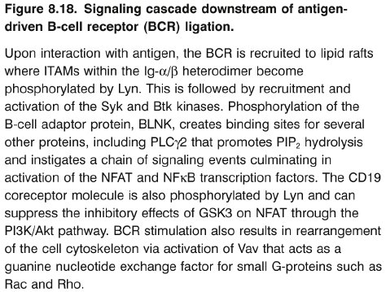
Chapter_8.indd 20
3/17/11 4:59 PM

Slide 21
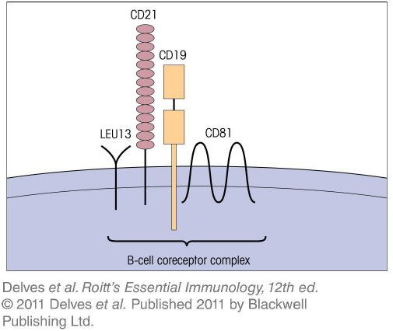
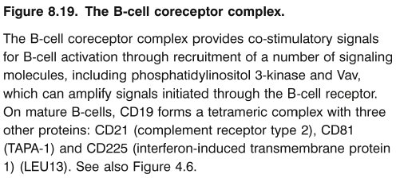
Chapter_8.indd 21
3/17/11 4:59 PM

Slide 22
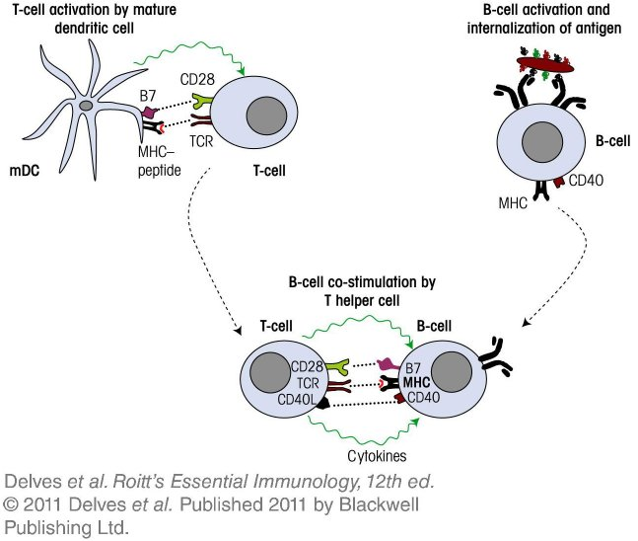
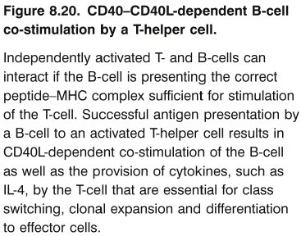
Chapter_8.indd 22
3/17/11 4:59 PM

Slide 23
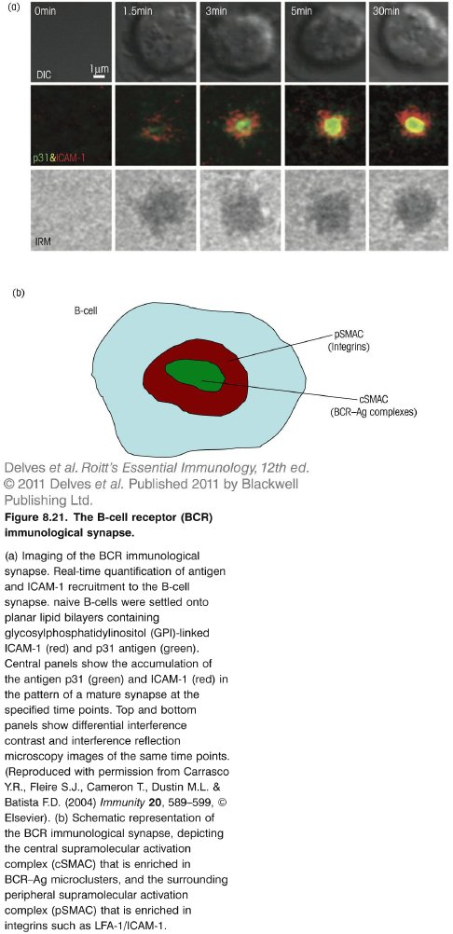
Chapter_8.indd 23
3/17/11 4:59 PM

