Slide 1
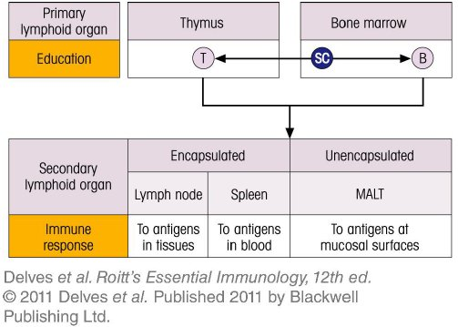
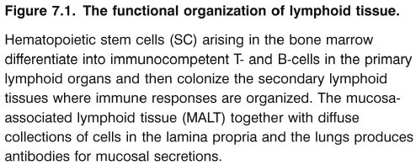
Chapter_7.indd 1
3/17/11 4:55 PM

Slide 2
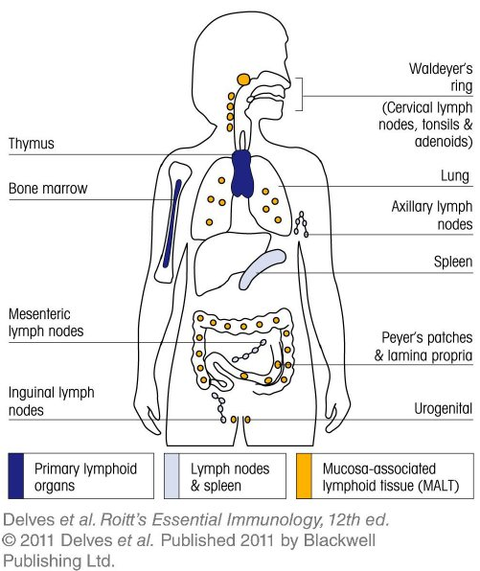
Chapter_7.indd 2
3/17/11 4:55 PM

Slide 3
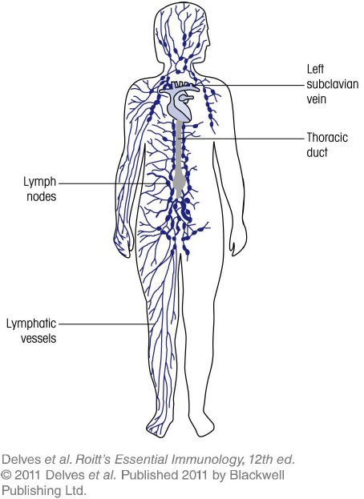
Chapter_7.indd 3
3/17/11 4:55 PM

Slide 4
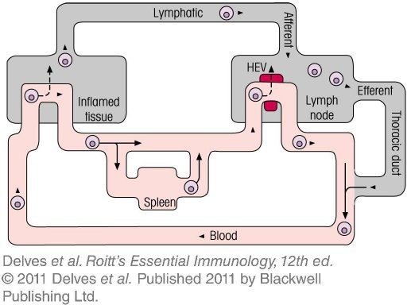
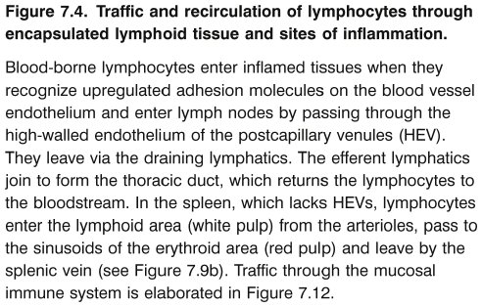
Chapter_7.indd 4
3/17/11 4:55 PM

Slide 5
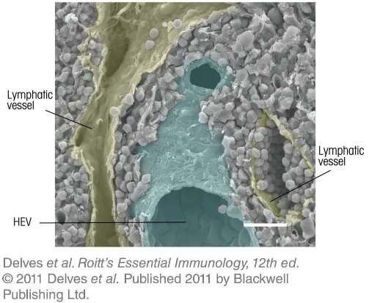
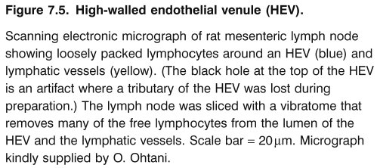
Chapter_7.indd 5
3/17/11 4:55 PM

Slide 6
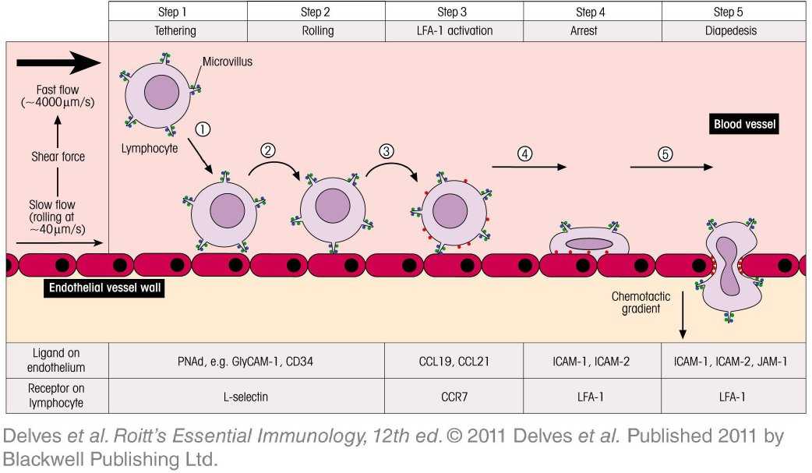
Chapter_7.indd 6
3/17/11 4:55 PM

Slide 7
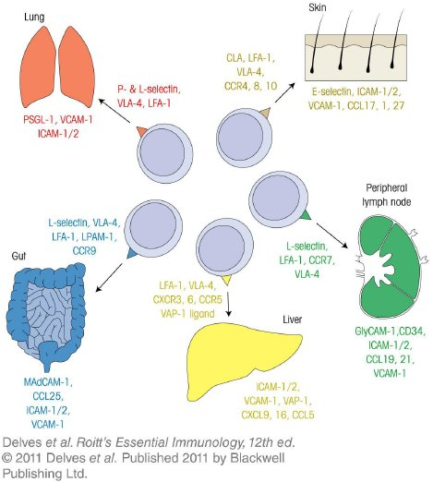
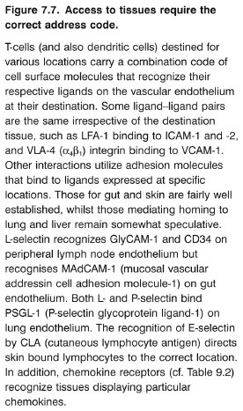
Chapter_7.indd 7
3/17/11 4:55 PM

Slide 8
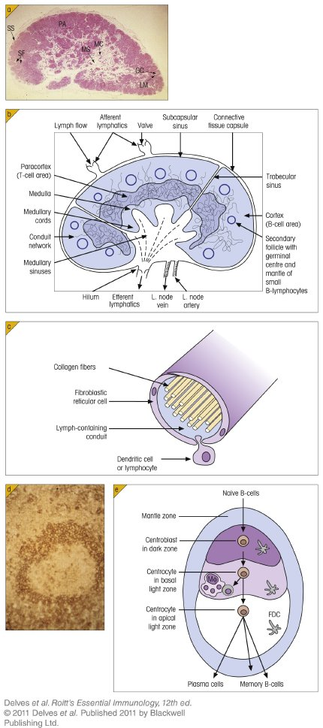
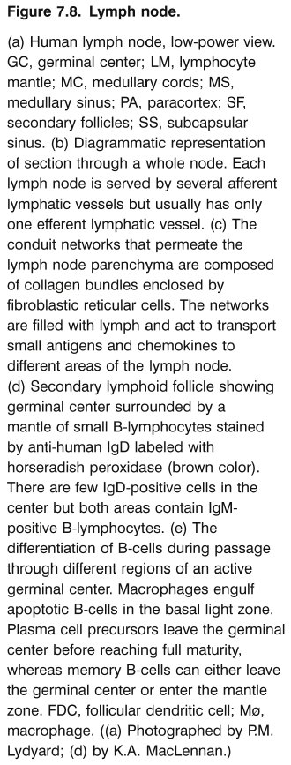
Chapter_7.indd 8
3/17/11 4:55 PM

Slide 9
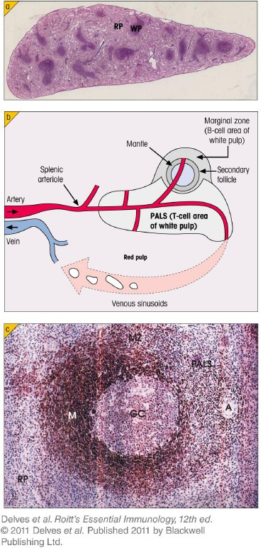
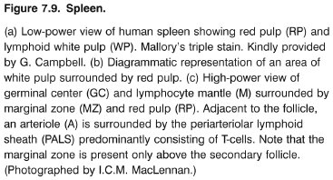
Chapter_7.indd 9
3/17/11 4:55 PM

Slide 10
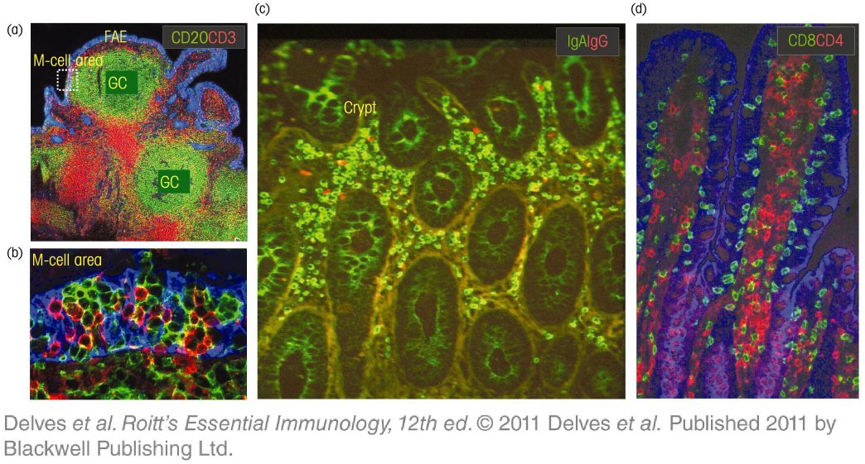
Chapter_7.indd 10
3/17/11 4:55 PM

Slide 11
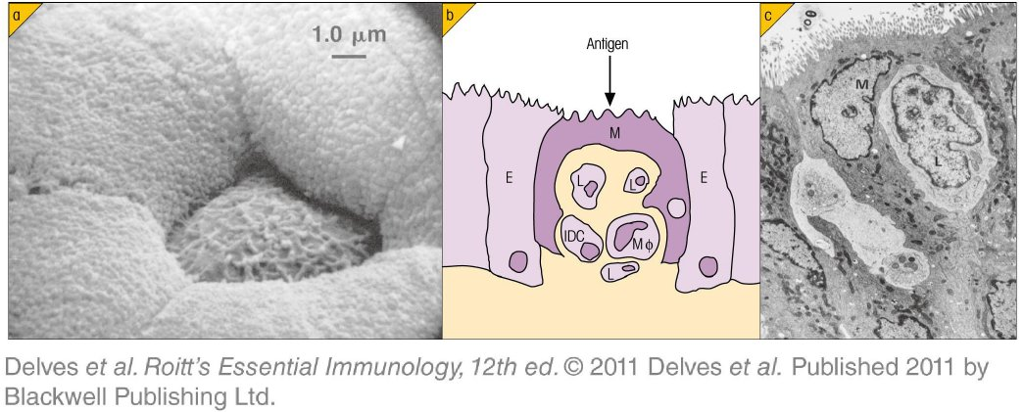
Chapter_7.indd 11
3/17/11 4:55 PM

Slide 12
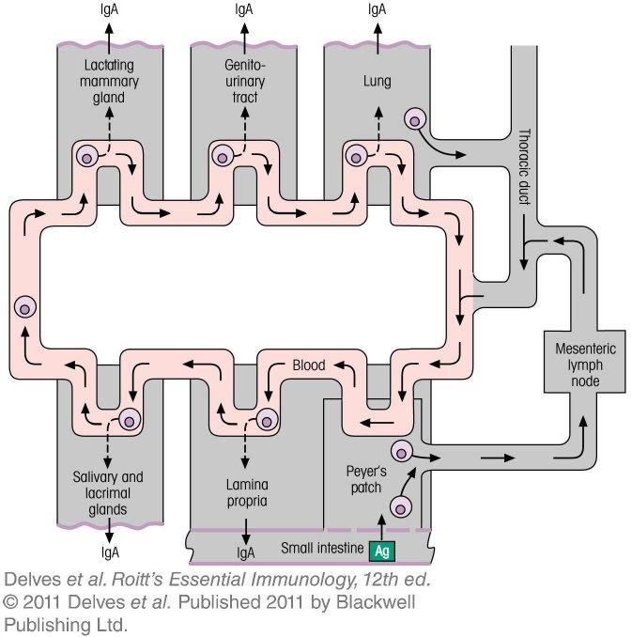
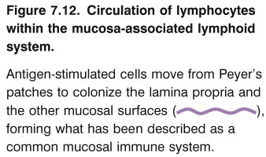
Chapter_7.indd 12
3/17/11 4:55 PM

Slide 13
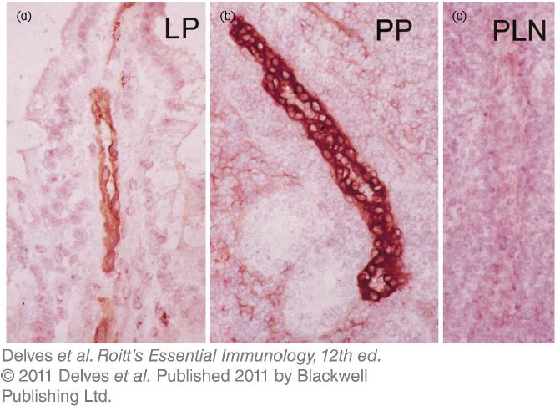
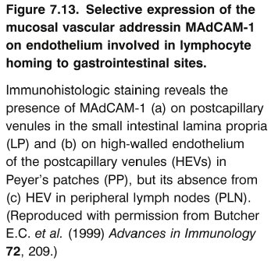
Chapter_7.indd 13
3/17/11 4:55 PM

Slide 14
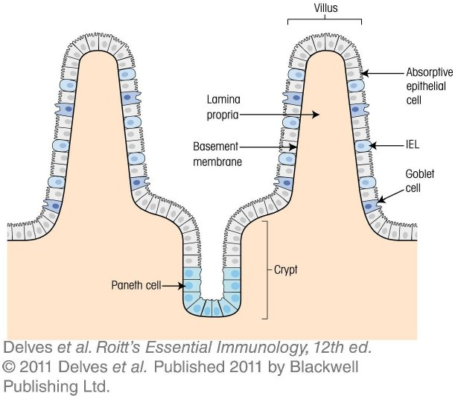
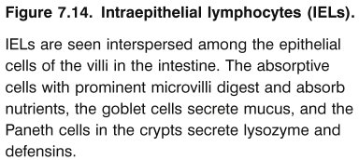
Chapter_7.indd 14
3/17/11 4:55 PM

Slide 15
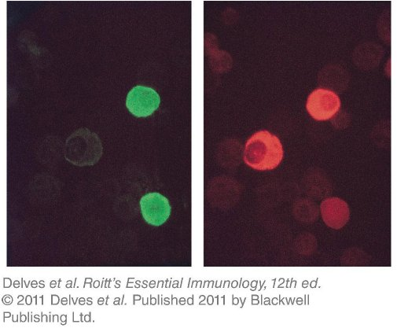
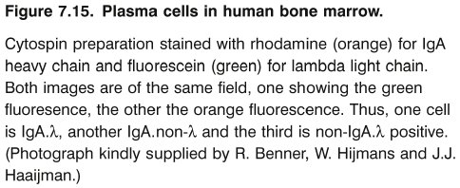
Chapter_7.indd 15
3/17/11 4:55 PM

Slide 16
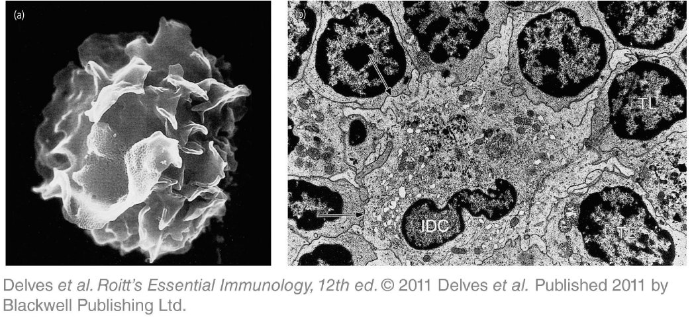
Chapter_7.indd 16
3/17/11 4:55 PM

Slide 17
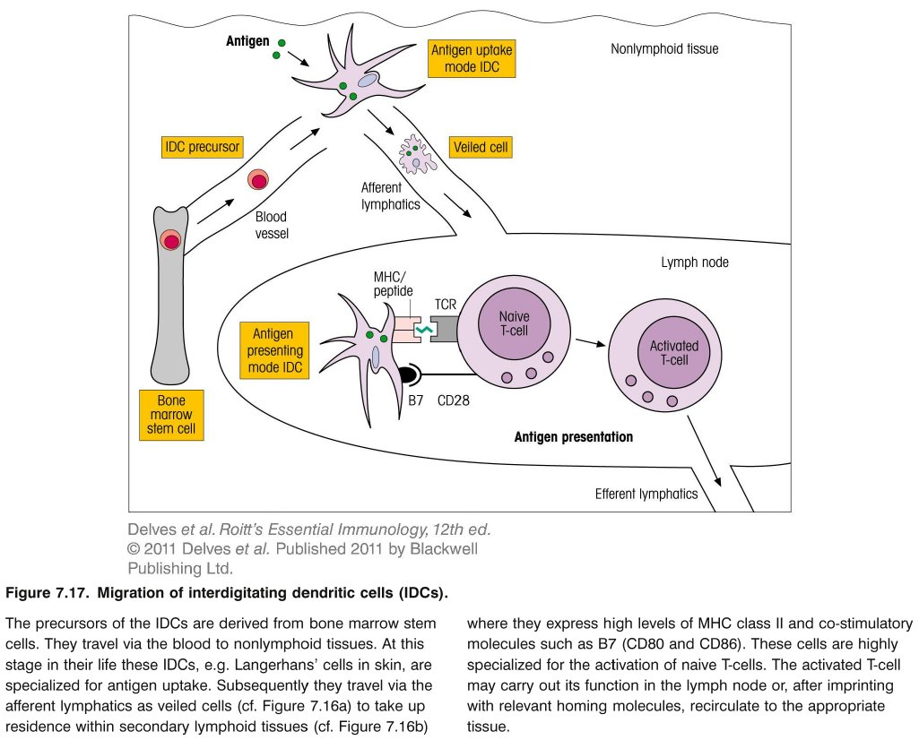
Chapter_7.indd 17
3/17/11 4:55 PM

