Slide 1
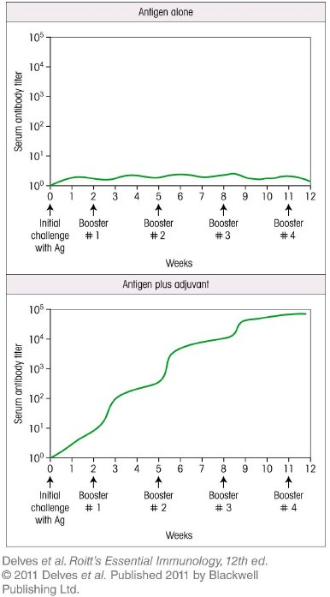
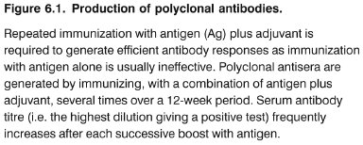
Chapter_6.indd 1
3/17/11 4:52 PM

Slide 2
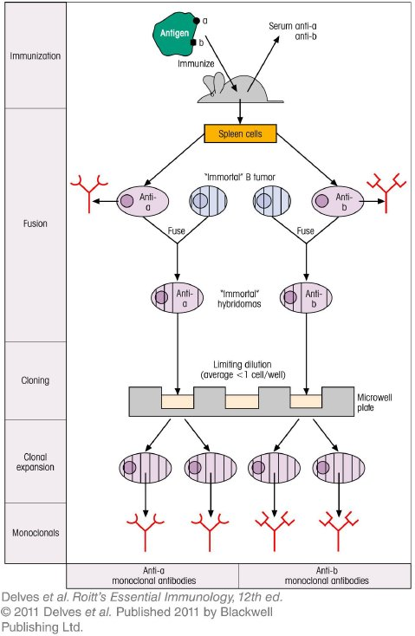
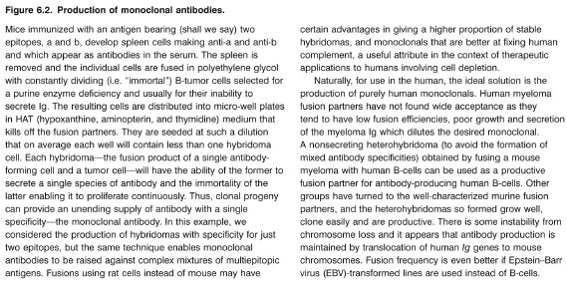
Chapter_6.indd 2
3/17/11 4:52 PM

Slide 3
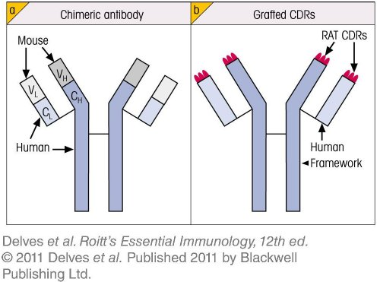
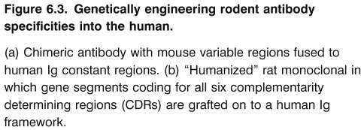
Chapter_6.indd 3
3/17/11 4:52 PM

Slide 4
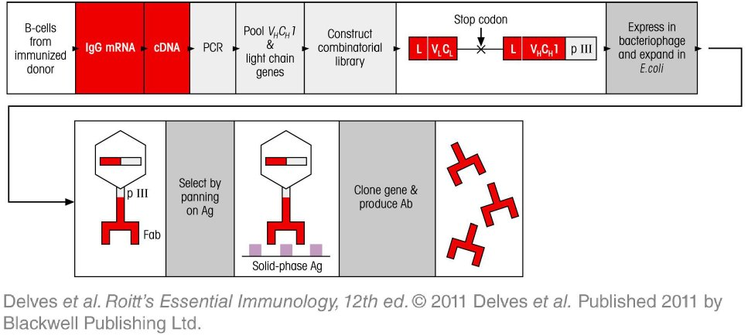
Chapter_6.indd 4
3/17/11 4:52 PM

Slide 5
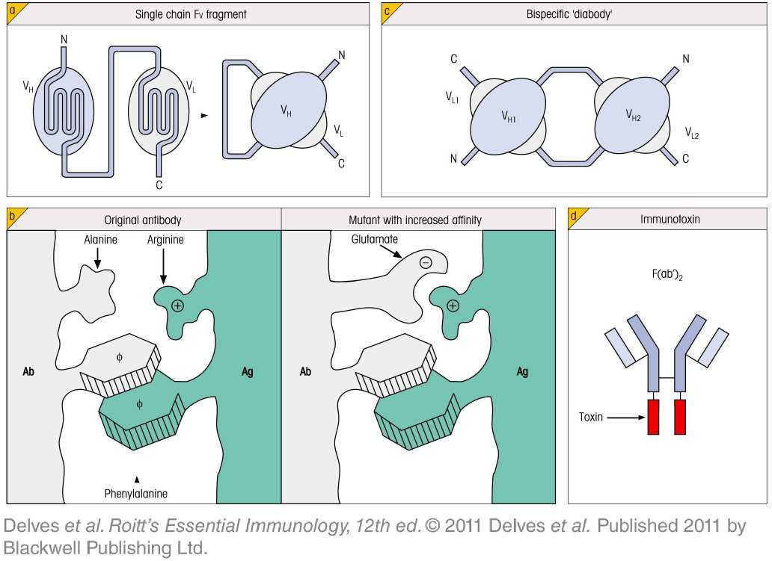
Chapter_6.indd 5
3/17/11 4:52 PM

Slide 6
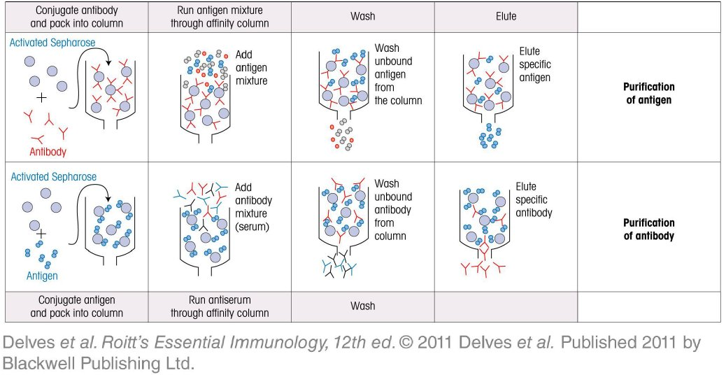
Chapter_6.indd 6
3/17/11 4:52 PM

Slide 7
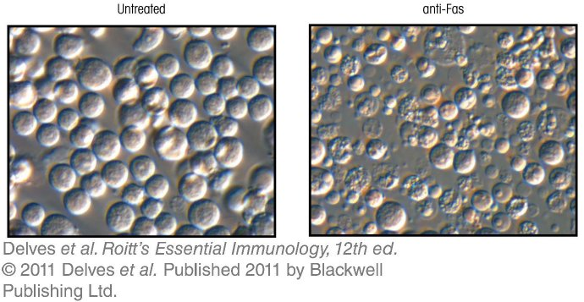
Chapter_6.indd 7
3/17/11 4:52 PM

Slide 8
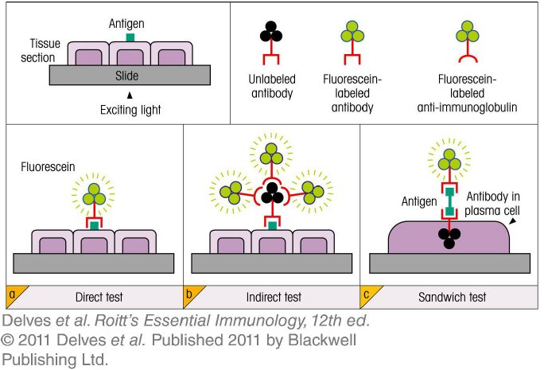
Chapter_6.indd 8
3/17/11 4:52 PM

Slide 9
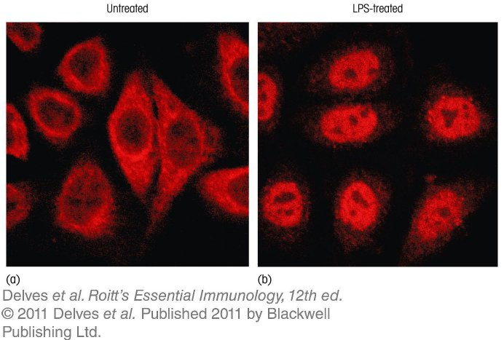
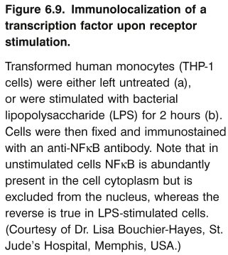
Chapter_6.indd 9
3/17/11 4:52 PM

Slide 10
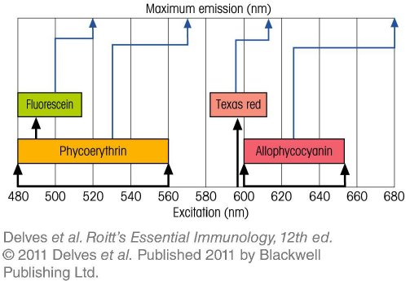
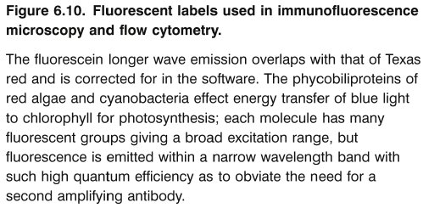
Chapter_6.indd 10
3/17/11 4:52 PM

Slide 11
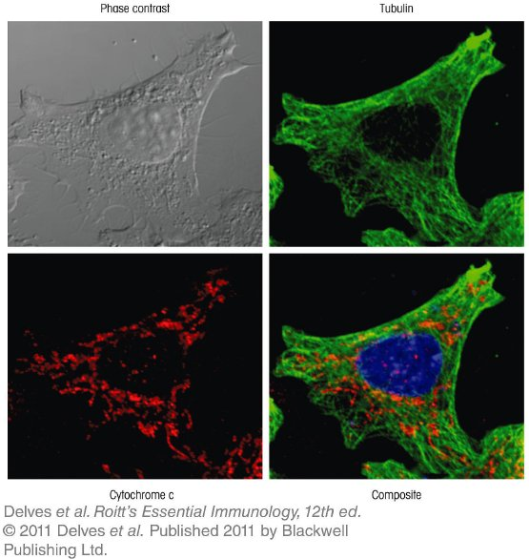
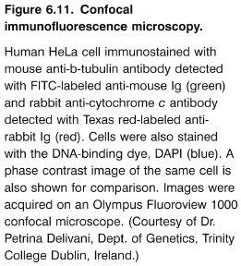
Chapter_6.indd 11
3/17/11 4:52 PM

Slide 12
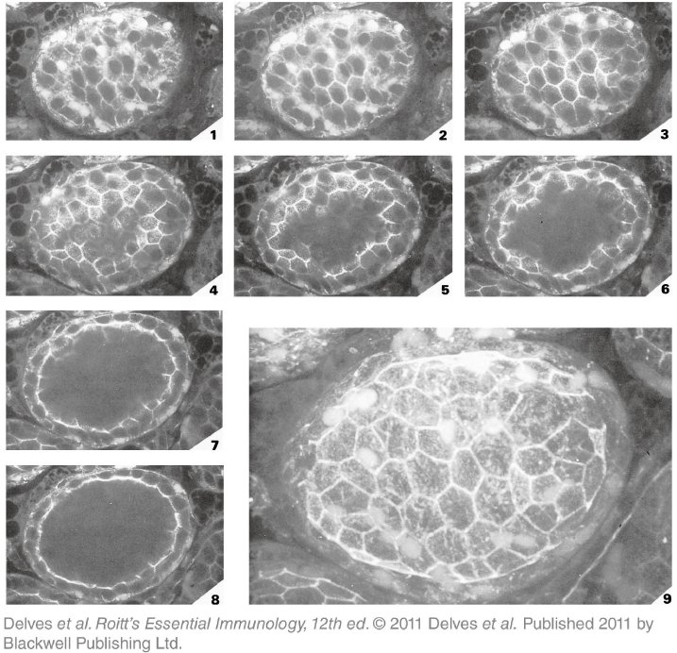
Chapter_6.indd 12
3/17/11 4:52 PM

Slide 13
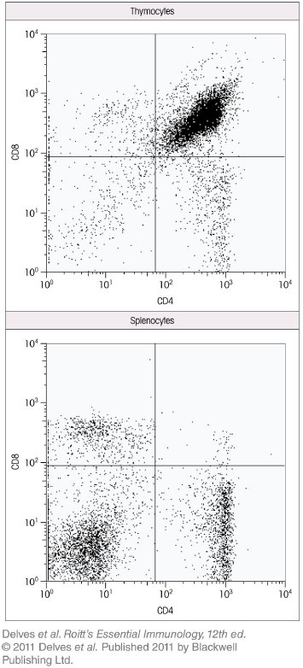
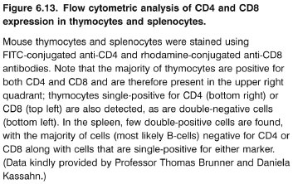
Chapter_6.indd 13
3/17/11 4:52 PM

Slide 14
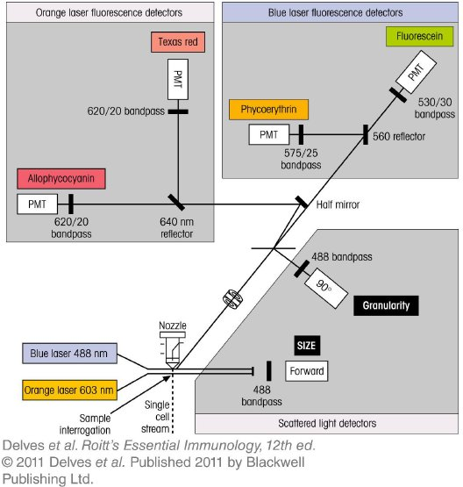
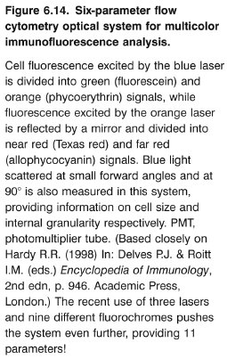
Chapter_6.indd 14
3/17/11 4:52 PM

Slide 15
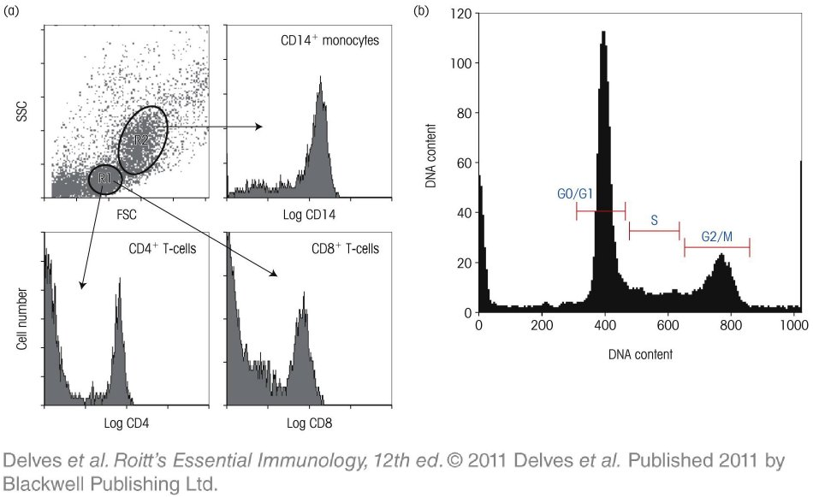
Chapter_6.indd 15
3/17/11 4:52 PM

Slide 16
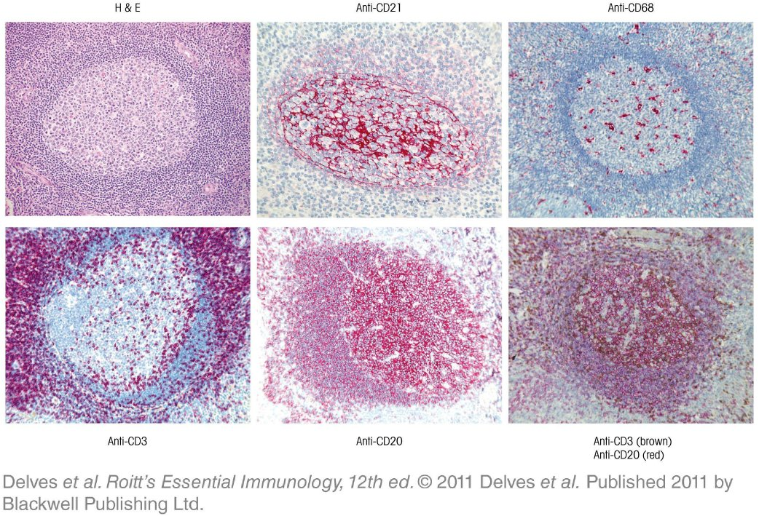
Chapter_6.indd 16
3/17/11 4:52 PM

Slide 17
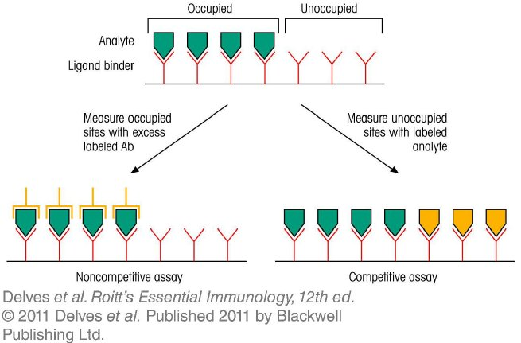
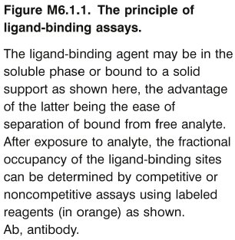
Chapter_6.indd 17
3/17/11 4:52 PM

Slide 18
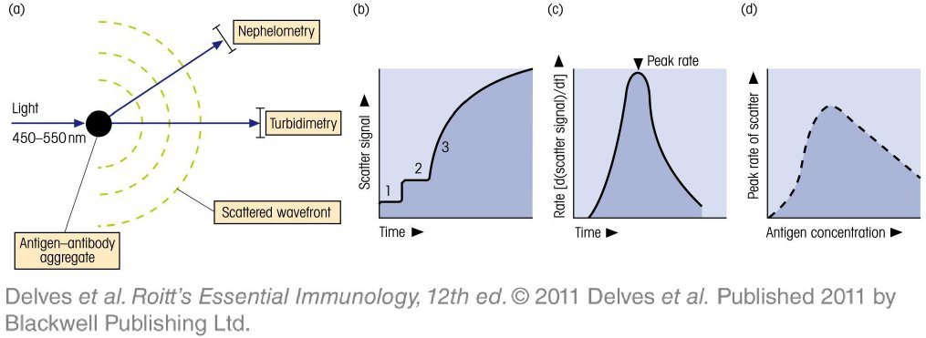
Chapter_6.indd 18
3/17/11 4:52 PM

Slide 19
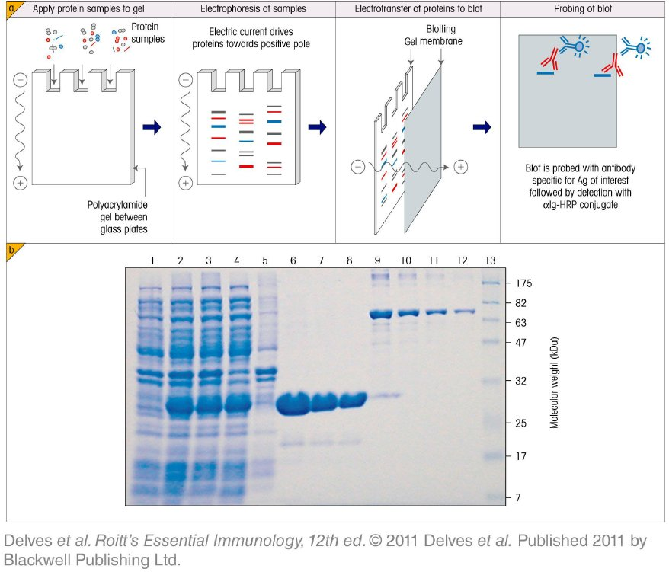
Chapter_6.indd 19
3/17/11 4:52 PM

Slide 20
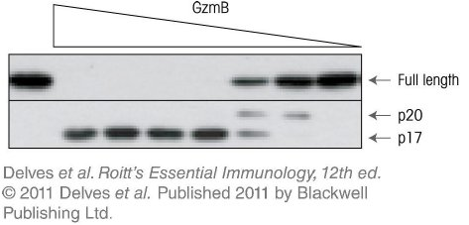
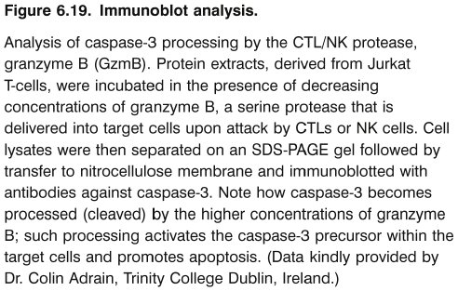
Chapter_6.indd 20
3/17/11 4:52 PM

Slide 21
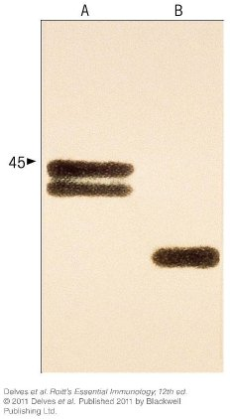
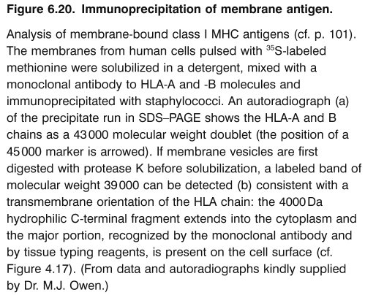
Chapter_6.indd 21
3/17/11 4:52 PM

Slide 22
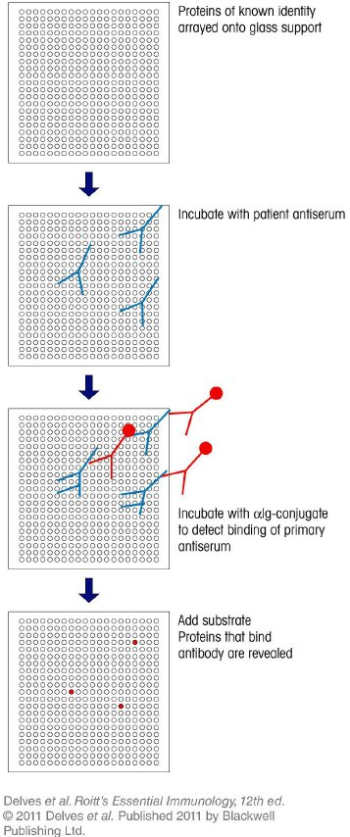
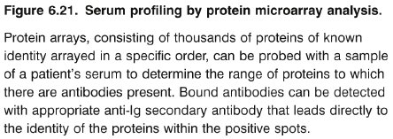
Chapter_6.indd 22
3/17/11 4:52 PM

Slide 23
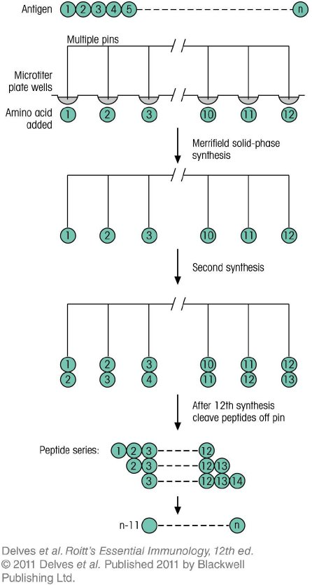
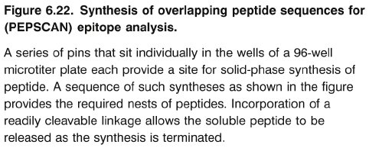
Chapter_6.indd 23
3/17/11 4:52 PM

Slide 24
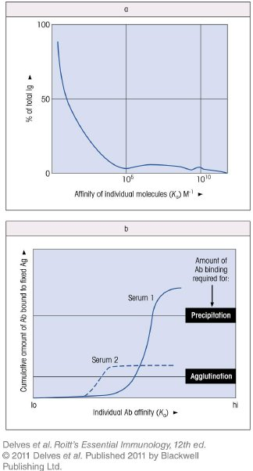
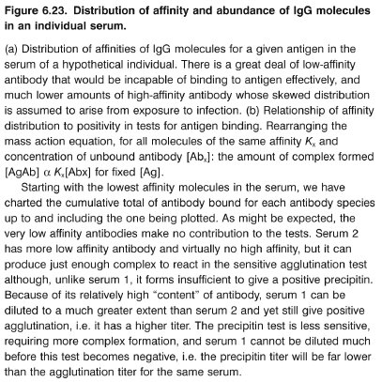
Chapter_6.indd 24
3/17/11 4:52 PM

Slide 25
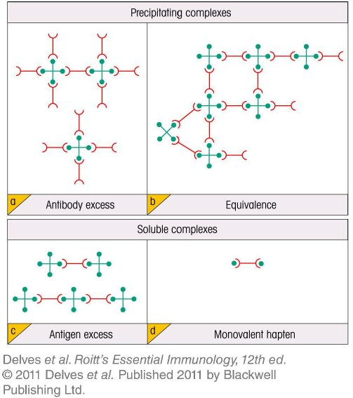
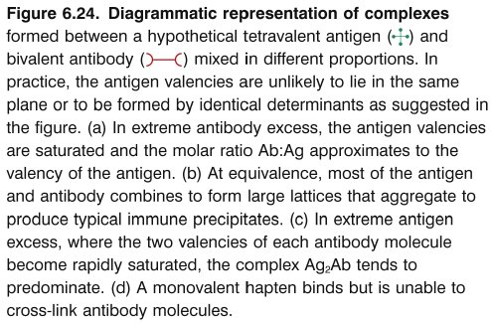
Chapter_6.indd 25
3/17/11 4:52 PM

Slide 26
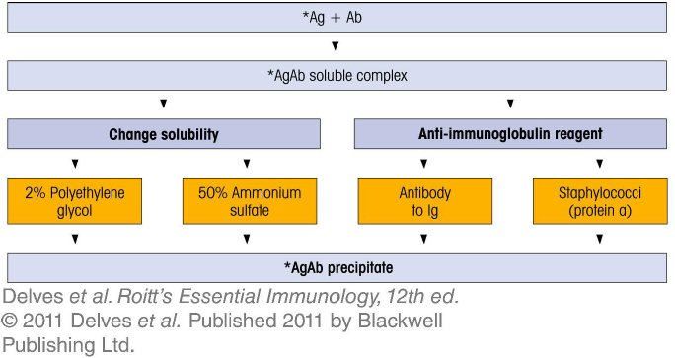
Chapter_6.indd 26
3/17/11 4:52 PM

Slide 27
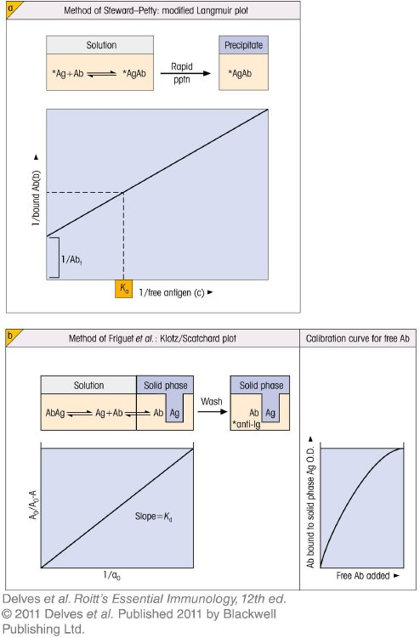
Chapter_6.indd 27
3/17/11 4:52 PM

Slide 28
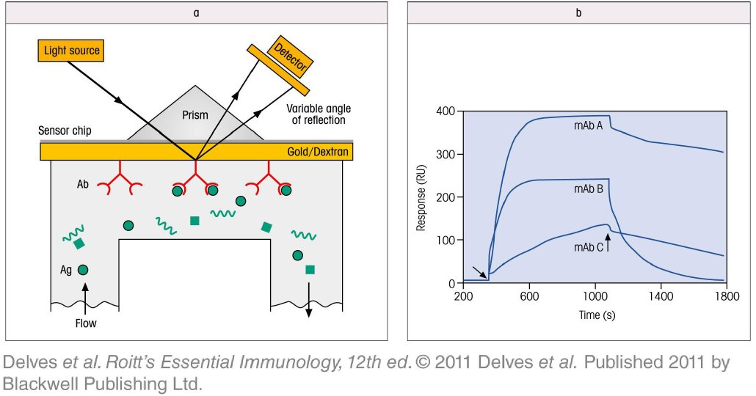
Chapter_6.indd 28
3/17/11 4:52 PM

Slide 29
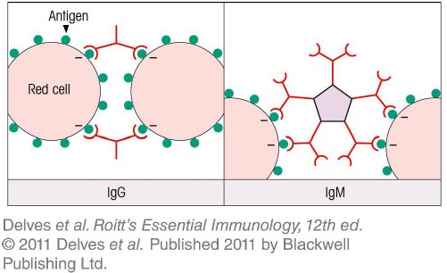
Chapter_6.indd 29
3/17/11 4:52 PM

Slide 30
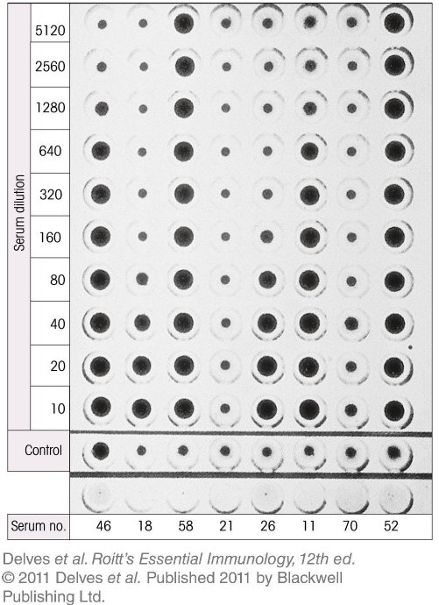
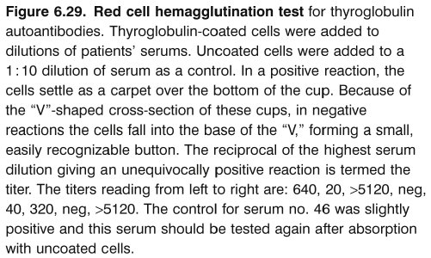
Chapter_6.indd 30
3/17/11 4:52 PM

Slide 31
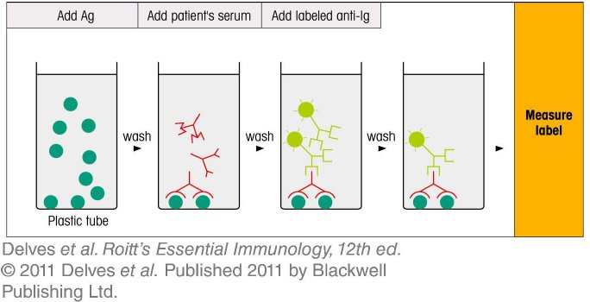
Chapter_6.indd 31
3/17/11 4:52 PM

Slide 32
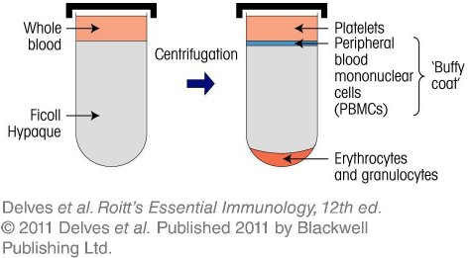
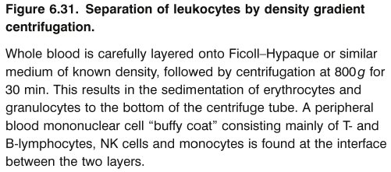
Chapter_6.indd 32
3/17/11 4:52 PM

Slide 33
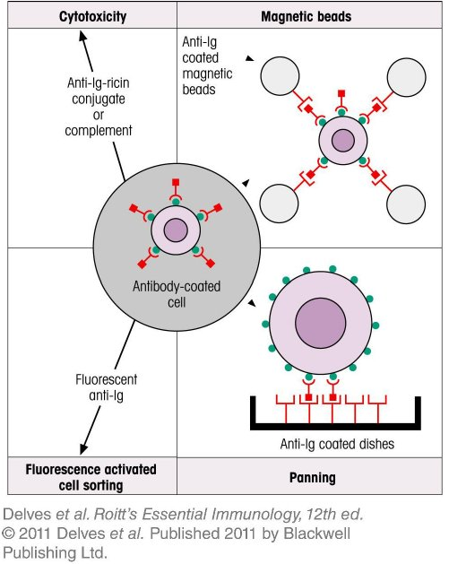
Chapter_6.indd 33
3/17/11 4:52 PM

Slide 34
Chapter_6.indd 34
3/17/11 4:52 PM

Slide 35
Chapter_6.indd 35
3/17/11 4:52 PM

Slide 36
Chapter_6.indd 36
3/17/11 4:52 PM

Slide 37
Chapter_6.indd 37
3/17/11 4:52 PM

Slide 38
Chapter_6.indd 38
3/17/11 4:52 PM

Slide 39
Chapter_6.indd 39
3/17/11 4:52 PM

Slide 40
Chapter_6.indd 40
3/17/11 4:52 PM

Slide 41
Chapter_6.indd 41
3/17/11 4:52 PM

Slide 42
Chapter_6.indd 42
3/17/11 4:52 PM

Slide 43
Chapter_6.indd 43
3/17/11 4:52 PM

Slide 44
Chapter_6.indd 44
3/17/11 4:52 PM

Slide 45
Chapter_6.indd 45
3/17/11 4:52 PM

Slide 46
Chapter_6.indd 46
3/17/11 4:52 PM

Slide 47
Chapter_6.indd 47
3/17/11 4:52 PM

Slide 48
Chapter_6.indd 48
3/17/11 4:52 PM

Slide 49
Chapter_6.indd 49
3/17/11 4:52 PM

