Slide 1
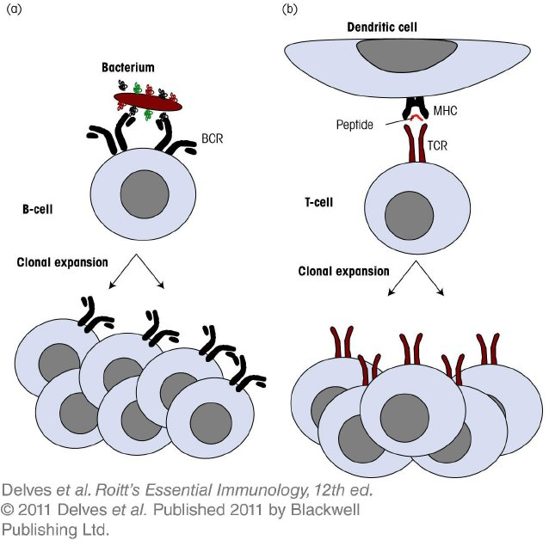
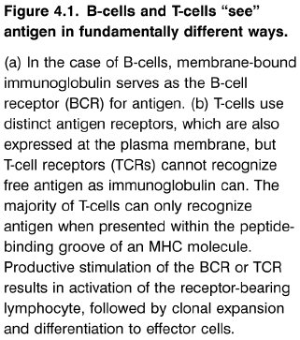
Chapter_4.indd 1
3/17/11 4:36 PM

Slide 2
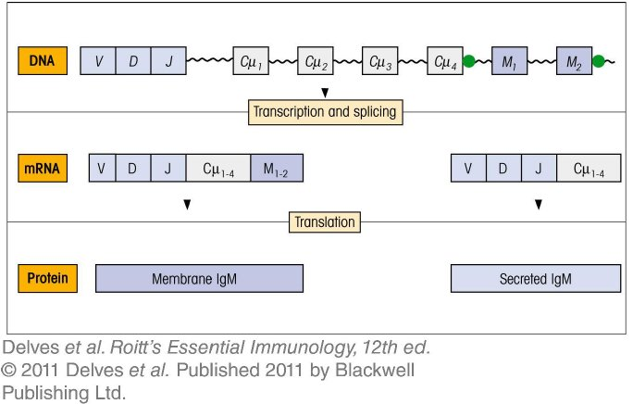
Chapter_4.indd 2
3/17/11 4:36 PM

Slide 3
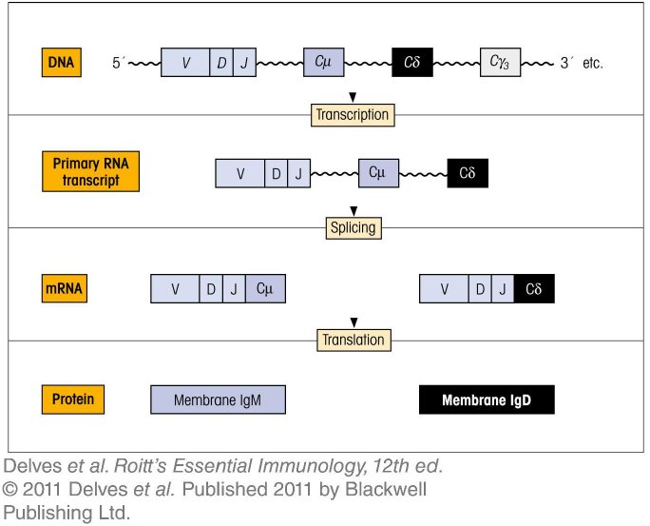
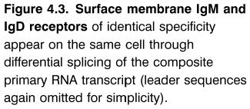
Chapter_4.indd 3
3/17/11 4:36 PM

Slide 4
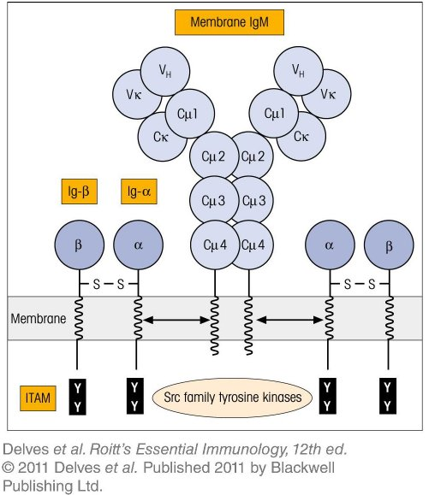
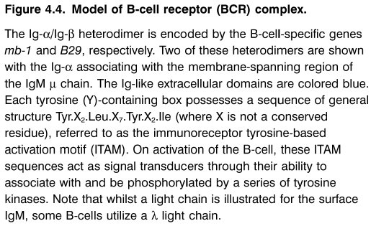
Chapter_4.indd 4
3/17/11 4:36 PM

Slide 5
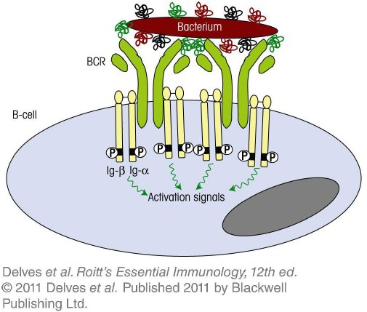
Chapter_4.indd 5
3/17/11 4:36 PM

Slide 6
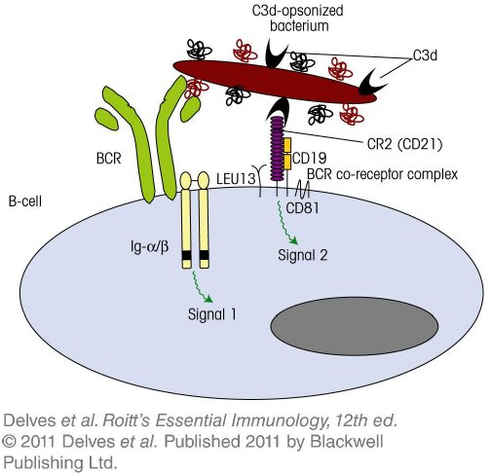
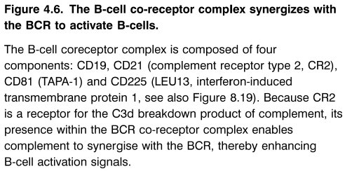
Chapter_4.indd 6
3/17/11 4:36 PM

Slide 7
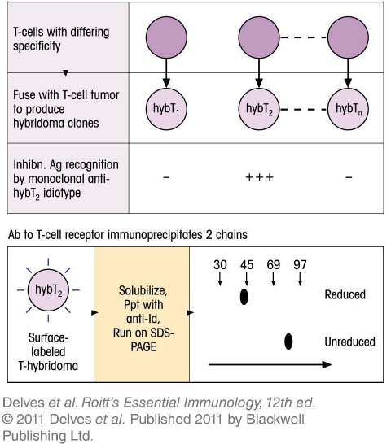
Chapter_4.indd 7
3/17/11 4:36 PM

Slide 8
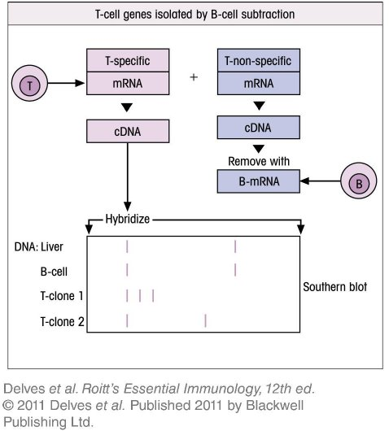
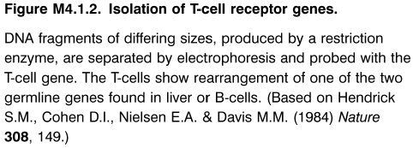
Chapter_4.indd 8
3/17/11 4:36 PM

Slide 9
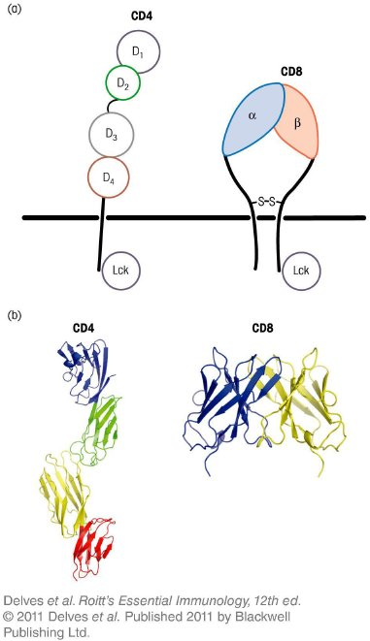
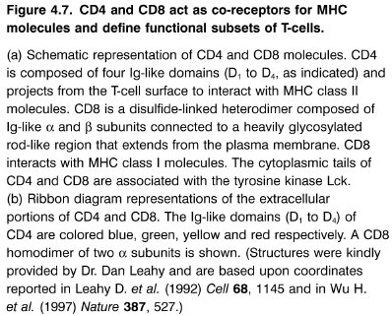
Chapter_4.indd 9
3/17/11 4:36 PM

Slide 10
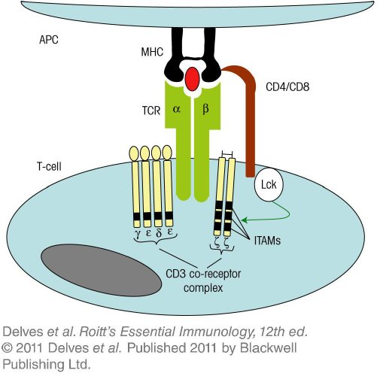
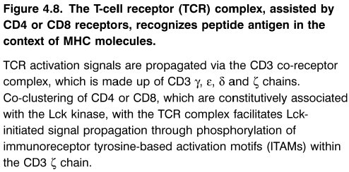
Chapter_4.indd 10
3/17/11 4:36 PM

Slide 11
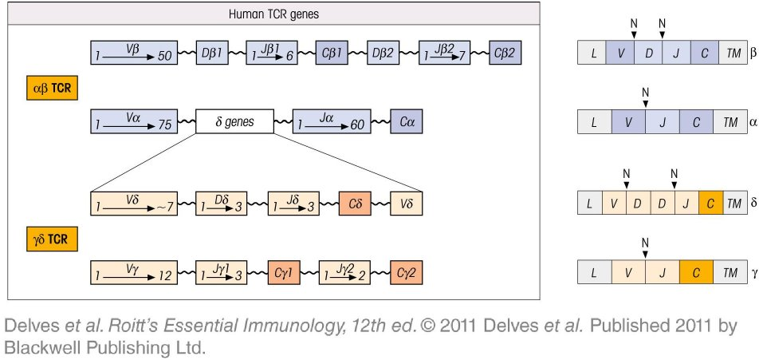
Chapter_4.indd 11
3/17/11 4:36 PM

Slide 12
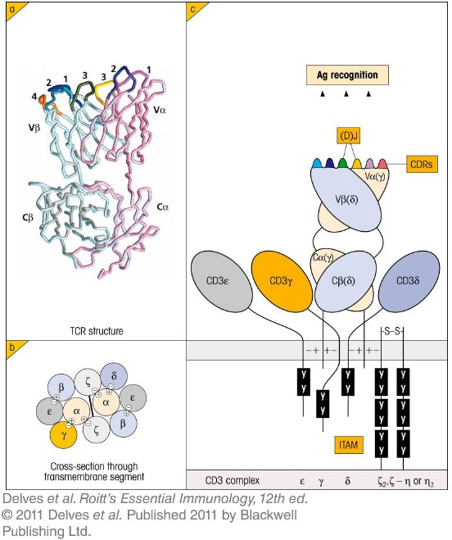
Chapter_4.indd 12
3/17/11 4:36 PM

Slide 13
Chapter_4.indd 13
3/17/11 4:36 PM

Slide 14
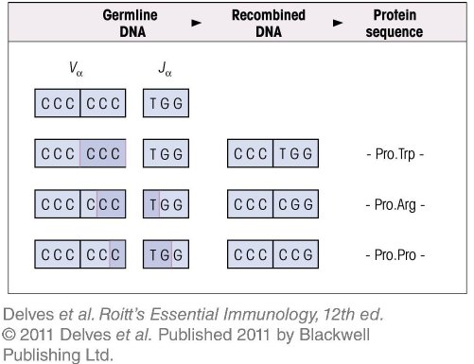
Chapter_4.indd 14
3/17/11 4:36 PM

Slide 15
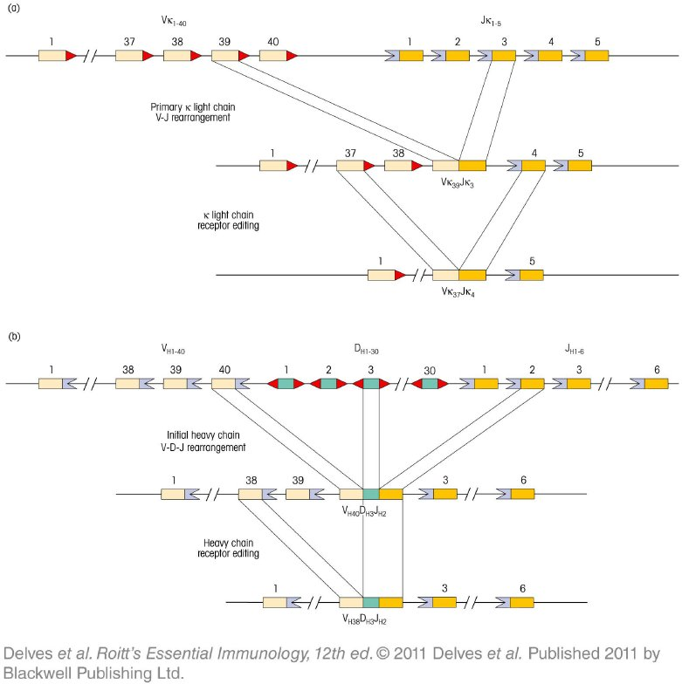
Chapter_4.indd 15
3/17/11 4:36 PM

Slide 16
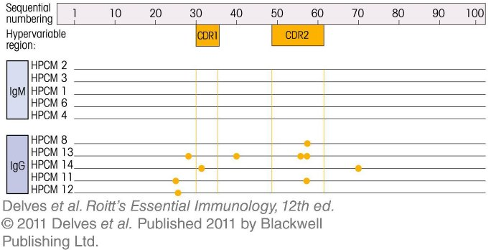
Chapter_4.indd 16
3/17/11 4:36 PM

Slide 17
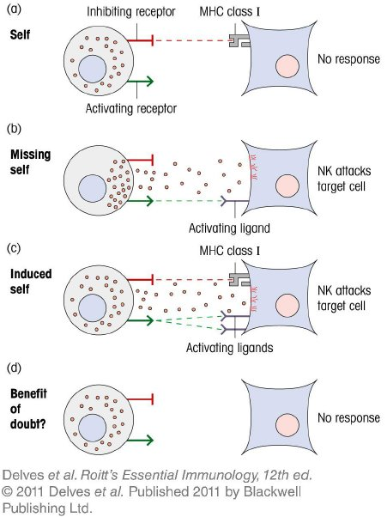
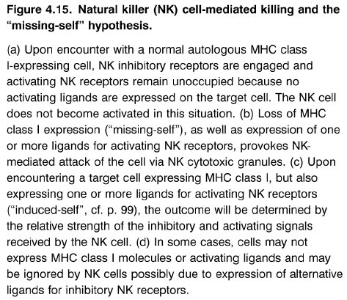
Chapter_4.indd 17
3/17/11 4:36 PM

Slide 18
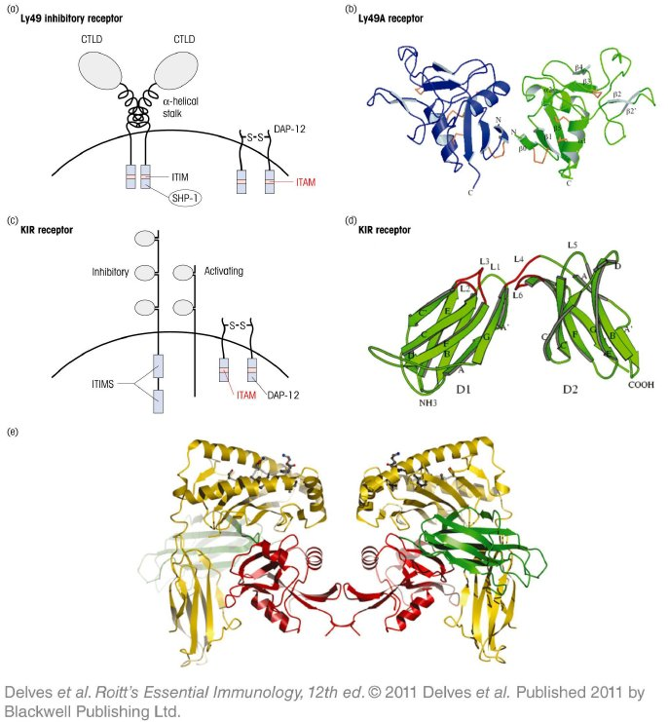
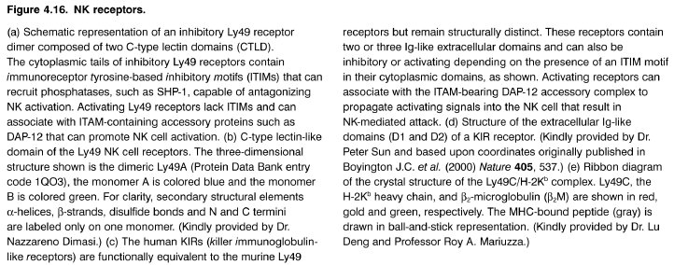
Chapter_4.indd 18
3/17/11 4:36 PM

Slide 19
Chapter_4.indd 19
3/17/11 4:36 PM

Slide 20
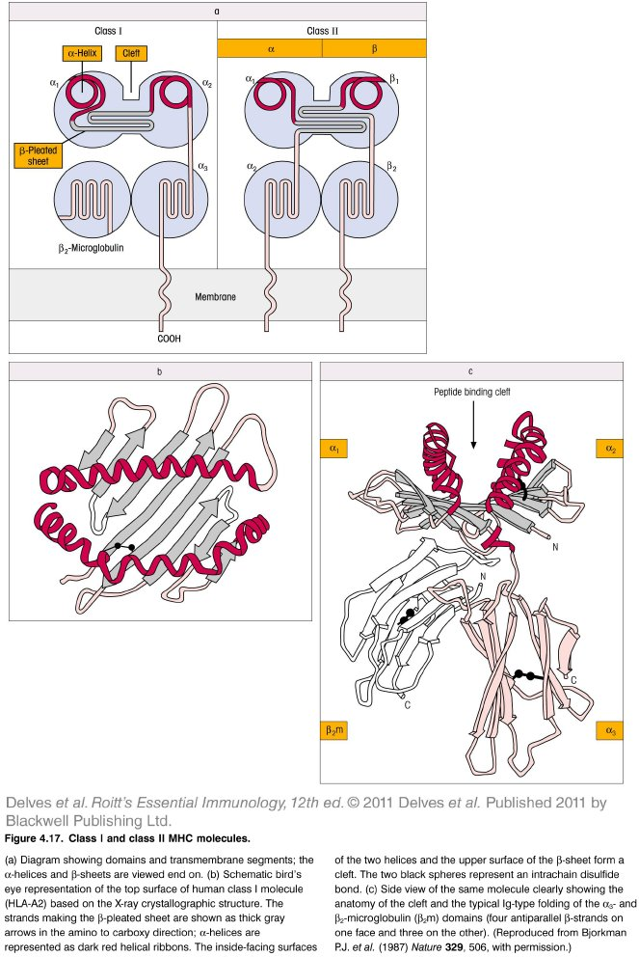
Chapter_4.indd 20
3/17/11 4:36 PM

Slide 21
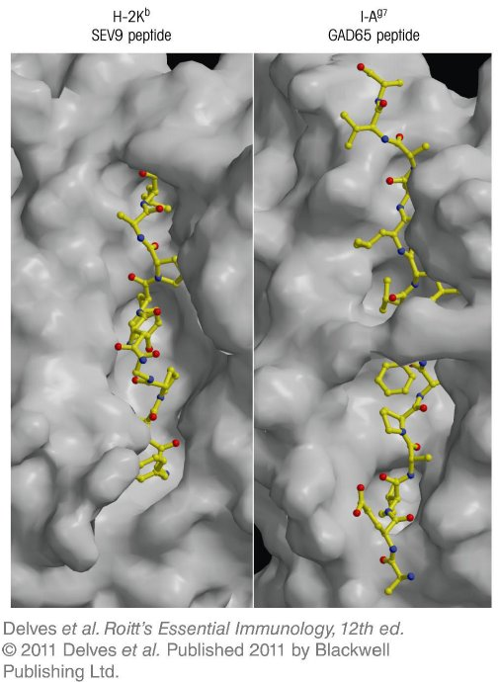
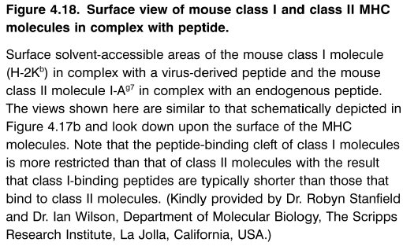
Chapter_4.indd 21
3/17/11 4:36 PM

Slide 22
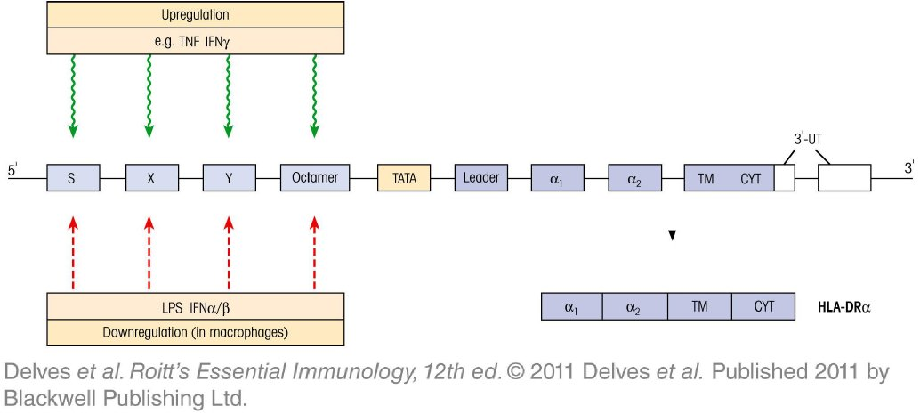
Chapter_4.indd 22
3/17/11 4:36 PM

Slide 23
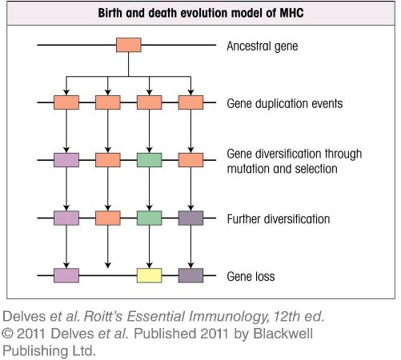
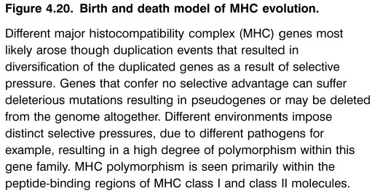
Chapter_4.indd 23
3/17/11 4:36 PM

Slide 24
Chapter_4.indd 24
3/17/11 4:36 PM

Slide 25
Chapter_4.indd 25
3/17/11 4:36 PM

Slide 26
Chapter_4.indd 26
3/17/11 4:36 PM

Slide 27
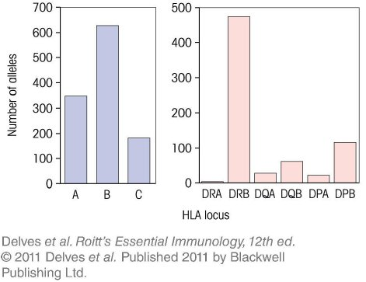
Chapter_4.indd 27
3/17/11 4:36 PM

Slide 28
Chapter_4.indd 28
3/17/11 4:36 PM

Slide 29
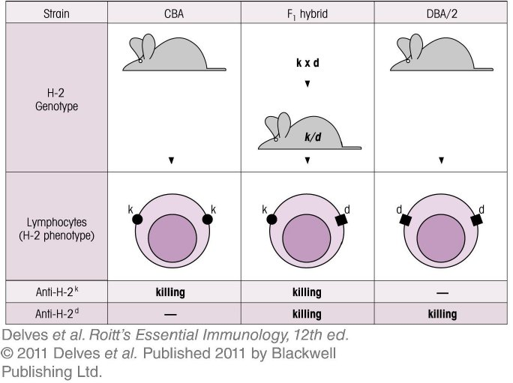
Chapter_4.indd 29
3/17/11 4:36 PM

Slide 30
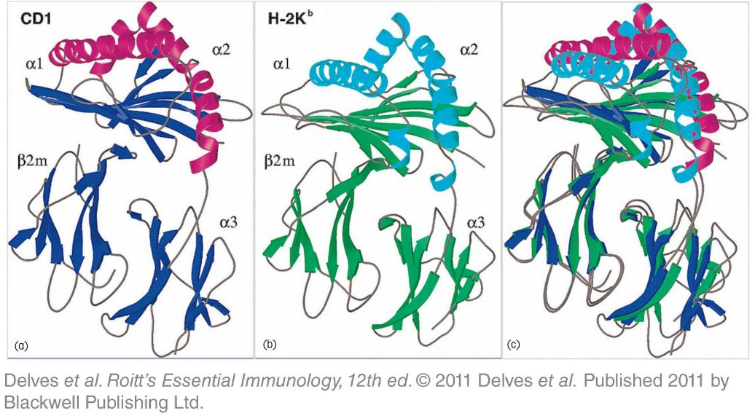
Chapter_4.indd 30
3/17/11 4:36 PM

