Slide 1
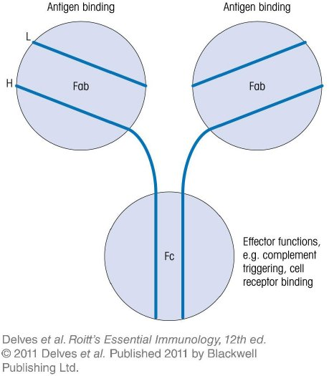
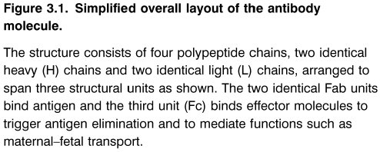
Chapter_3.indd 1
3/17/11 4:30 PM

Slide 2
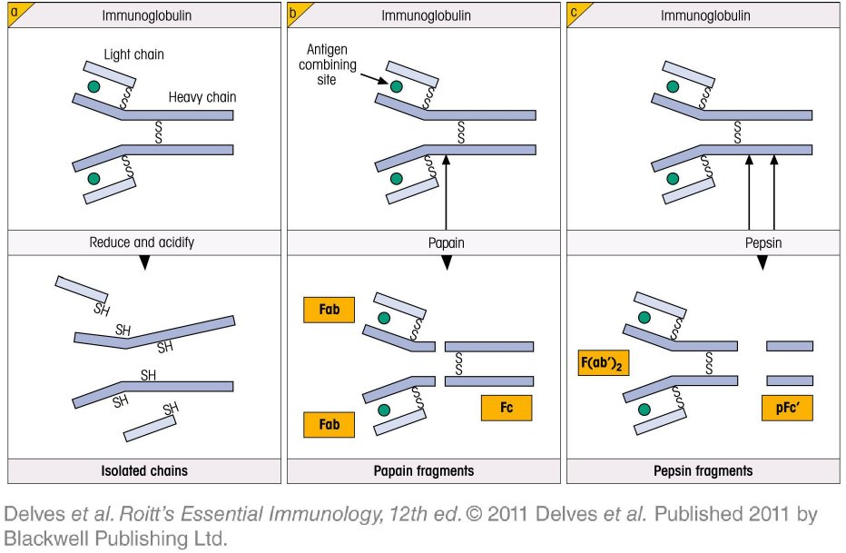
Chapter_3.indd 2
3/17/11 4:30 PM

Slide 3
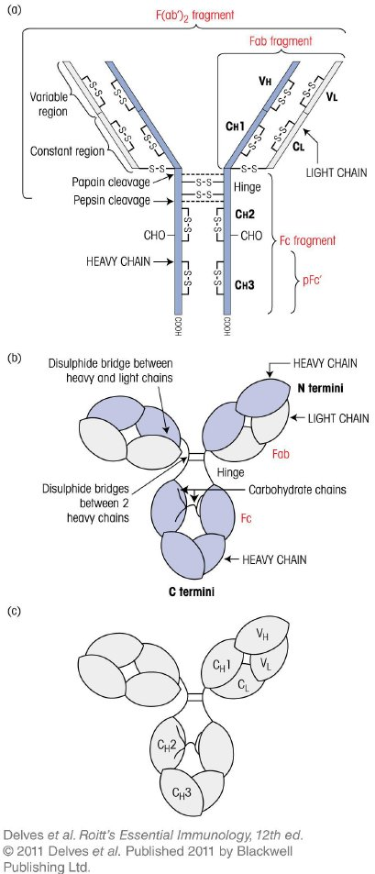
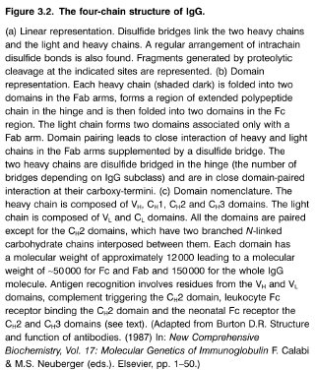
Chapter_3.indd 3
3/17/11 4:30 PM

Slide 4
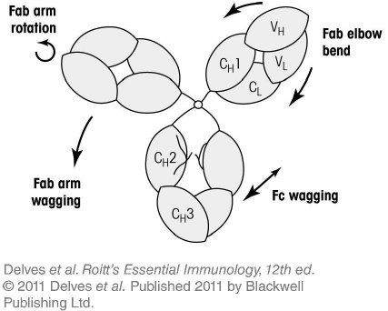
Chapter_3.indd 4
3/17/11 4:30 PM

Slide 5
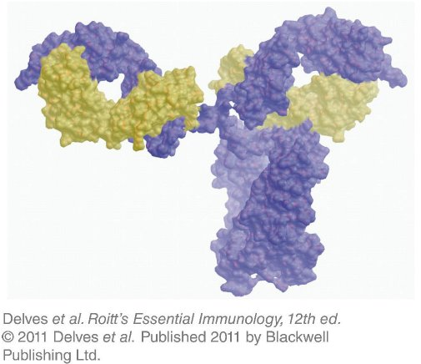
Chapter_3.indd 5
3/17/11 4:30 PM

Slide 6
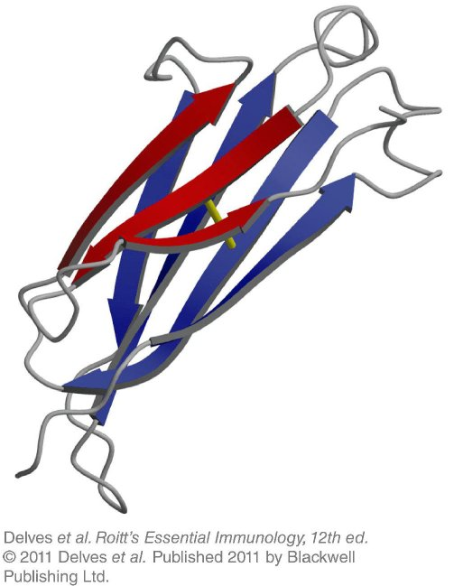
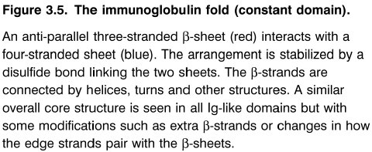
Chapter_3.indd 6
3/17/11 4:30 PM

Slide 7
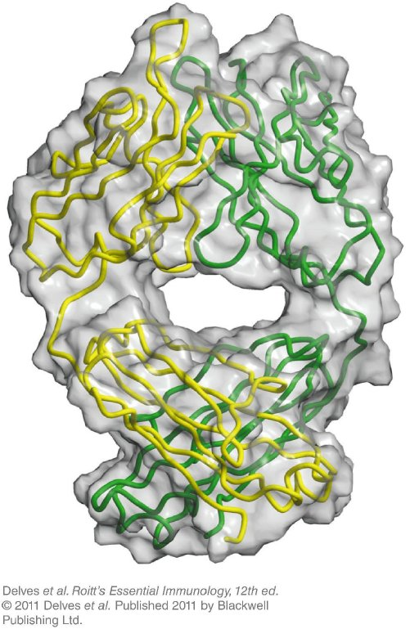
Chapter_3.indd 7
3/17/11 4:30 PM

Slide 8
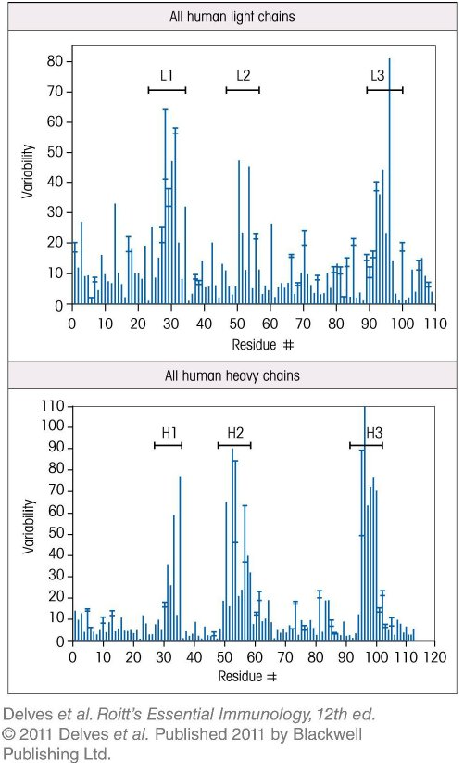
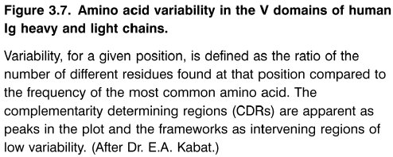
Chapter_3.indd 8
3/17/11 4:30 PM

Slide 9
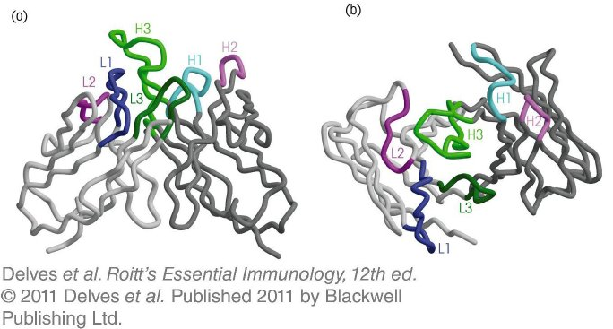
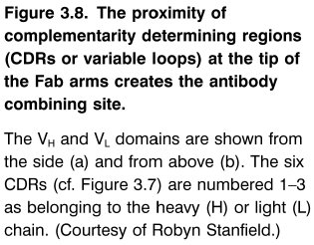
Chapter_3.indd 9
3/17/11 4:30 PM

Slide 10
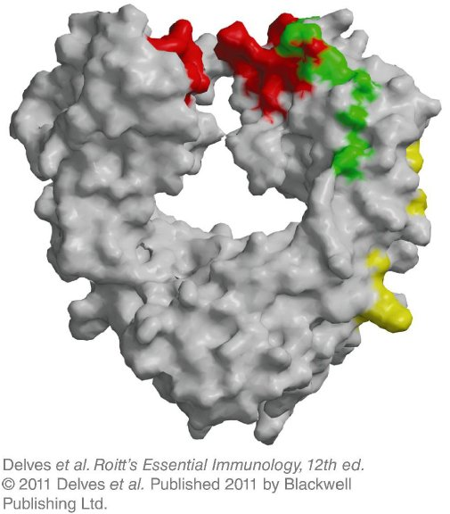
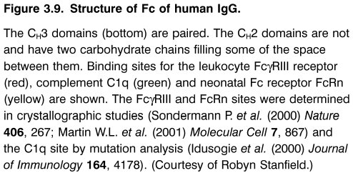
Chapter_3.indd 10
3/17/11 4:30 PM

Slide 11
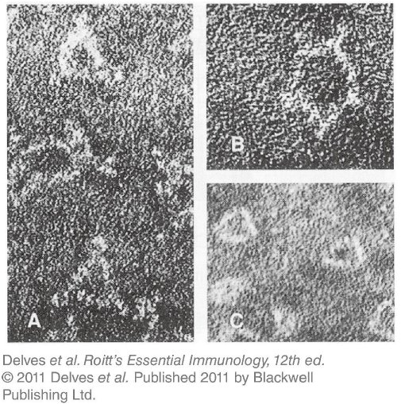
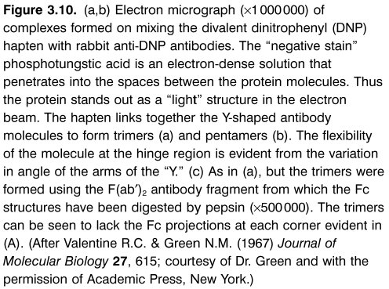
Chapter_3.indd 11
3/17/11 4:30 PM

Slide 12
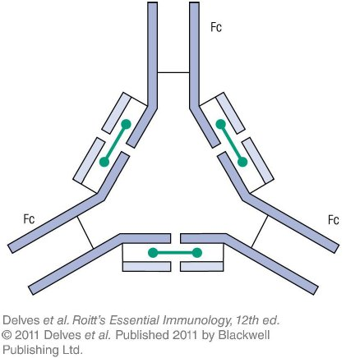
Chapter_3.indd 12
3/17/11 4:30 PM

Slide 13
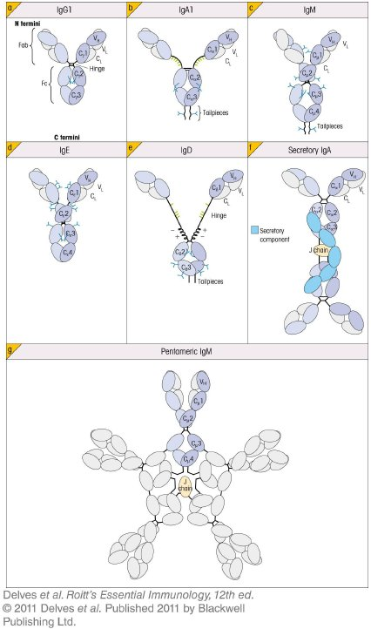
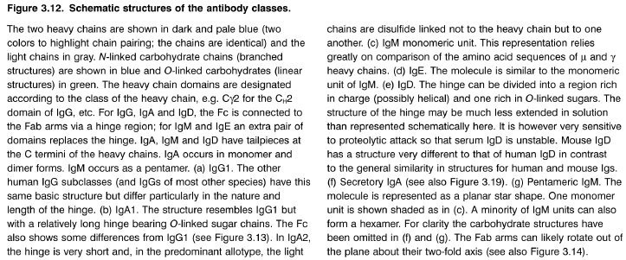
Chapter_3.indd 13
3/17/11 4:30 PM

Slide 14
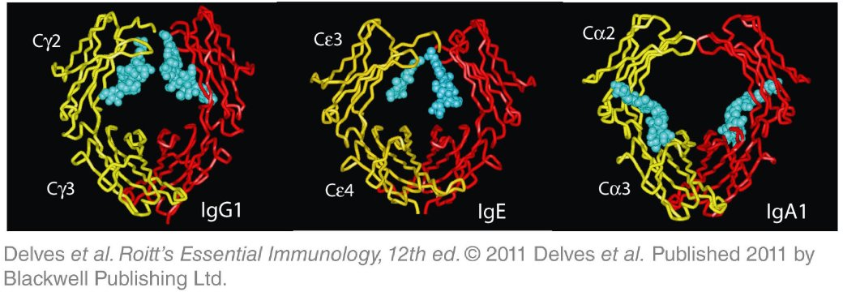
Chapter_3.indd 14
3/17/11 4:30 PM

Slide 15
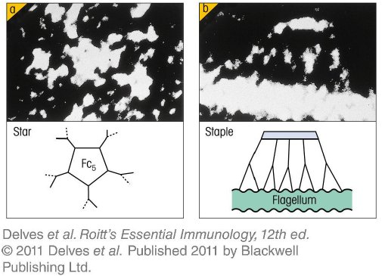
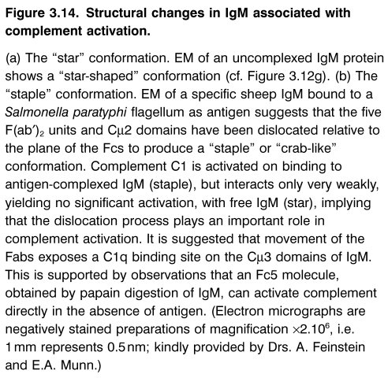
Chapter_3.indd 15
3/17/11 4:30 PM

Slide 16
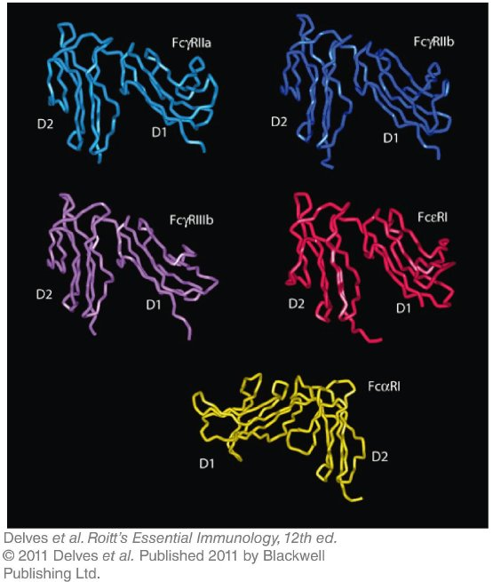
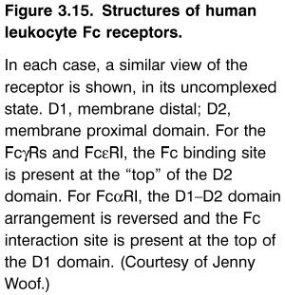
Chapter_3.indd 16
3/17/11 4:30 PM

Slide 17
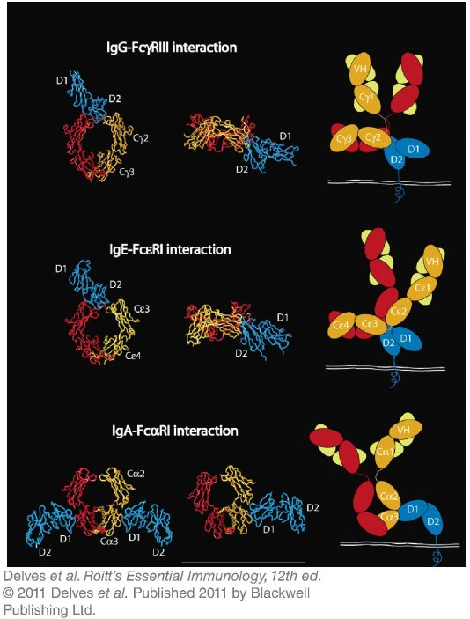
Chapter_3.indd 17
3/17/11 4:30 PM

Slide 18
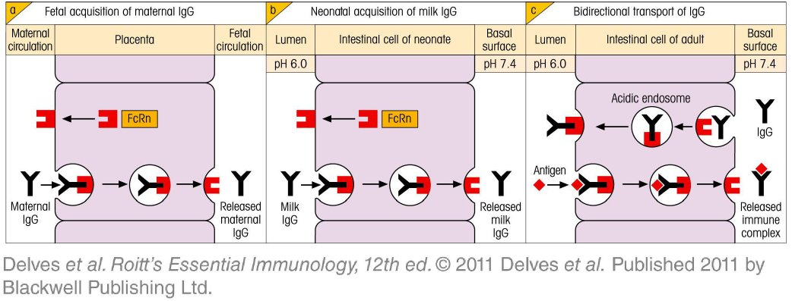
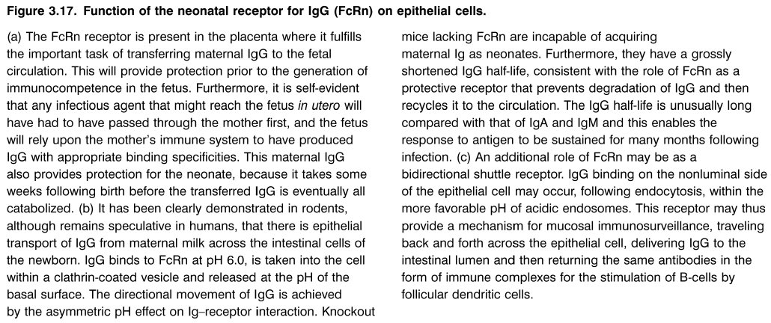
Chapter_3.indd 18
3/17/11 4:30 PM

Slide 19
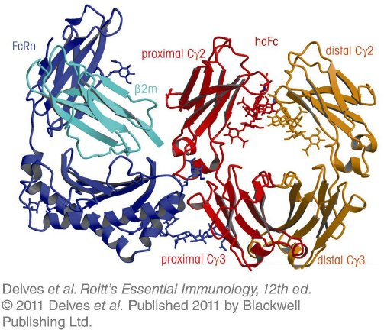
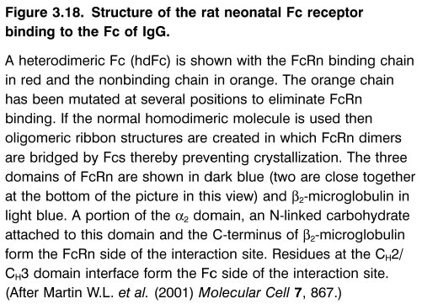
Chapter_3.indd 19
3/17/11 4:30 PM

Slide 20
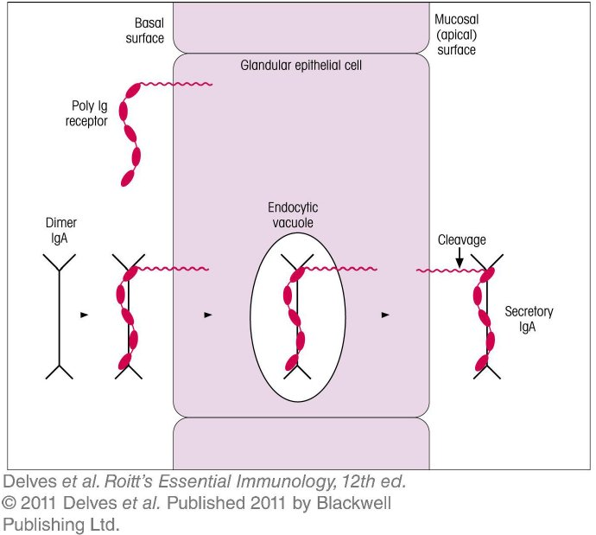
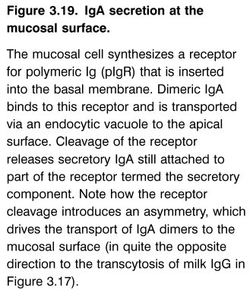
Chapter_3.indd 20
3/17/11 4:30 PM

Slide 21
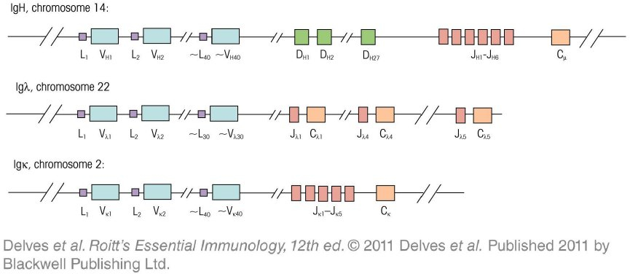
Chapter_3.indd 21
3/17/11 4:30 PM

Slide 22
Chapter_3.indd 22
3/17/11 4:30 PM

Slide 23
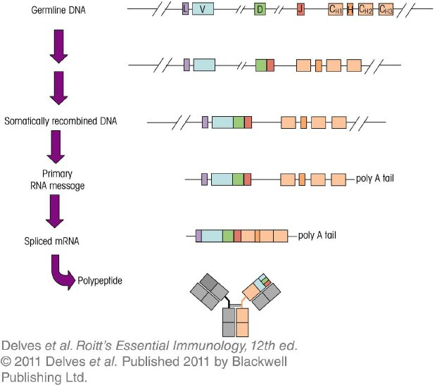
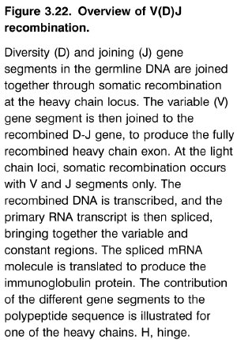
Chapter_3.indd 23
3/17/11 4:30 PM

Slide 24
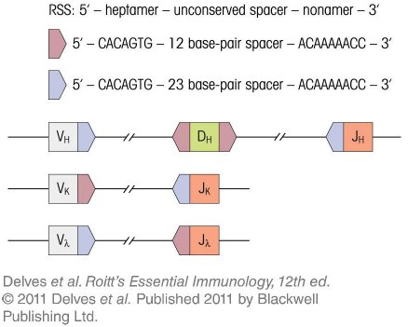
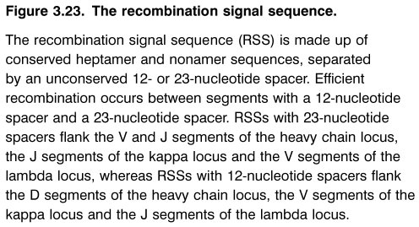
Chapter_3.indd 24
3/17/11 4:30 PM

Slide 25
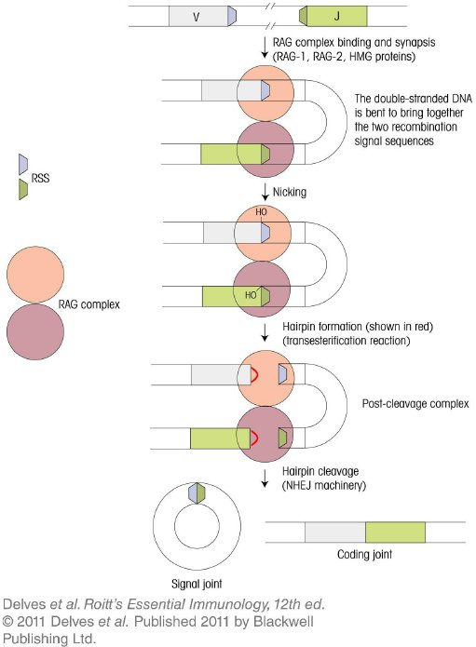
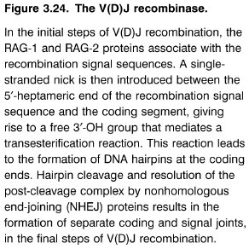
Chapter_3.indd 25
3/17/11 4:30 PM

Slide 26
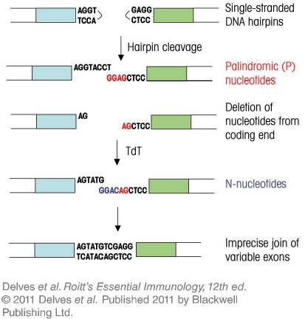
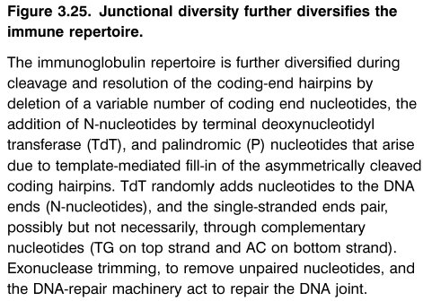
Chapter_3.indd 26
3/17/11 4:30 PM

Slide 27
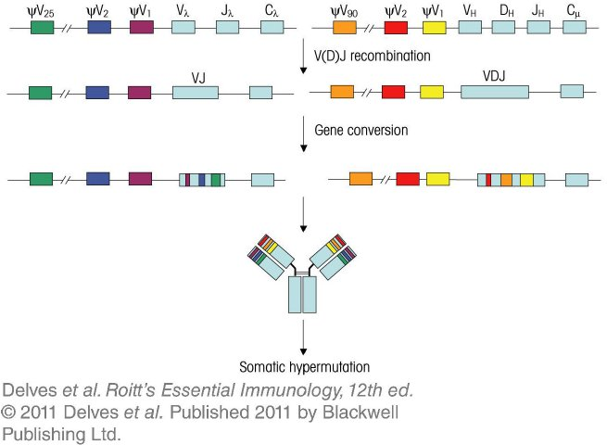
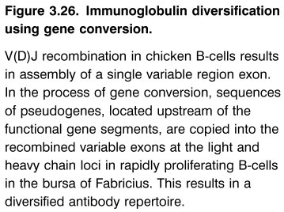
Chapter_3.indd 27
3/17/11 4:30 PM

Slide 28
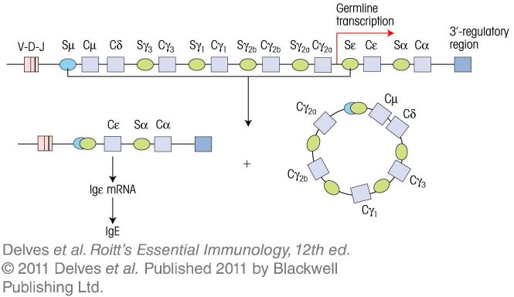
Chapter_3.indd 28
3/17/11 4:30 PM

