Slide 1
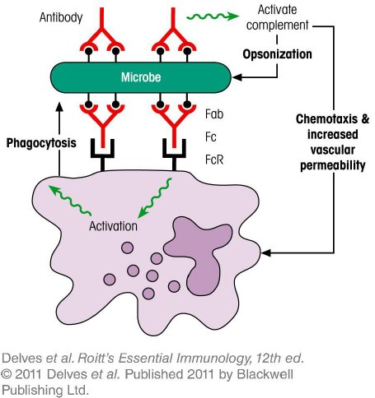
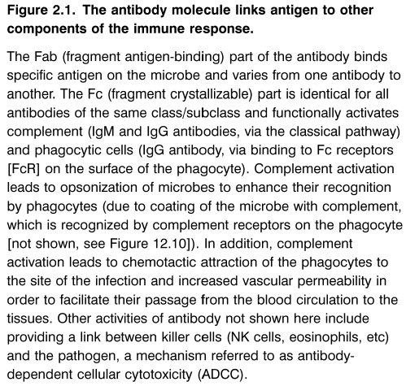
Chapter_2.indd 1
3/17/11 4:23 PM

Slide 2
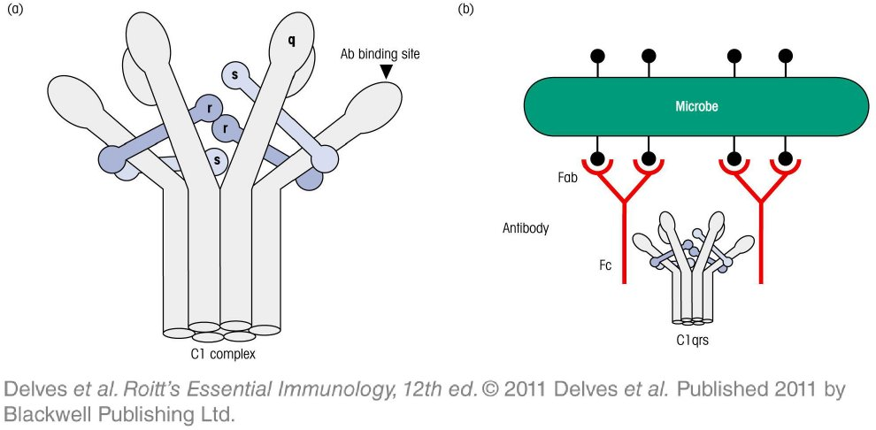
Chapter_2.indd 2
3/17/11 4:23 PM

Slide 3
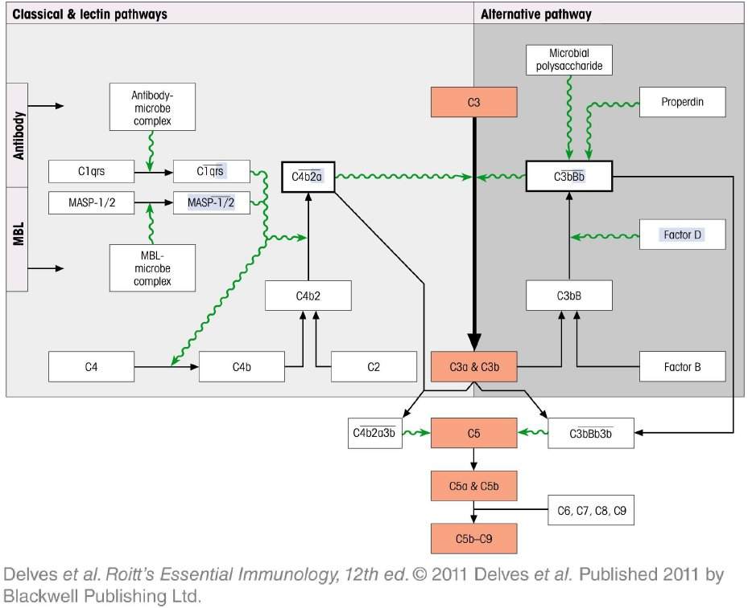
Chapter_2.indd 3
3/17/11 4:23 PM

Slide 4
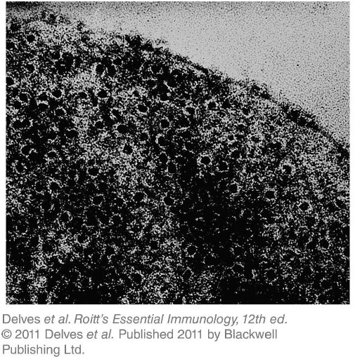
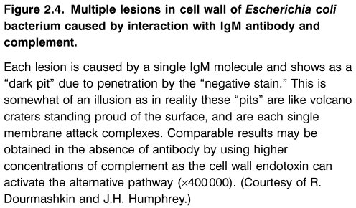
Chapter_2.indd 4
3/17/11 4:23 PM

Slide 5
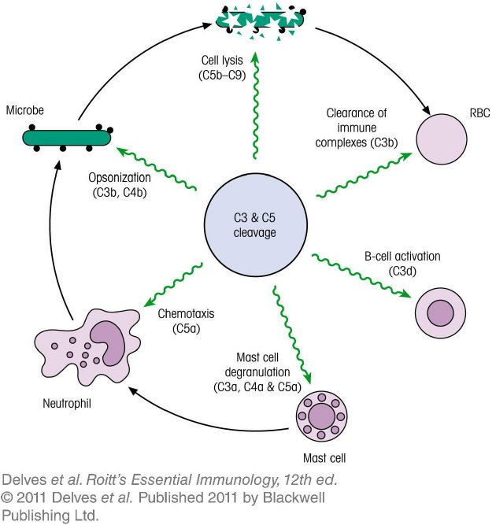
Chapter_2.indd 5
3/17/11 4:23 PM

Slide 6
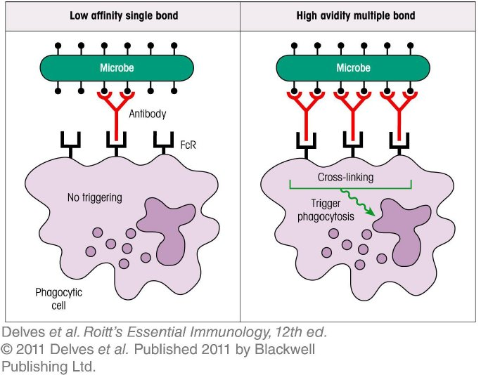
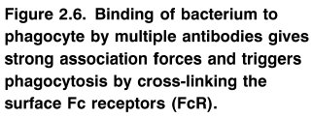
Chapter_2.indd 6
3/17/11 4:23 PM

Slide 7
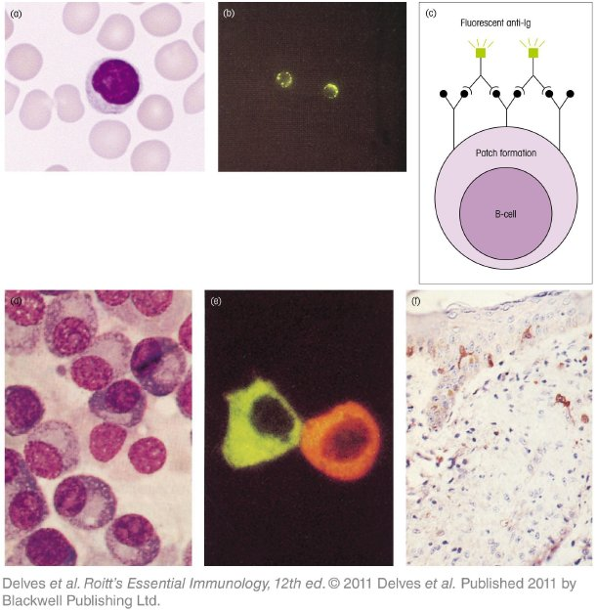
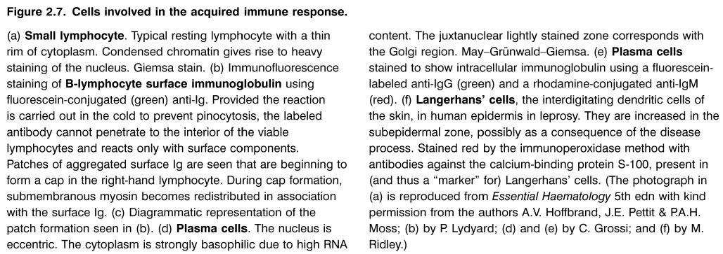
Chapter_2.indd 7
3/17/11 4:23 PM

Slide 8
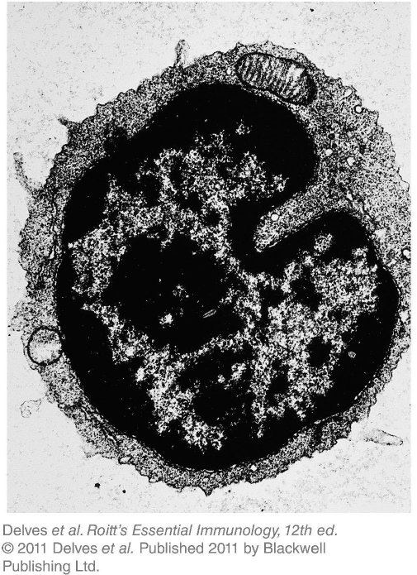
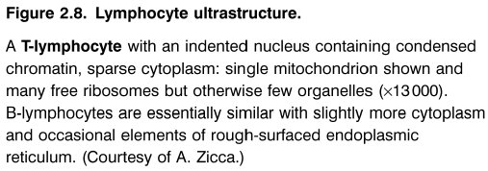
Chapter_2.indd 8
3/17/11 4:23 PM

Slide 9
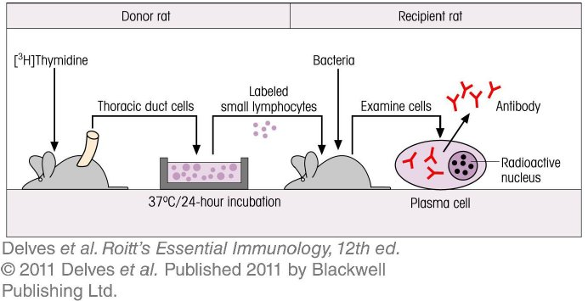
Chapter_2.indd 9
3/17/11 4:23 PM

Slide 10
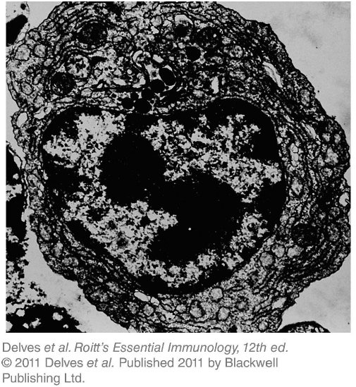
Chapter_2.indd 10
3/17/11 4:23 PM

Slide 11
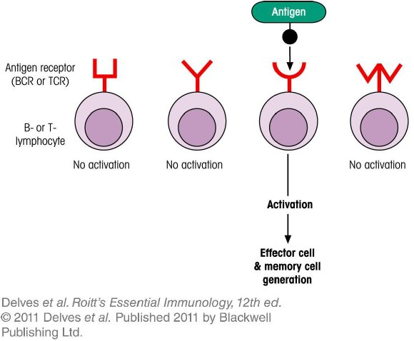
Chapter_2.indd 11
3/17/11 4:23 PM

Slide 12
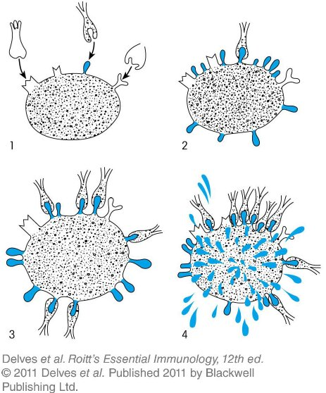
Chapter_2.indd 12
3/17/11 4:23 PM

Slide 13
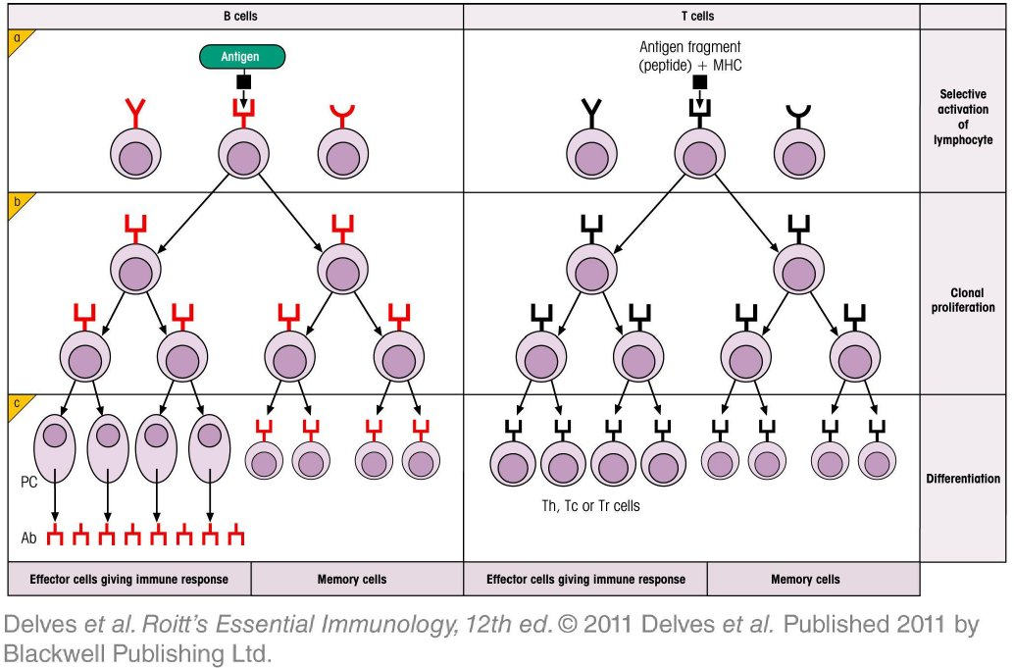
Chapter_2.indd 13
3/17/11 4:23 PM

Slide 14
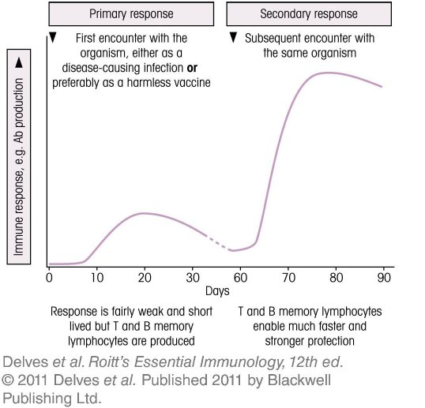
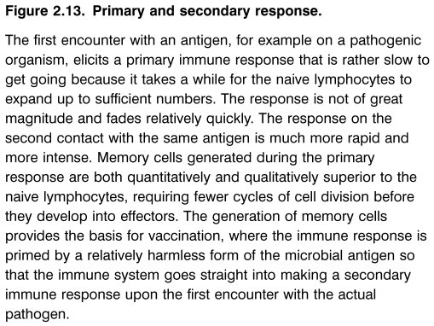
Chapter_2.indd 14
3/17/11 4:23 PM

Slide 15
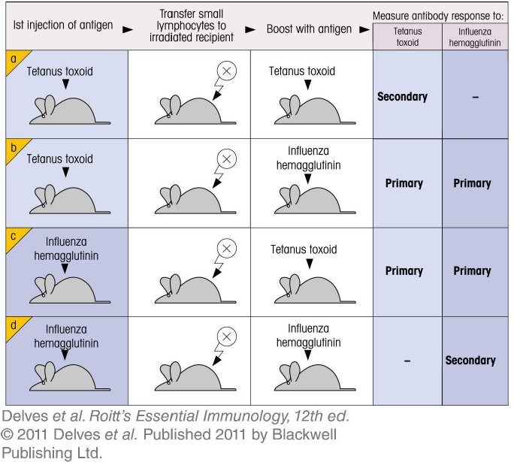
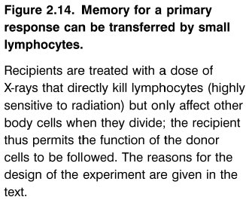
Chapter_2.indd 15
3/17/11 4:23 PM

Slide 16
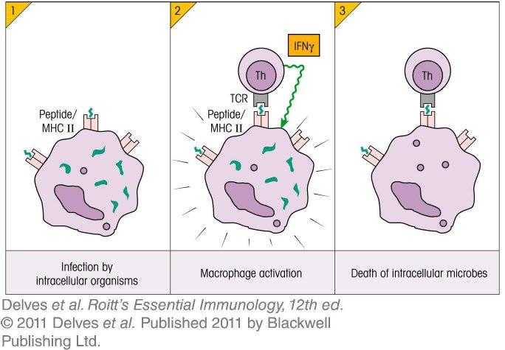
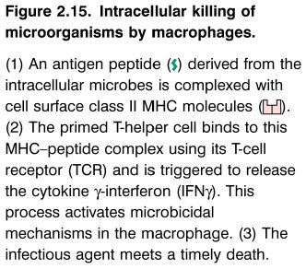
Chapter_2.indd 16
3/17/11 4:23 PM

Slide 17
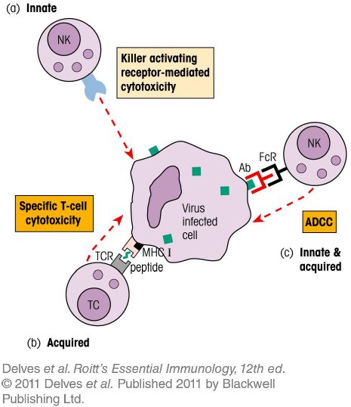
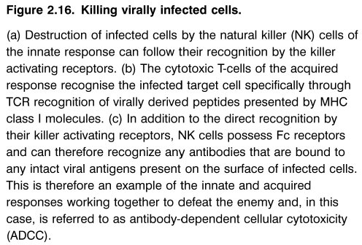
Chapter_2.indd 17
3/17/11 4:23 PM

Slide 18
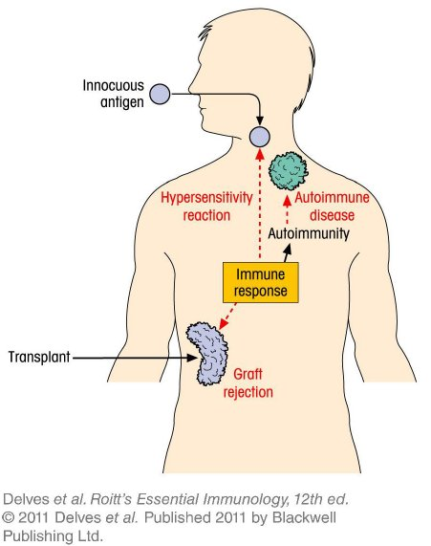
Chapter_2.indd 18
3/17/11 4:23 PM

Slide 19
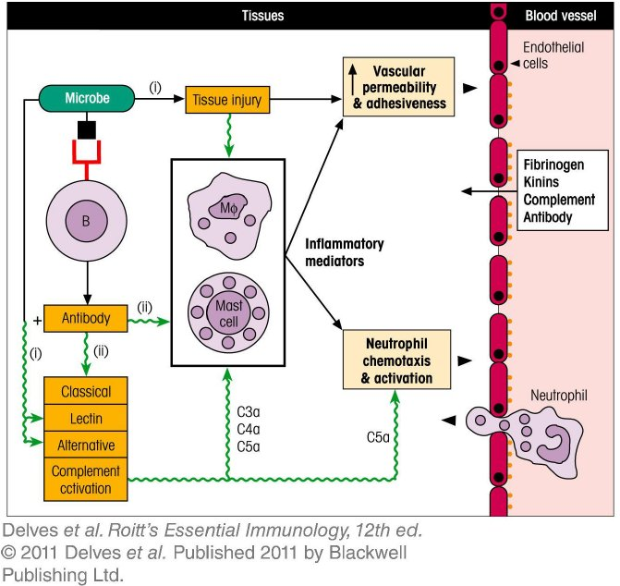
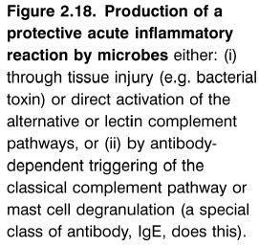
Chapter_2.indd 19
3/17/11 4:23 PM

Slide 20
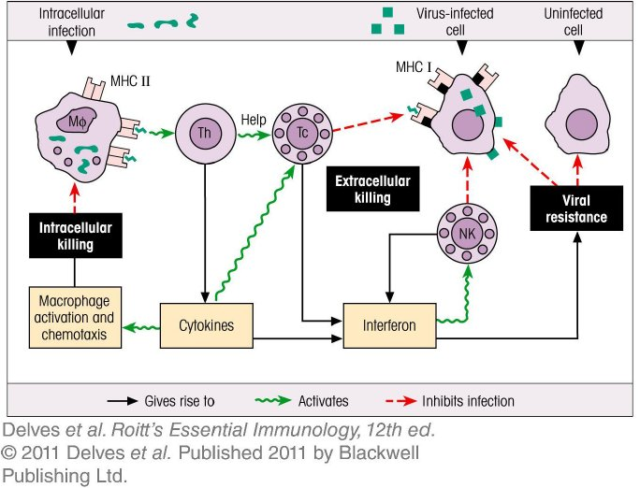
Chapter_2.indd 20
3/17/11 4:23 PM

Slide 21
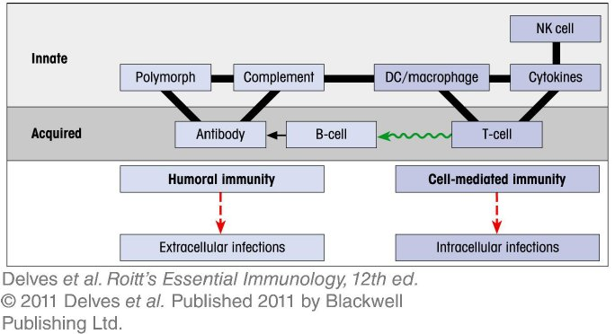
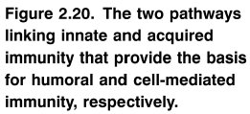
Chapter_2.indd 21
3/17/11 4:23 PM

