Slide 1
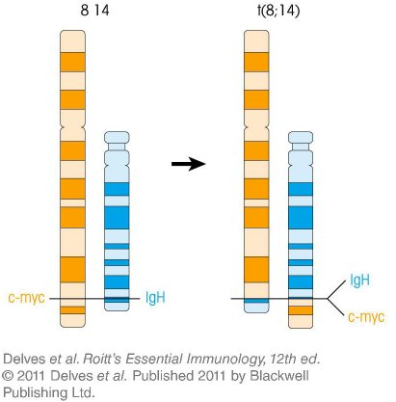
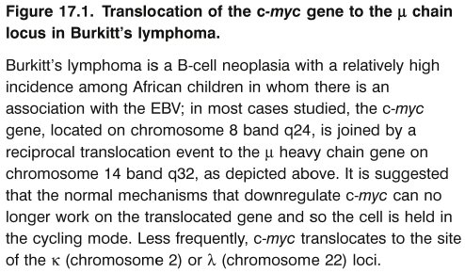
Chapter_17.indd 1
3/17/11 5:32 PM

Slide 2
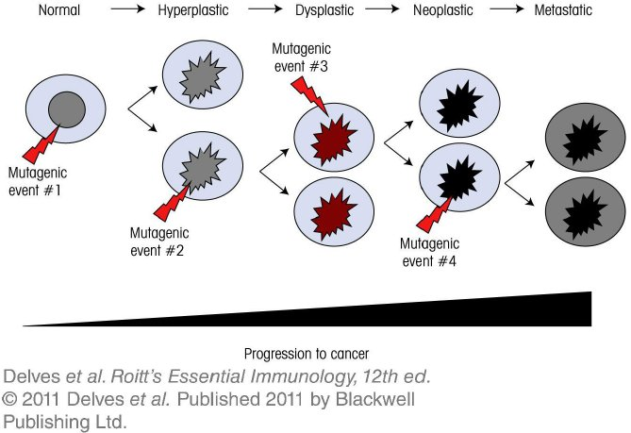
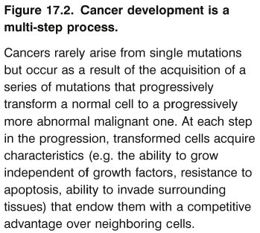
Chapter_17.indd 2
3/17/11 5:32 PM

Slide 3
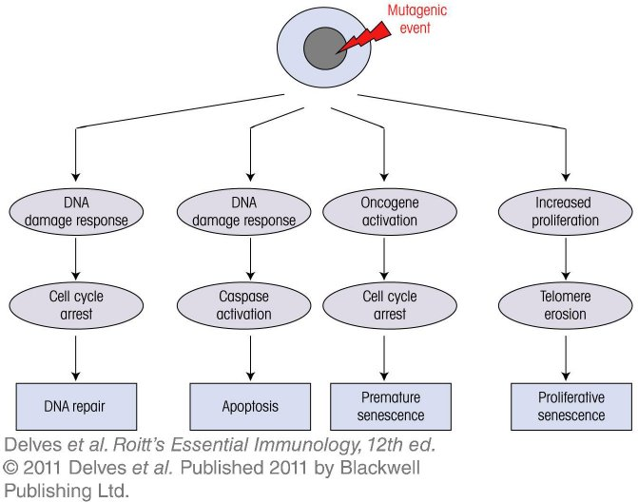
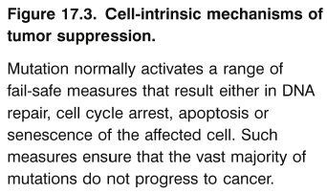
Chapter_17.indd 3
3/17/11 5:32 PM

Slide 4
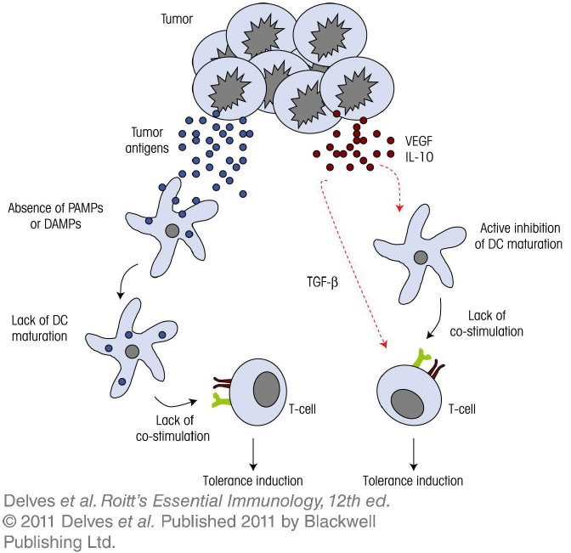
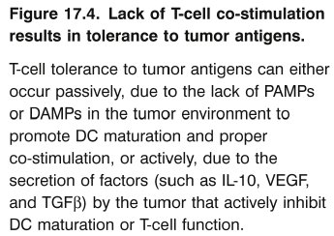
Chapter_17.indd 4
3/17/11 5:32 PM

Slide 5
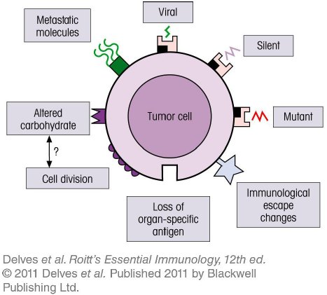
Chapter_17.indd 5
3/17/11 5:32 PM

Slide 6
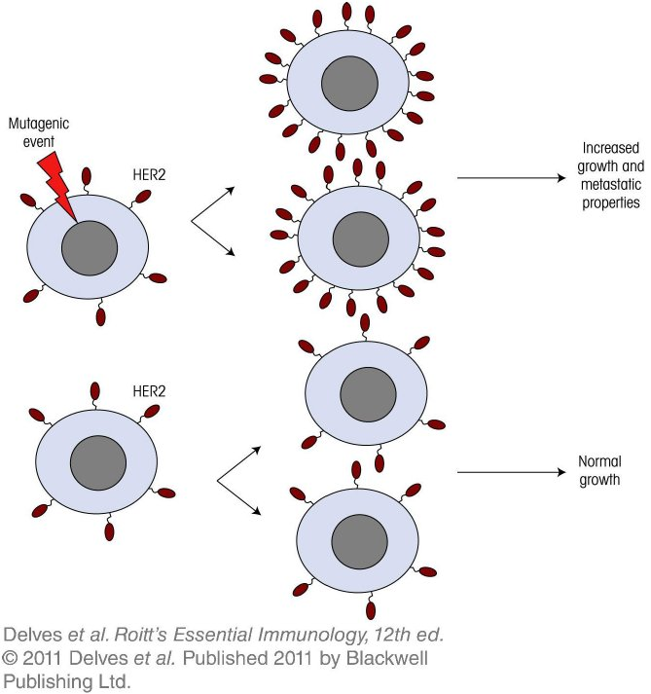
Chapter_17.indd 6
3/17/11 5:32 PM

Slide 7
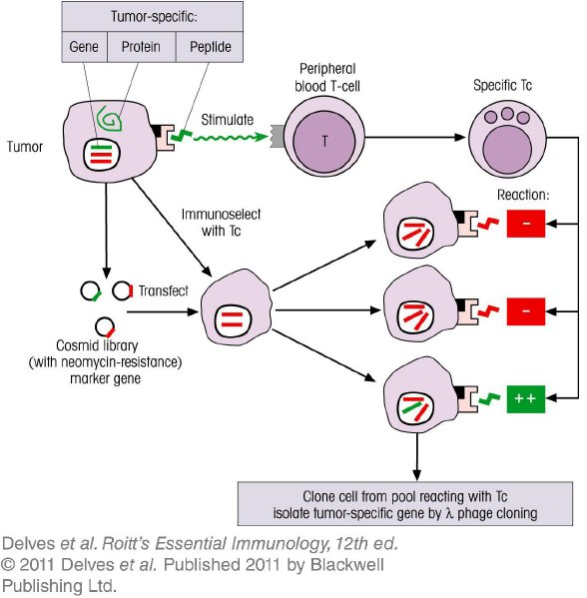
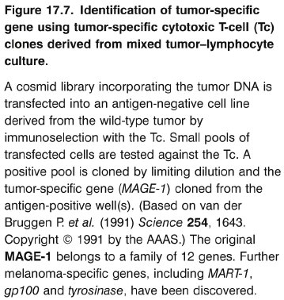
Chapter_17.indd 7
3/17/11 5:32 PM

Slide 8
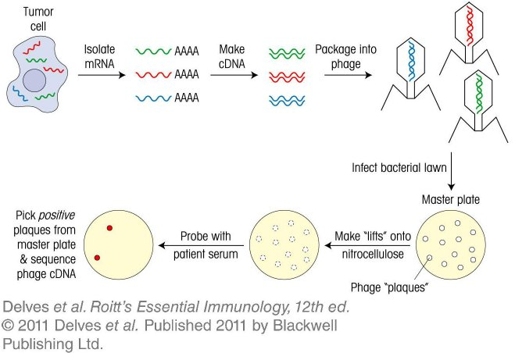
Chapter_17.indd 8
3/17/11 5:32 PM

Slide 9
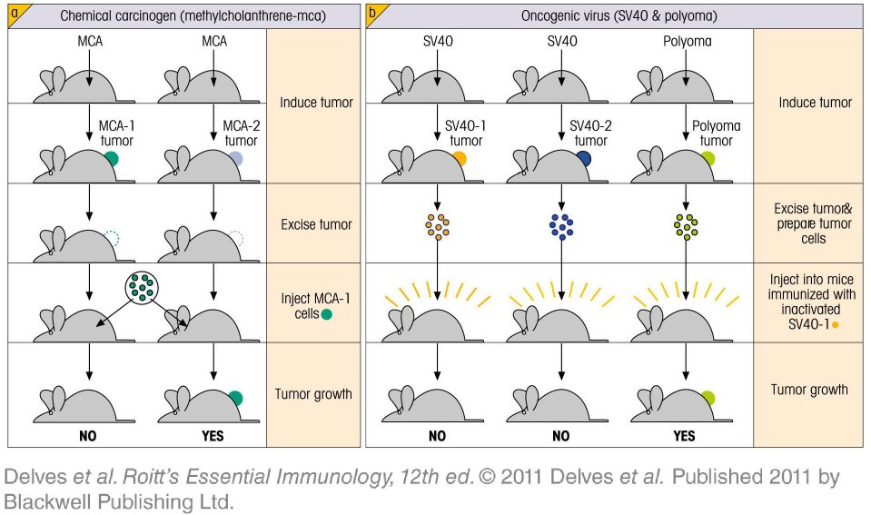
Chapter_17.indd 9
3/17/11 5:32 PM

Slide 10
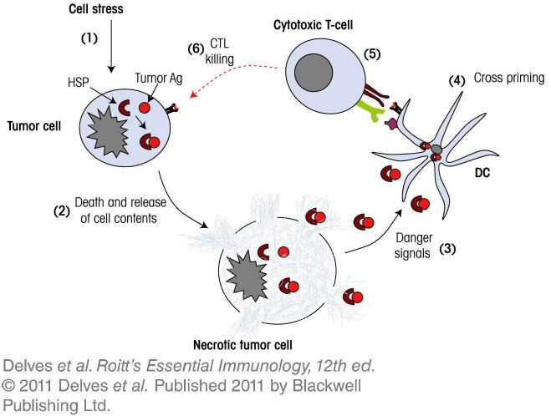
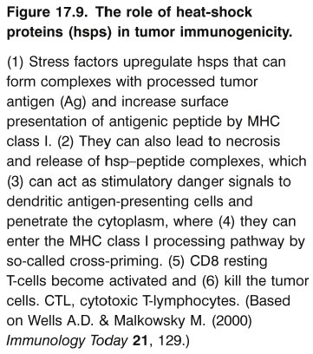
Chapter_17.indd 10
3/17/11 5:32 PM

Slide 11
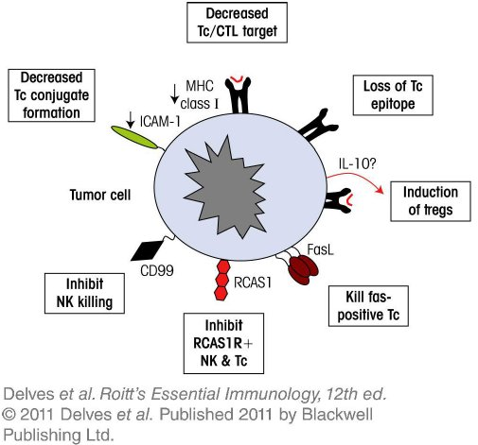
Chapter_17.indd 11
3/17/11 5:32 PM

Slide 12
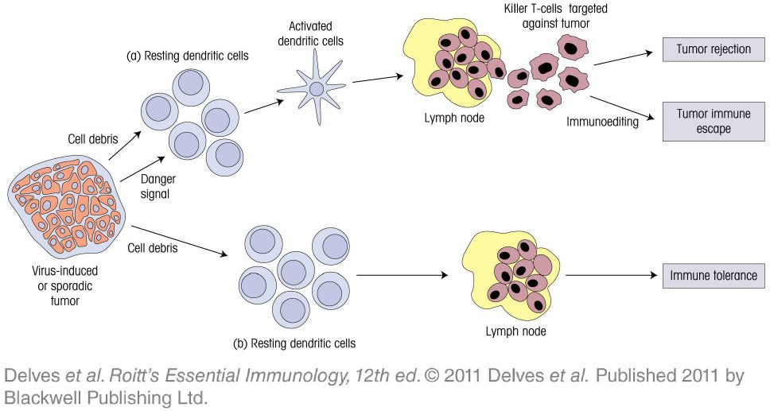
Chapter_17.indd 12
3/17/11 5:32 PM

Slide 13
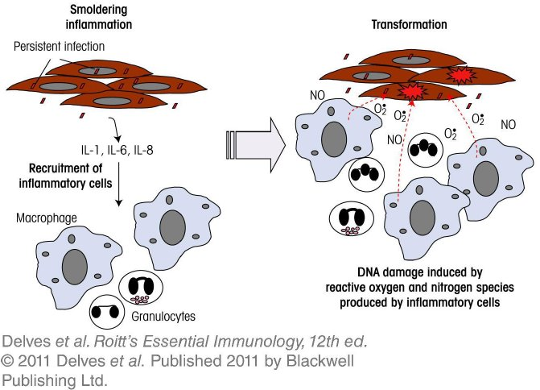
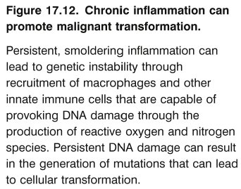
Chapter_17.indd 13
3/17/11 5:32 PM

Slide 14
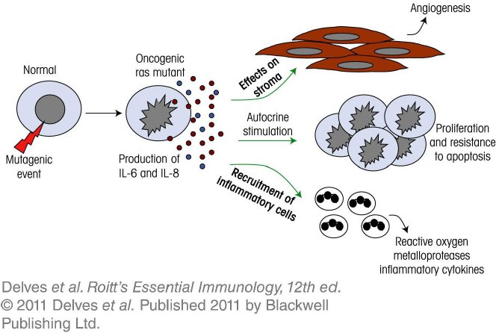
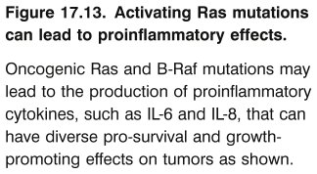
Chapter_17.indd 14
3/17/11 5:32 PM

Slide 15
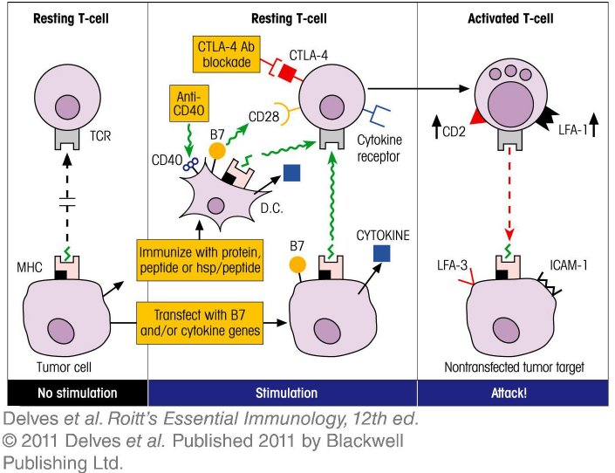
Chapter_17.indd 15
3/17/11 5:32 PM

Slide 16
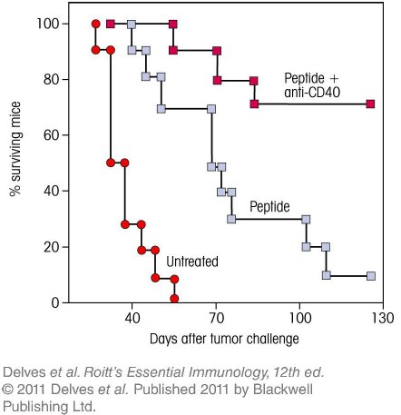
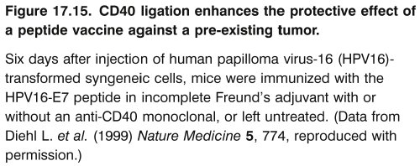
Chapter_17.indd 16
3/17/11 5:32 PM

Slide 17
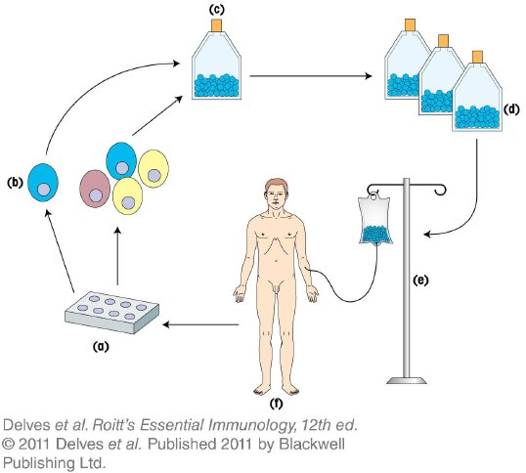
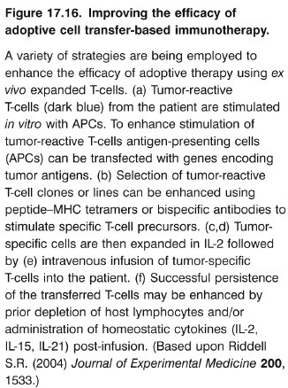
Chapter_17.indd 17
3/17/11 5:32 PM

Slide 18
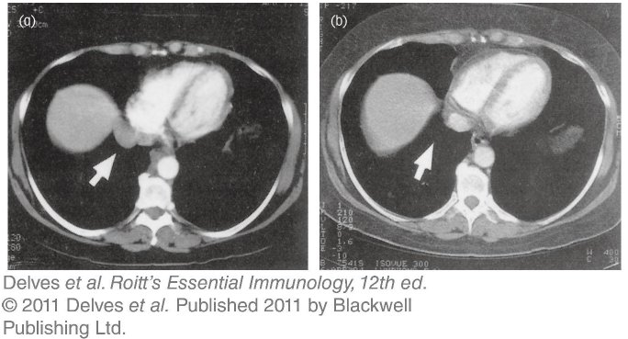
Chapter_17.indd 18
3/17/11 5:32 PM

Slide 19
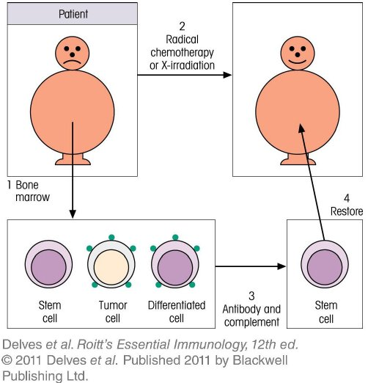
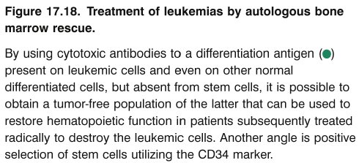
Chapter_17.indd 19
3/17/11 5:32 PM

Slide 20
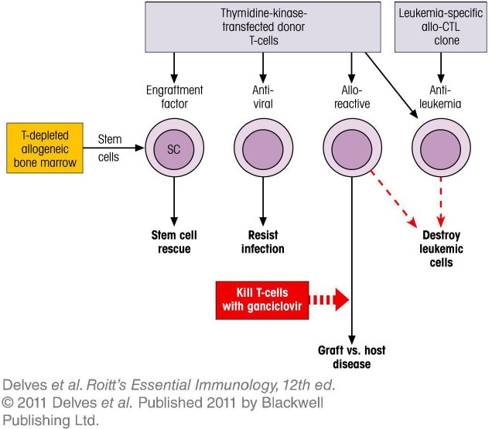
Chapter_17.indd 20
3/17/11 5:32 PM

