Slide 1
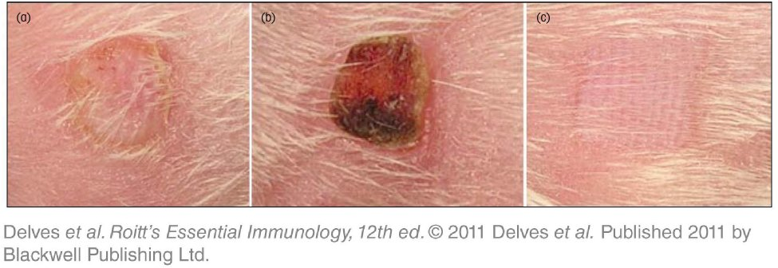
Chapter_16.indd 1
3/17/11 5:29 PM

Slide 2
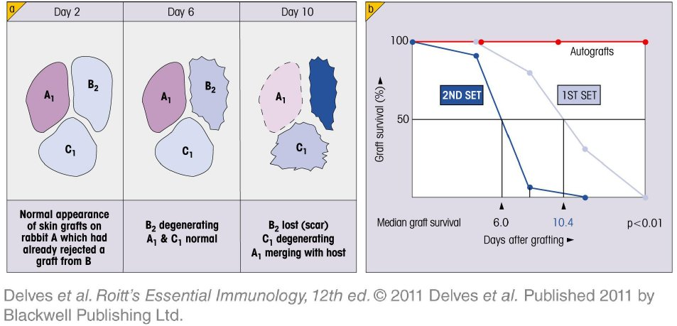
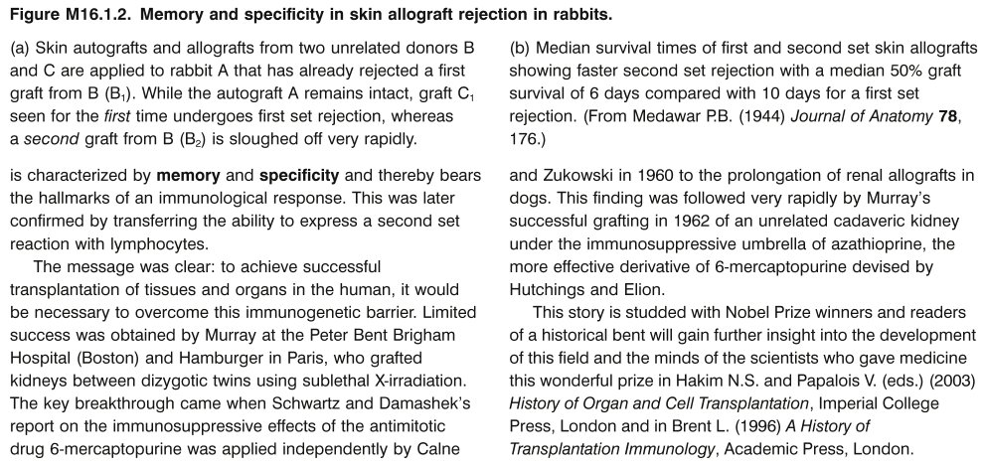
Chapter_16.indd 2
3/17/11 5:29 PM

Slide 3
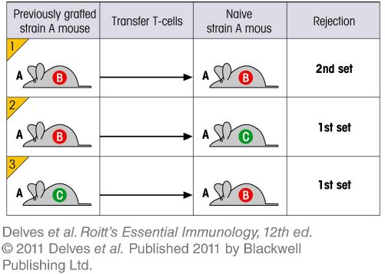
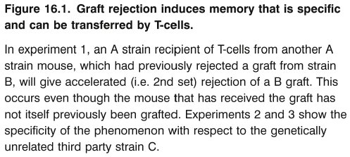
Chapter_16.indd 3
3/17/11 5:29 PM

Slide 4
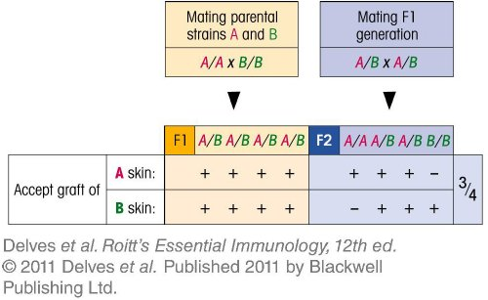
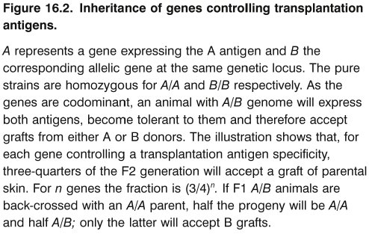
Chapter_16.indd 4
3/17/11 5:29 PM

Slide 5
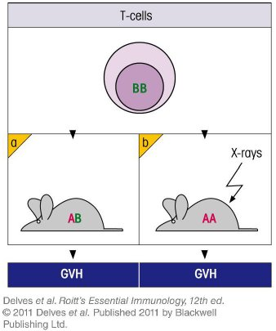
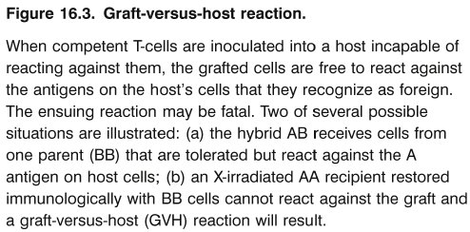
Chapter_16.indd 5
3/17/11 5:29 PM

Slide 6
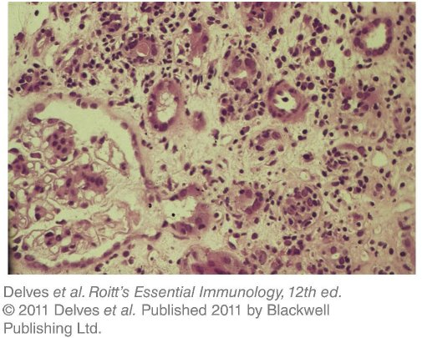
Chapter_16.indd 6
3/17/11 5:29 PM

Slide 7
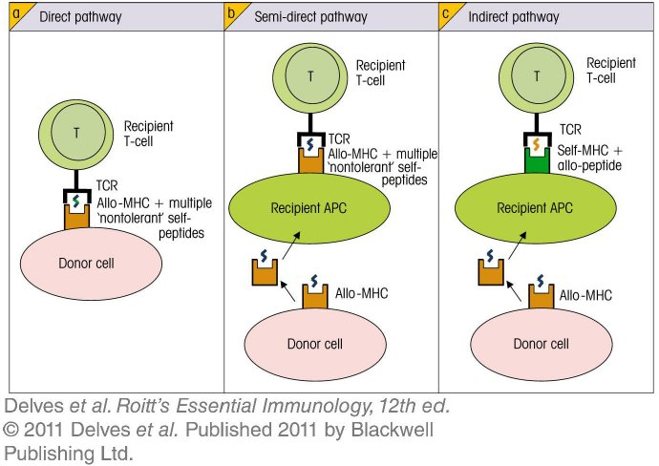
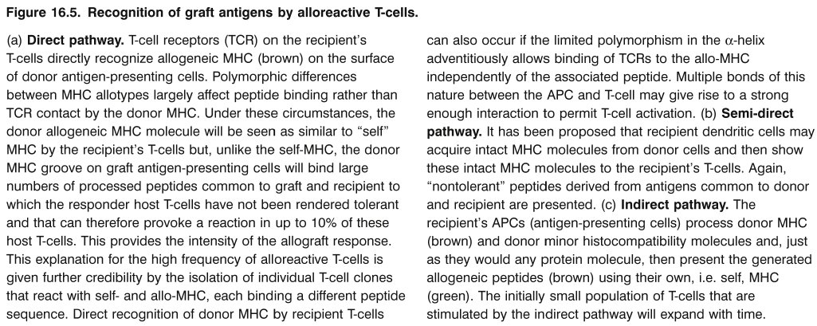
Chapter_16.indd 7
3/17/11 5:29 PM

Slide 8
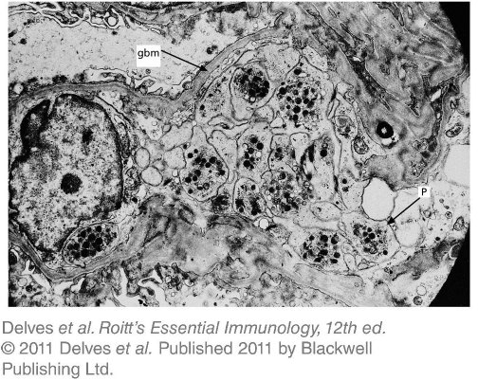
Chapter_16.indd 8
3/17/11 5:29 PM

Slide 9
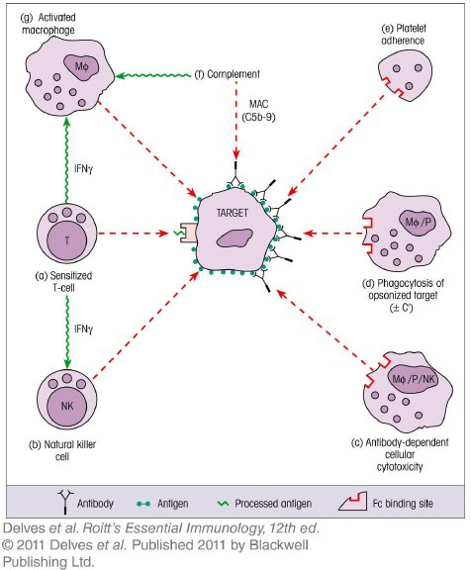
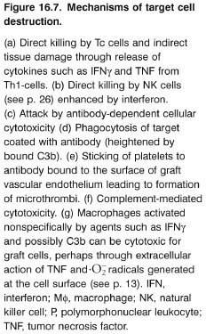
Chapter_16.indd 9
3/17/11 5:29 PM

Slide 10
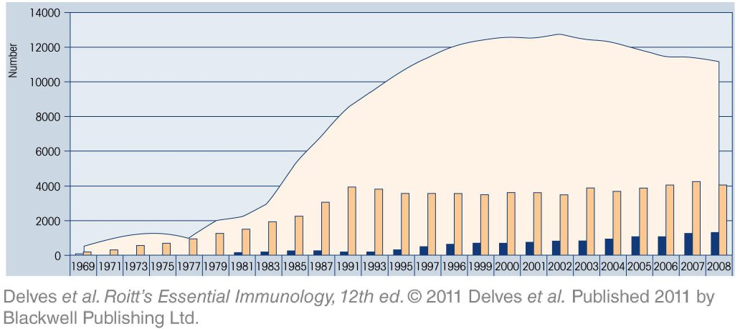
Chapter_16.indd 10
3/17/11 5:29 PM

Slide 11
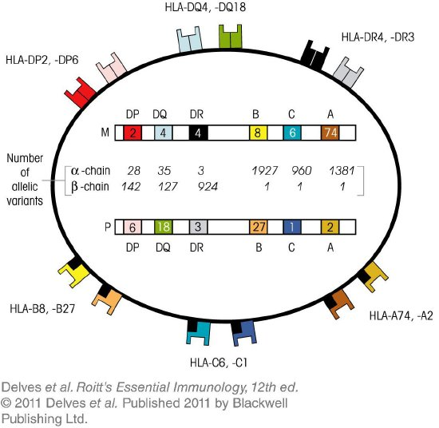
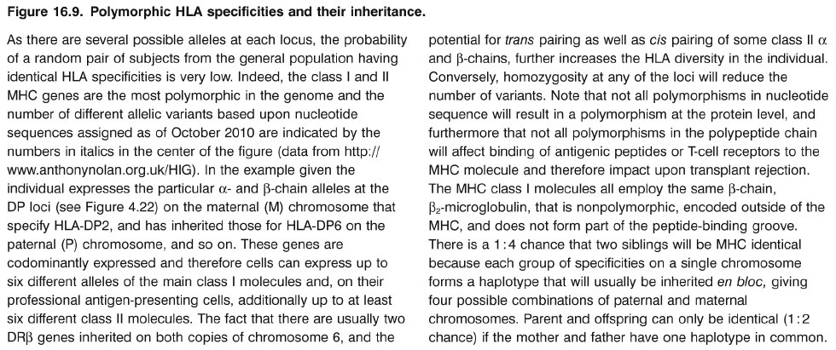
Chapter_16.indd 11
3/17/11 5:29 PM

Slide 12
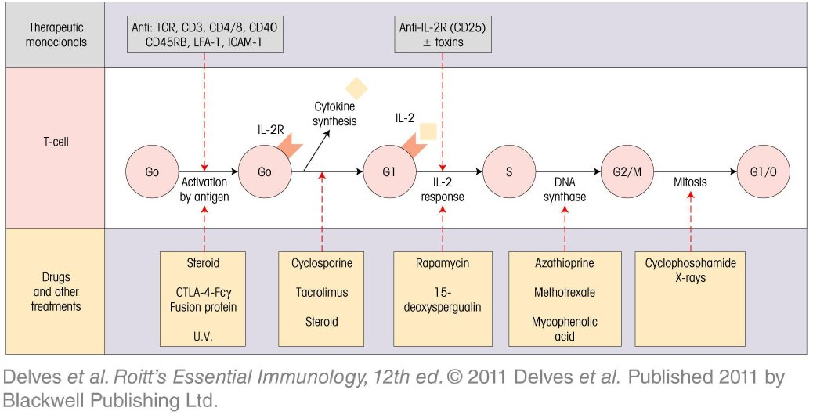
Chapter_16.indd 12
3/17/11 5:29 PM

Slide 13
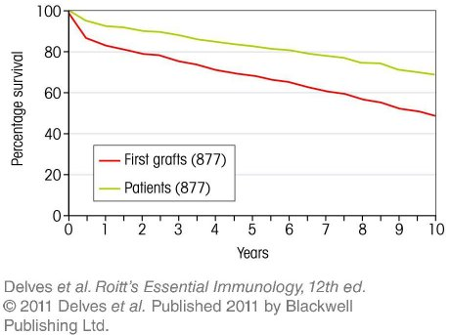
Chapter_16.indd 13
3/17/11 5:29 PM

Slide 14
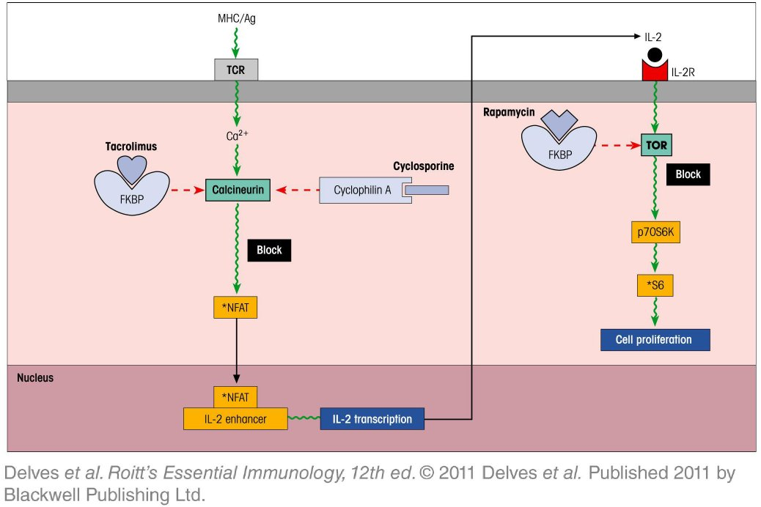
Chapter_16.indd 14
3/17/11 5:29 PM

Slide 15
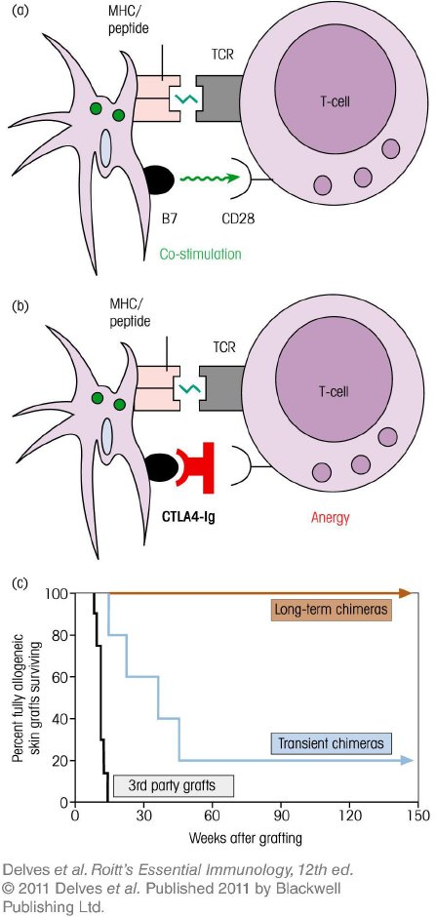
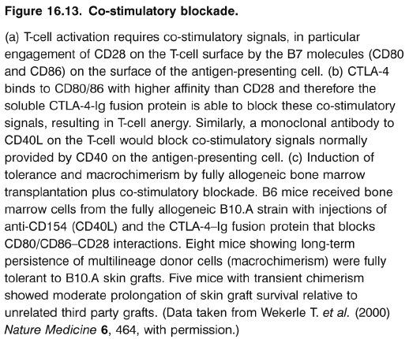
Chapter_16.indd 15
3/17/11 5:29 PM

Slide 16
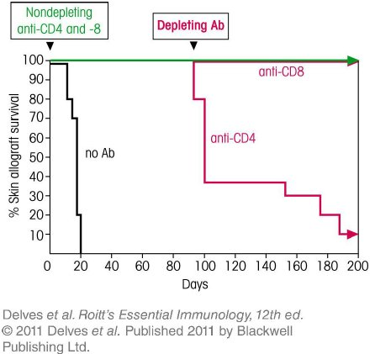
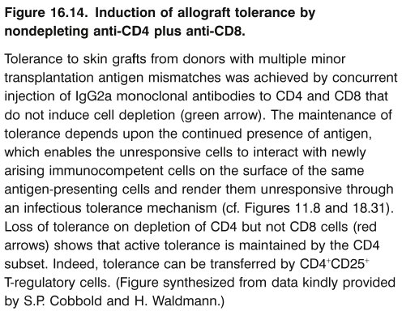
Chapter_16.indd 16
3/17/11 5:29 PM

Slide 17
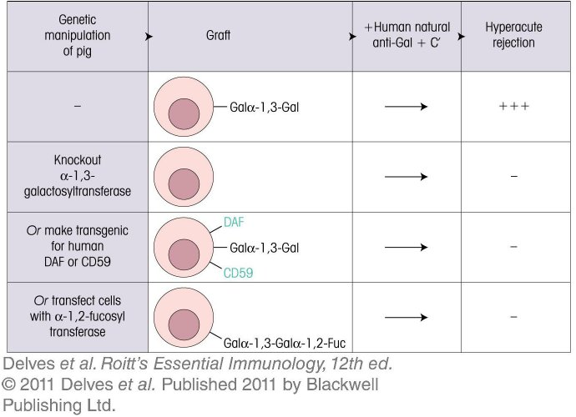
Chapter_16.indd 17
3/17/11 5:29 PM

Slide 18
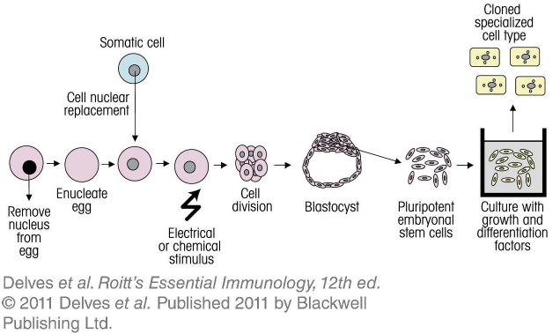
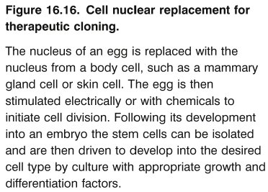
Chapter_16.indd 18
3/17/11 5:29 PM

Slide 19
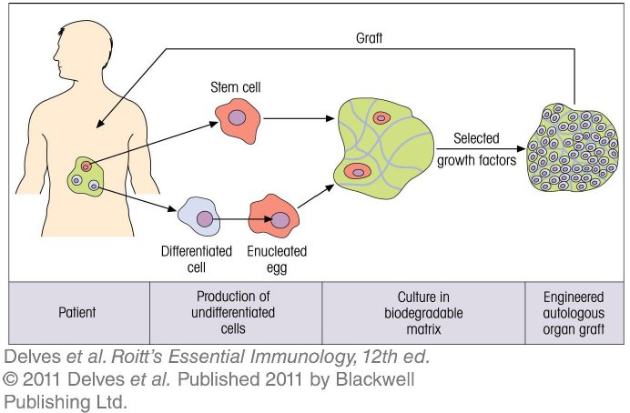
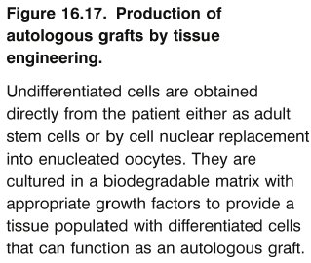
Chapter_16.indd 19
3/17/11 5:29 PM

Slide 20
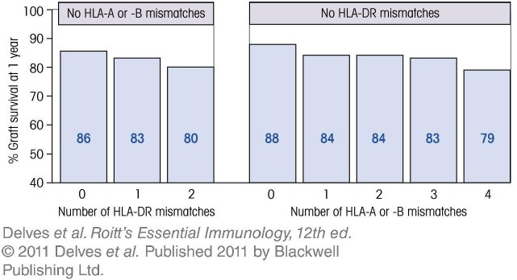
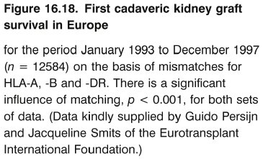
Chapter_16.indd 20
3/17/11 5:29 PM

Slide 21
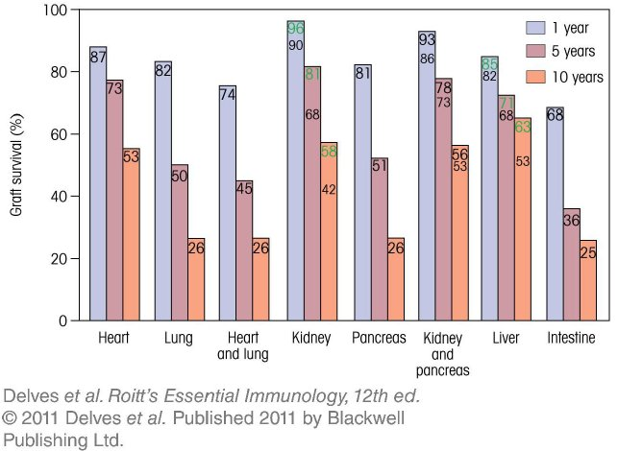
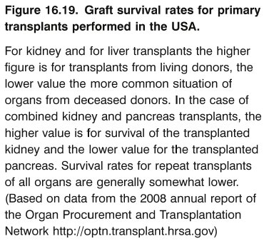
Chapter_16.indd 21
3/17/11 5:29 PM

Slide 22
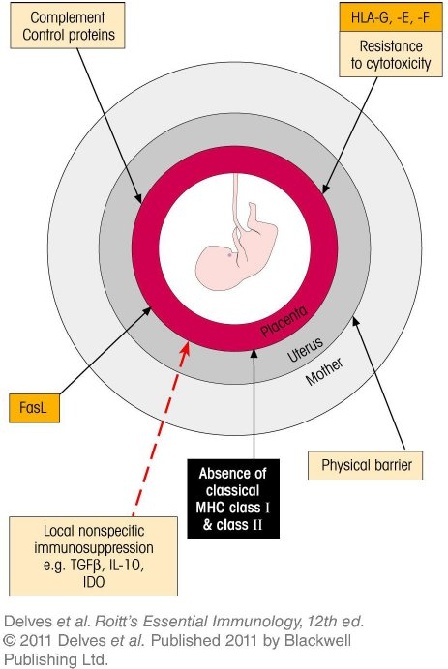
Chapter_16.indd 22
3/17/11 5:29 PM

