Slide 1

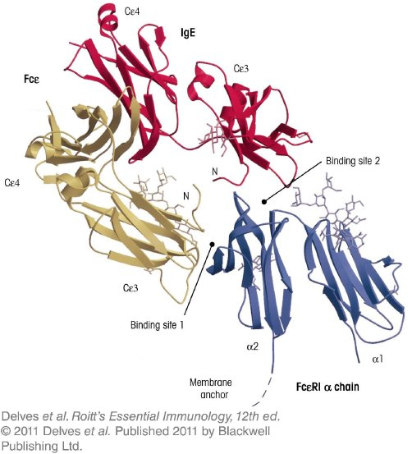
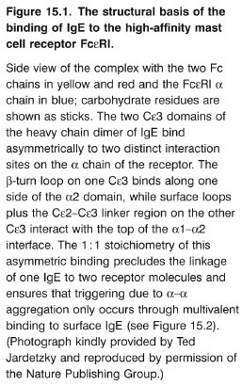
Chapter_15.indd 1
3/17/11 5:25 PM

Slide 2
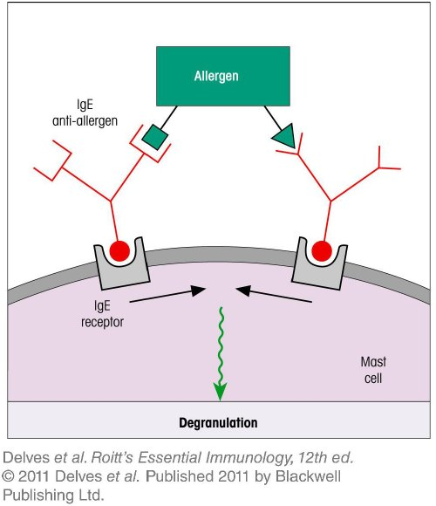
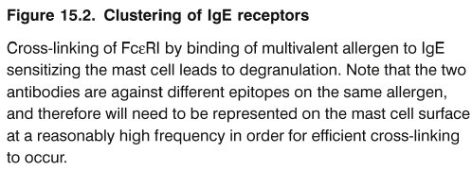
Chapter_15.indd 2
3/17/11 5:25 PM

Slide 3
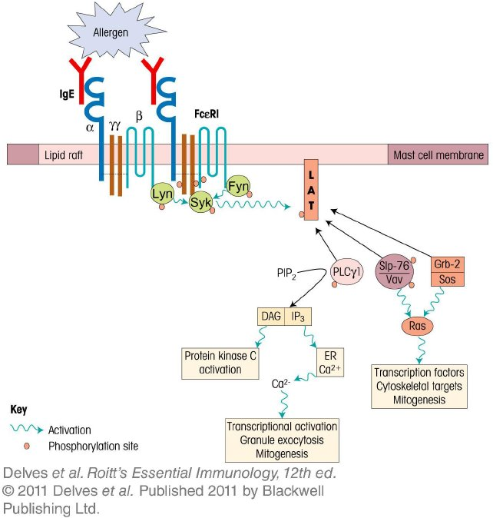
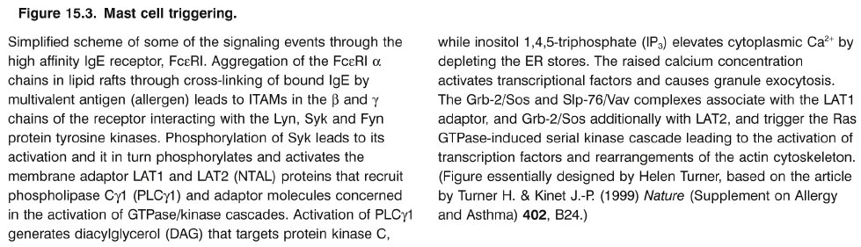
Chapter_15.indd 3
3/17/11 5:25 PM

Slide 4
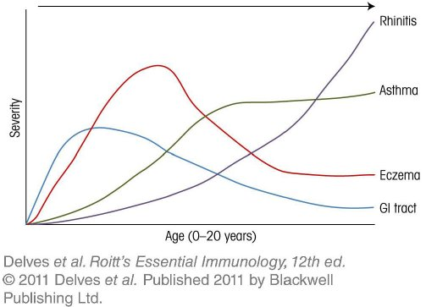
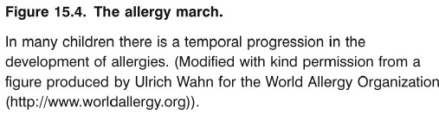
Chapter_15.indd 4
3/17/11 5:25 PM

Slide 5
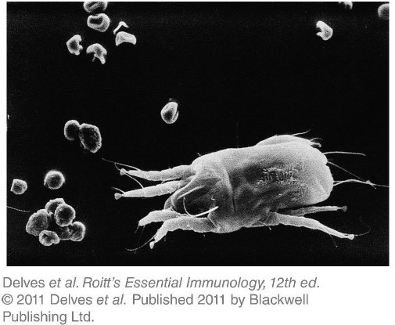
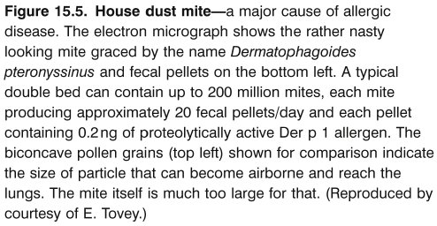
Chapter_15.indd 5
3/17/11 5:25 PM

Slide 6
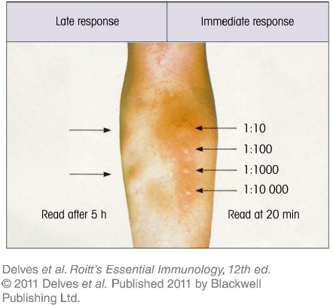
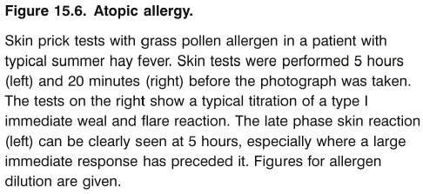
Chapter_15.indd 6
3/17/11 5:25 PM

Slide 7
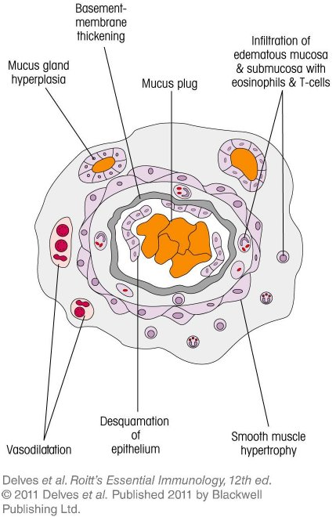

Chapter_15.indd 7
3/17/11 5:25 PM

Slide 8
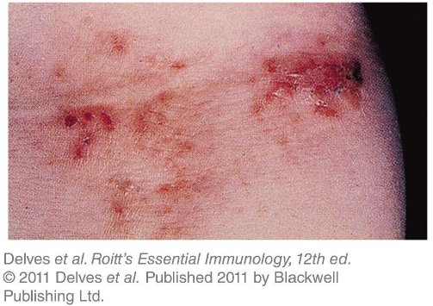

Chapter_15.indd 8
3/17/11 5:25 PM

Slide 9
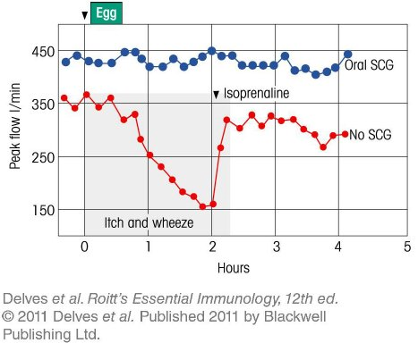
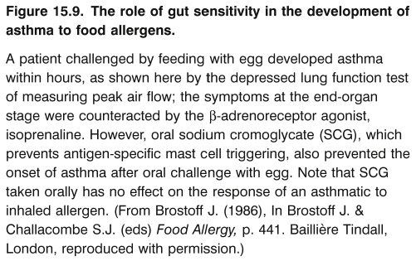
Chapter_15.indd 9
3/17/11 5:25 PM

Slide 10
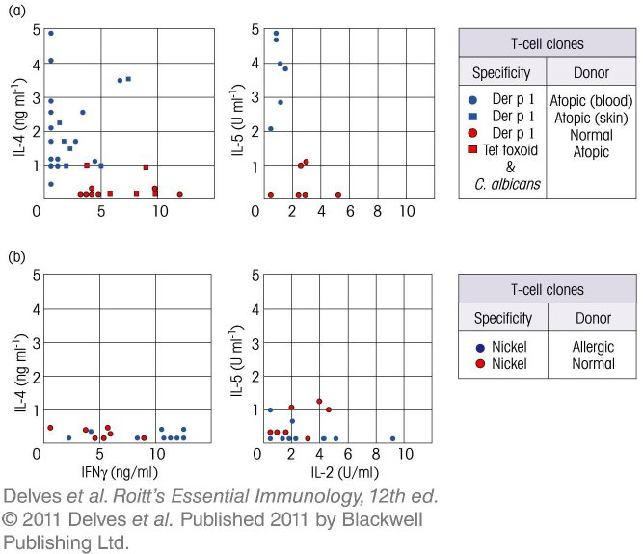
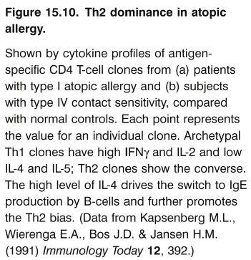
Chapter_15.indd 10
3/17/11 5:25 PM

Slide 11
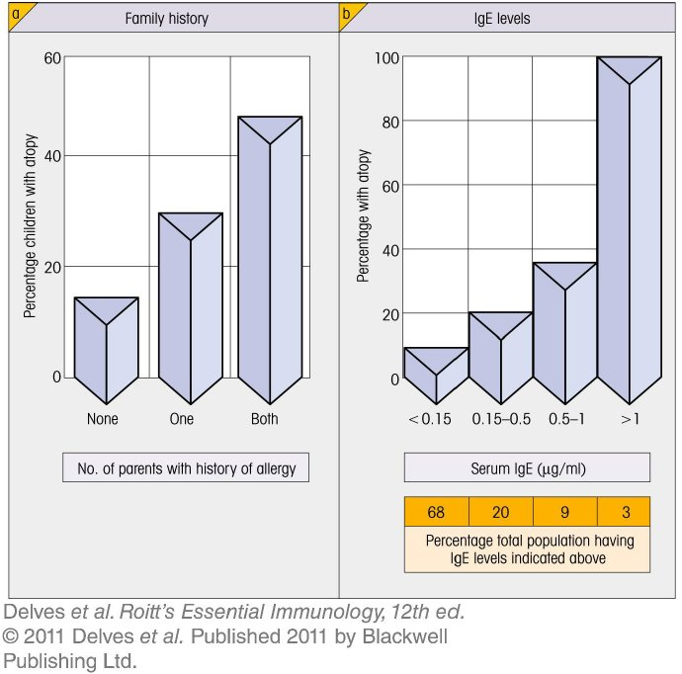
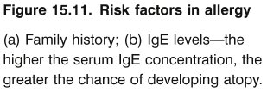
Chapter_15.indd 11
3/17/11 5:25 PM

Slide 12
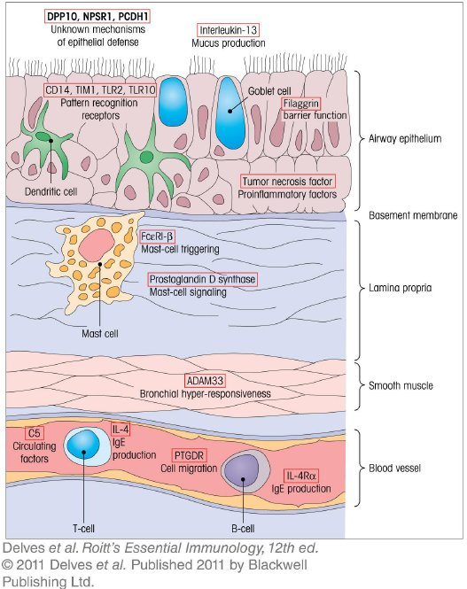
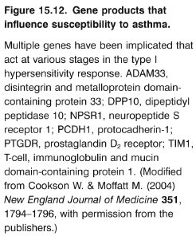
Chapter_15.indd 12
3/17/11 5:25 PM

Slide 13
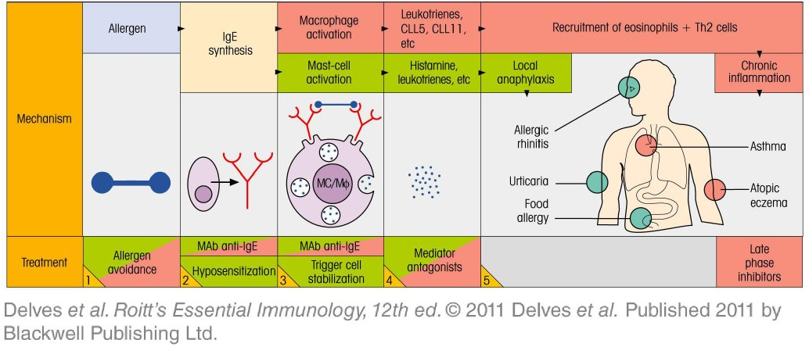
Chapter_15.indd 13
3/17/11 5:25 PM

Slide 14
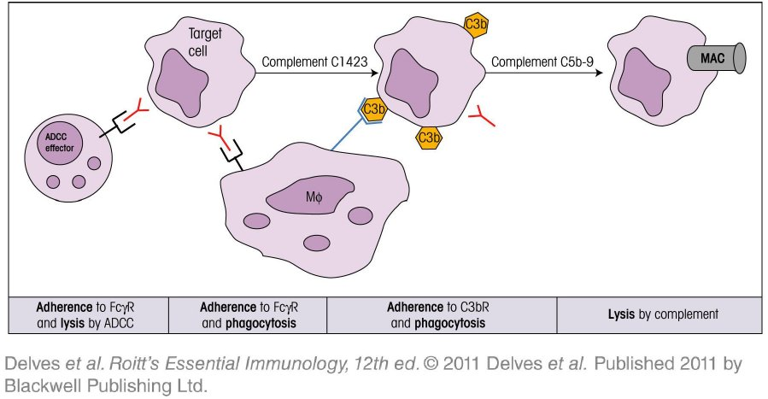
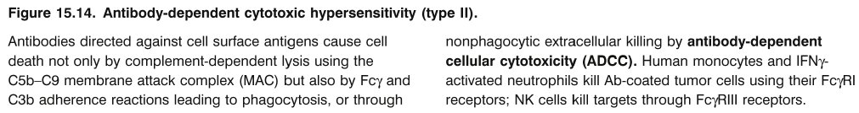
Chapter_15.indd 14
3/17/11 5:25 PM

Slide 15
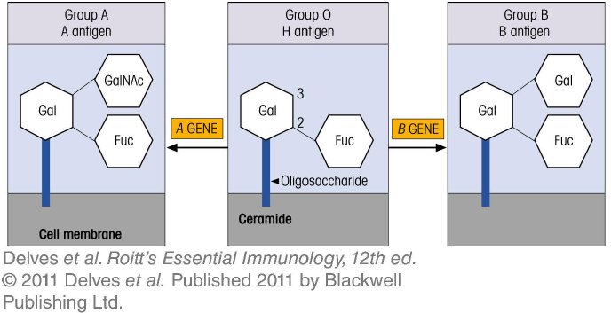
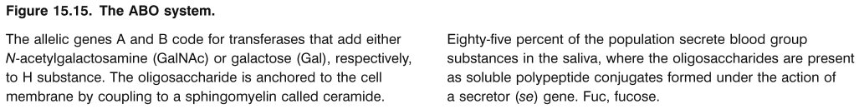
Chapter_15.indd 15
3/17/11 5:25 PM

Slide 16
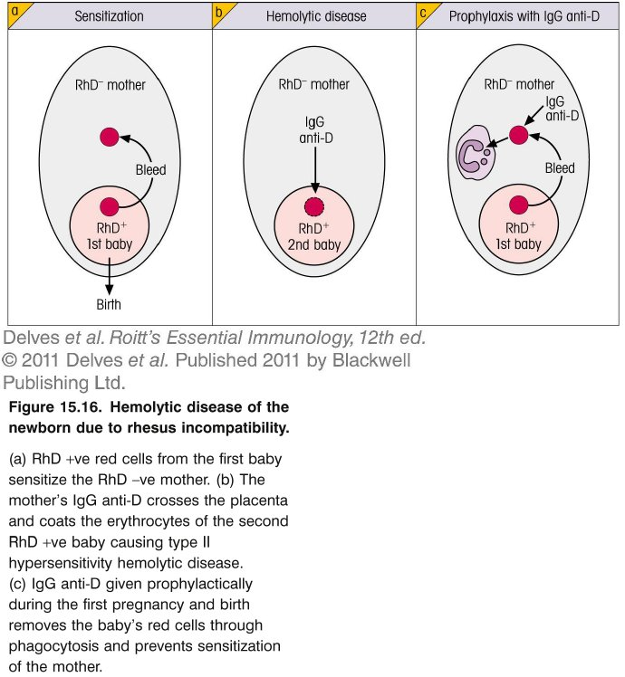
Chapter_15.indd 16
3/17/11 5:25 PM

Slide 17
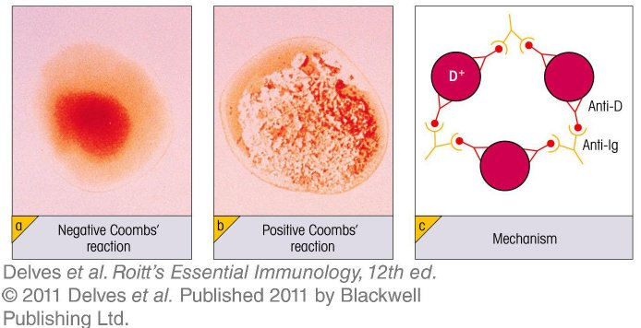
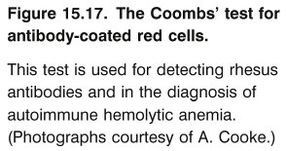
Chapter_15.indd 17
3/17/11 5:25 PM

Slide 18
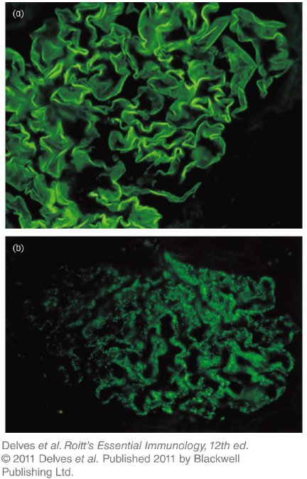
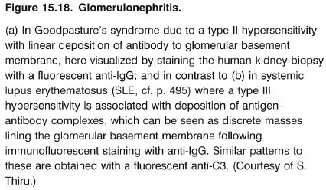
Chapter_15.indd 18
3/17/11 5:25 PM

Slide 19
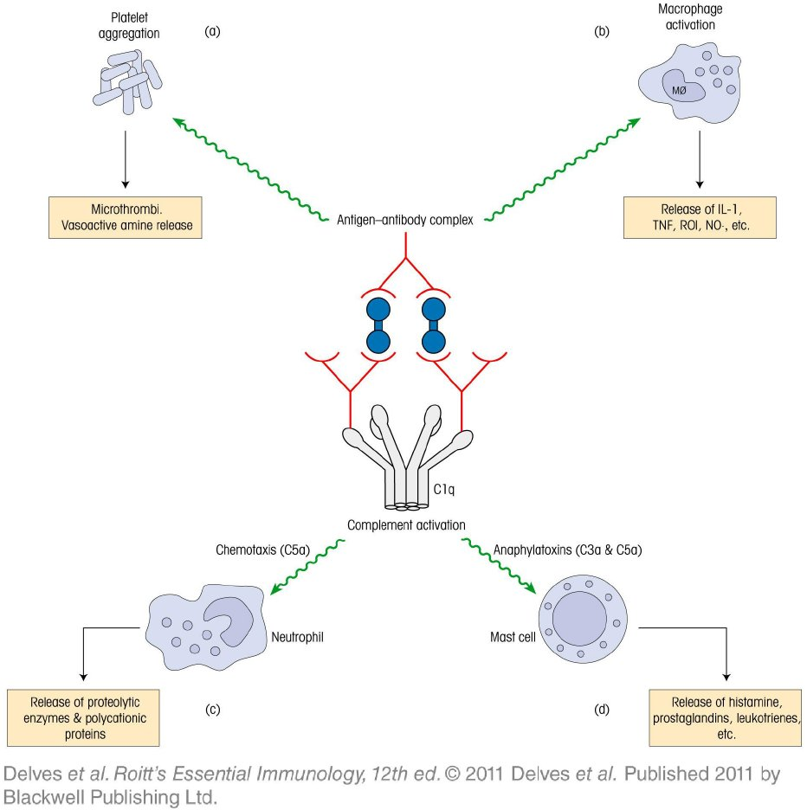
Chapter_15.indd 19
3/17/11 5:25 PM

Slide 20
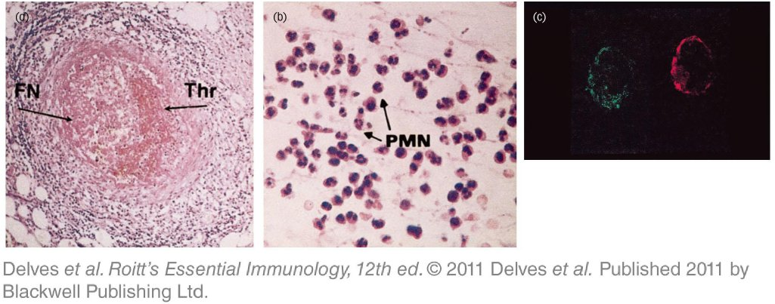
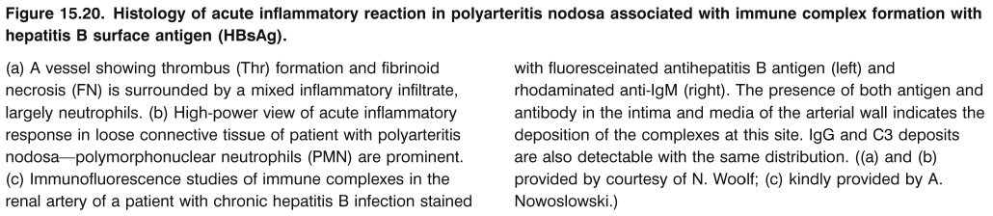
Chapter_15.indd 20
3/17/11 5:25 PM

Slide 21
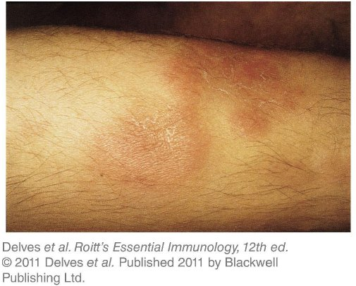
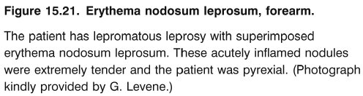
Chapter_15.indd 21
3/17/11 5:25 PM

Slide 22
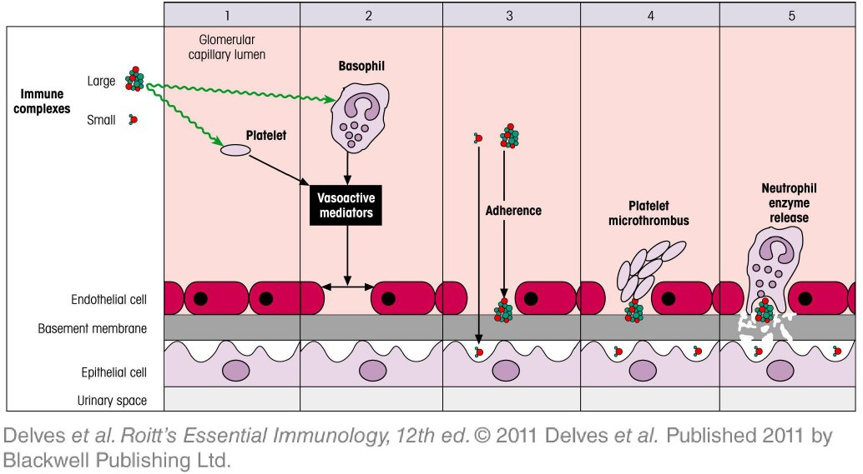
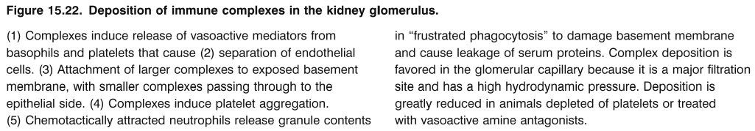
Chapter_15.indd 22
3/17/11 5:26 PM

Slide 23
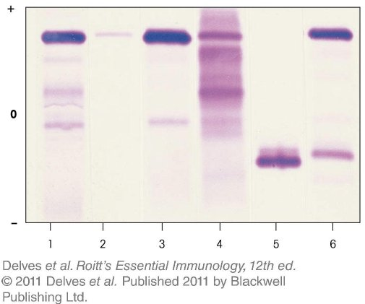
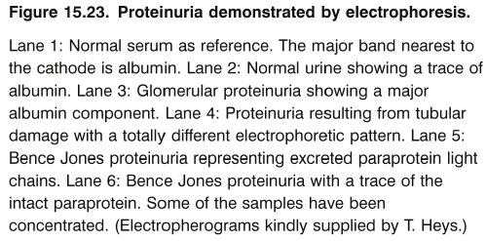
Chapter_15.indd 23
3/17/11 5:26 PM

Slide 24
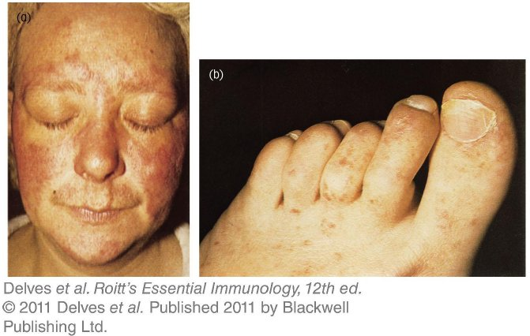
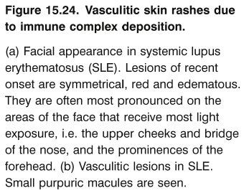
Chapter_15.indd 24
3/17/11 5:26 PM

Slide 25
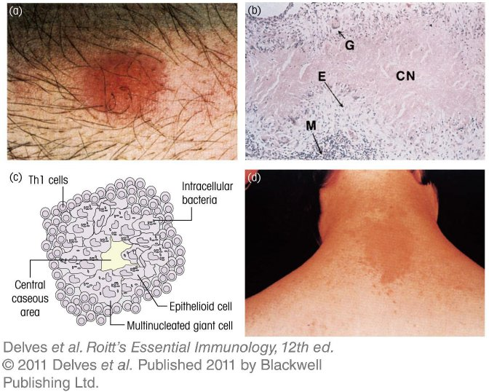
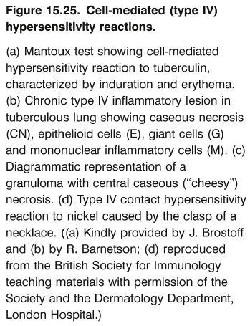
Chapter_15.indd 25
3/17/11 5:26 PM

Slide 26
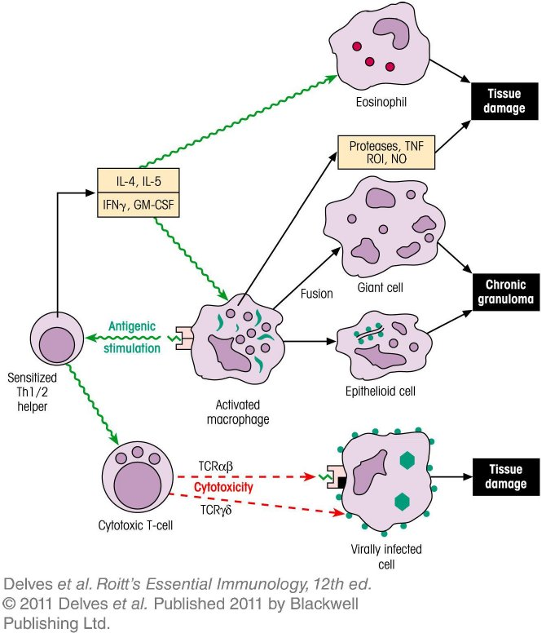
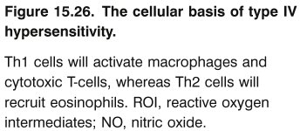
Chapter_15.indd 26
3/17/11 5:26 PM

Slide 27
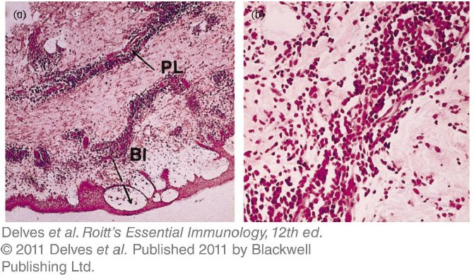
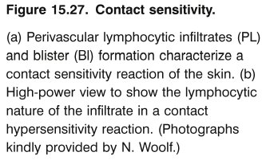
Chapter_15.indd 27
3/17/11 5:26 PM

Slide 28
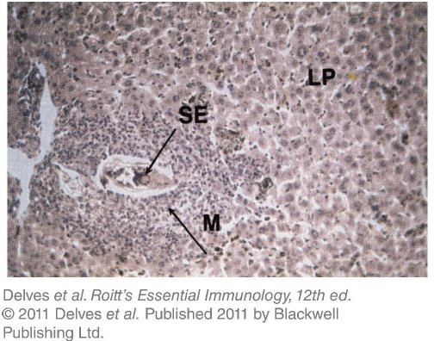

Chapter_15.indd 28
3/17/11 5:26 PM

