Slide 1
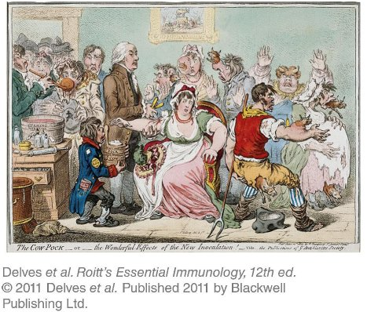
Chapter_13.indd 1
3/17/11 5:19 PM

Slide 2
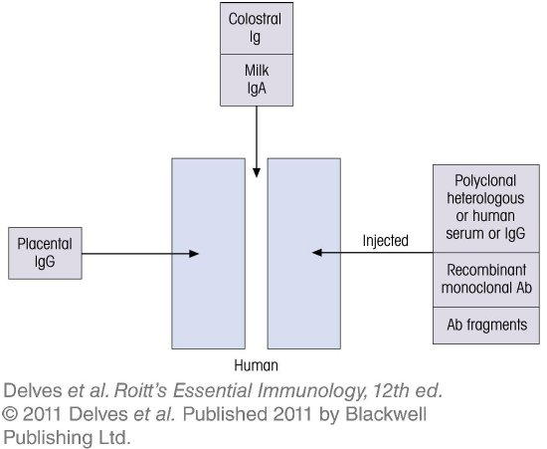
Chapter_13.indd 2
3/17/11 5:19 PM

Slide 3
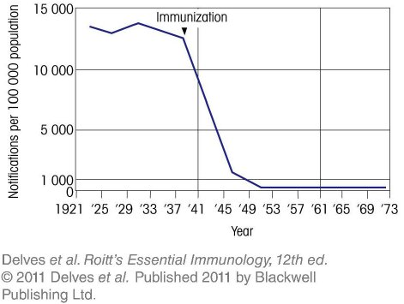
Chapter_13.indd 3
3/17/11 5:19 PM

Slide 4
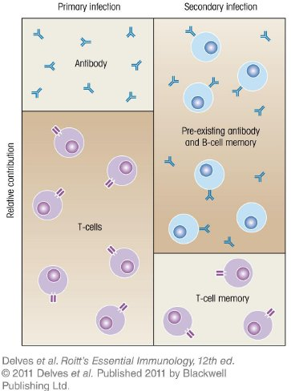
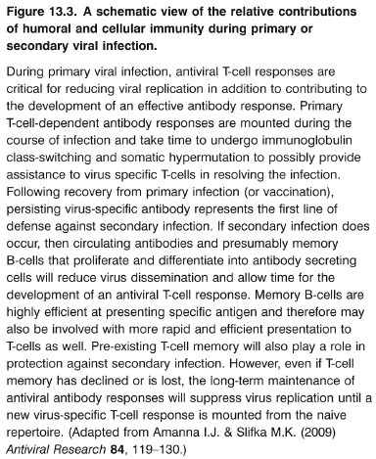
Chapter_13.indd 4
3/17/11 5:19 PM

Slide 5
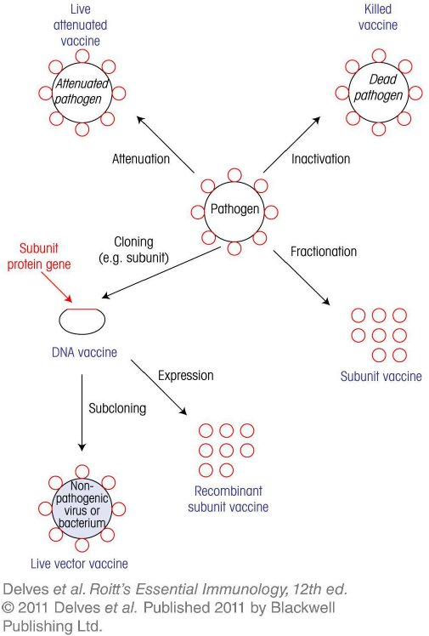
Chapter_13.indd 5
3/17/11 5:19 PM

Slide 6
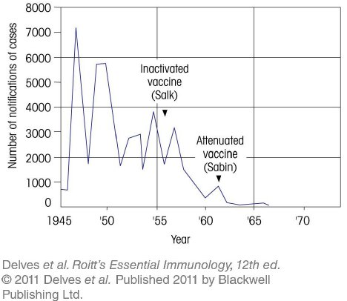
Chapter_13.indd 6
3/17/11 5:19 PM

Slide 7
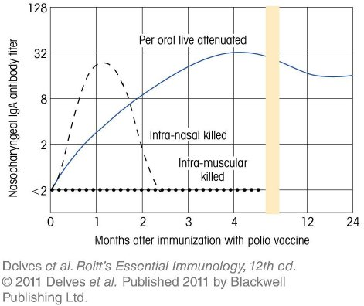
Chapter_13.indd 7
3/17/11 5:19 PM

Slide 8
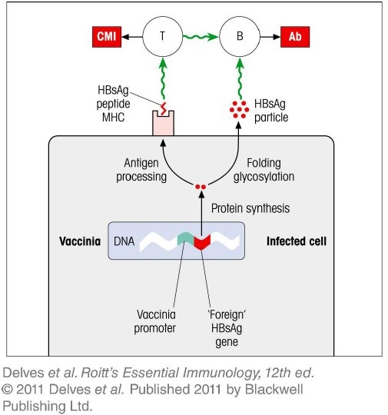
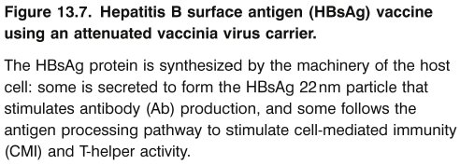
Chapter_13.indd 8
3/17/11 5:19 PM

Slide 9
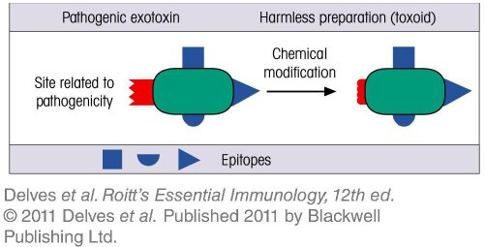
Chapter_13.indd 9
3/17/11 5:19 PM

Slide 10
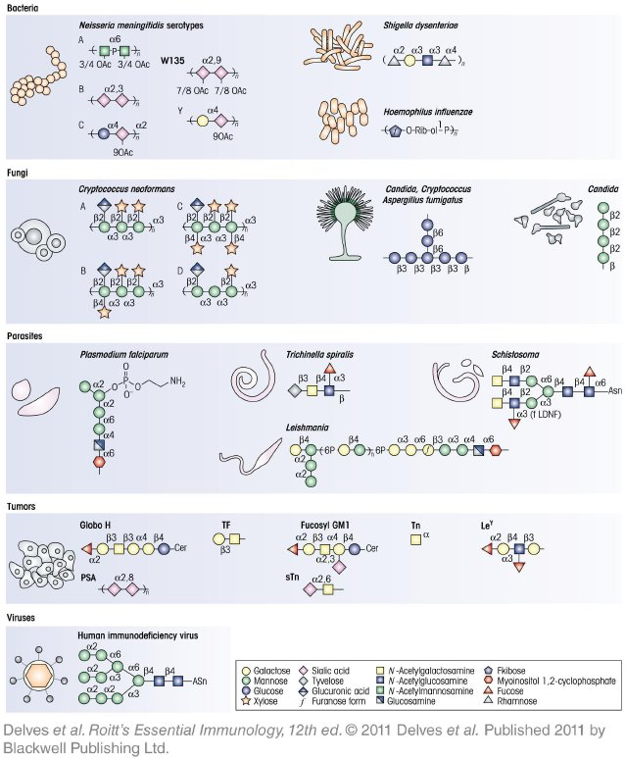
Chapter_13.indd 10
3/17/11 5:19 PM

Slide 11
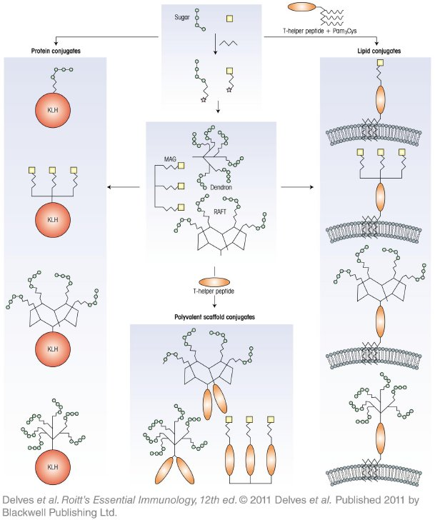
Chapter_13.indd 11
3/17/11 5:19 PM

Slide 12
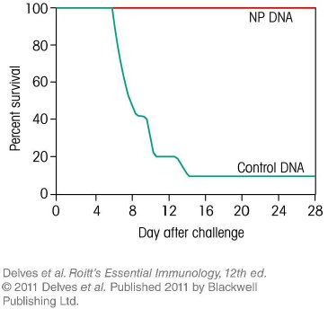
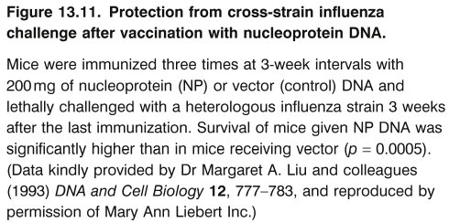
Chapter_13.indd 12
3/17/11 5:19 PM

Slide 13
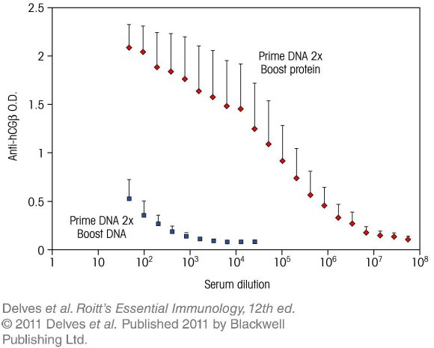
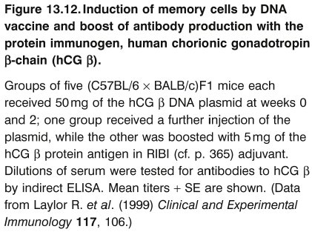
Chapter_13.indd 13
3/17/11 5:19 PM

Slide 14
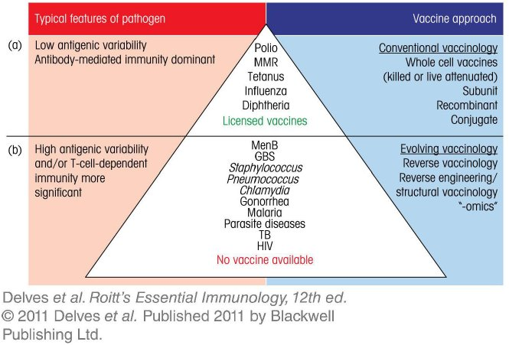
Chapter_13.indd 14
3/17/11 5:19 PM

Slide 15
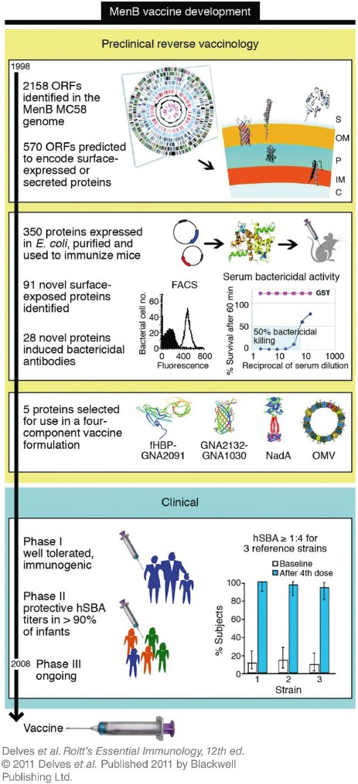
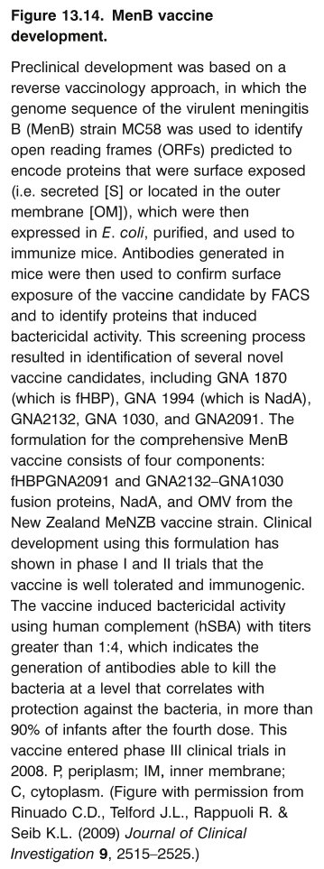
Chapter_13.indd 15
3/17/11 5:19 PM

Slide 16
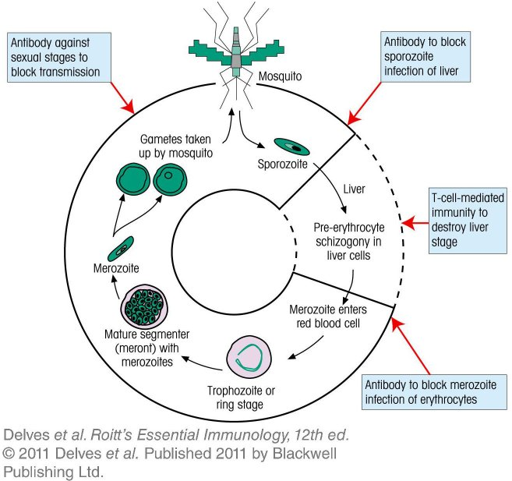
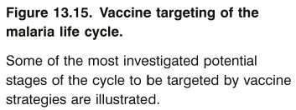
Chapter_13.indd 16
3/17/11 5:19 PM

