Slide 1
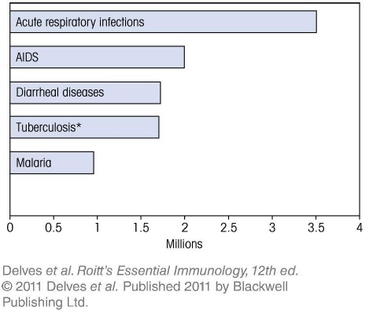
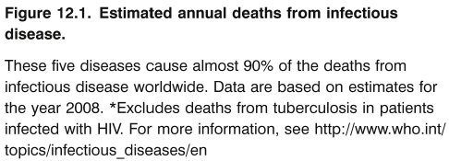
Chapter_12.indd 1
3/17/11 5:16 PM

Slide 2
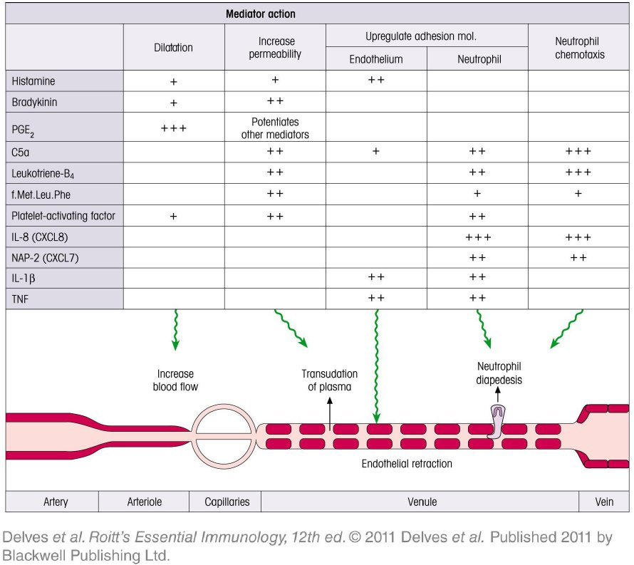
Chapter_12.indd 2
3/17/11 5:16 PM

Slide 3
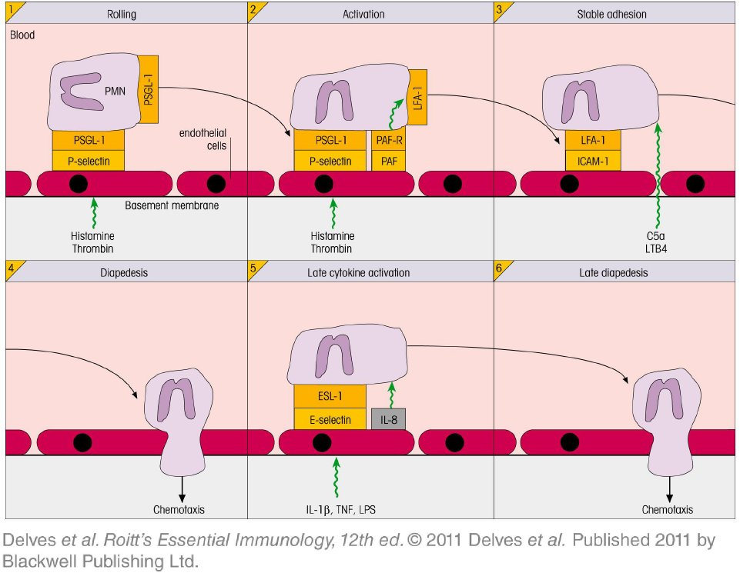
Chapter_12.indd 3
3/17/11 5:16 PM

Slide 4
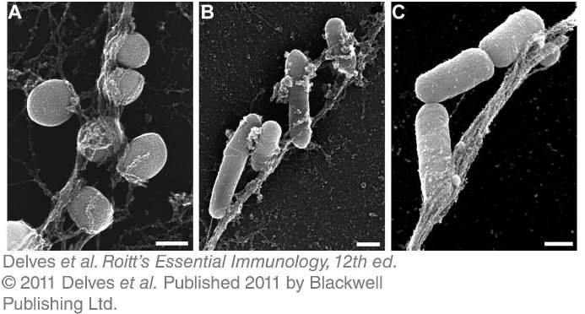
Chapter_12.indd 4
3/17/11 5:16 PM

Slide 5
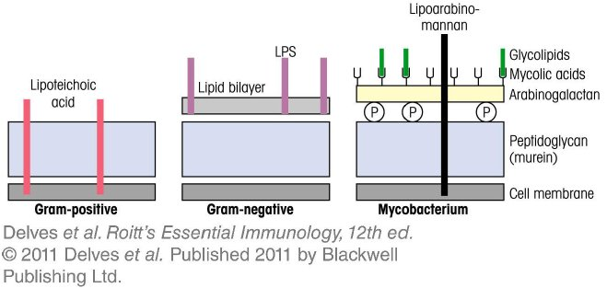
Chapter_12.indd 5
3/17/11 5:16 PM

Slide 6
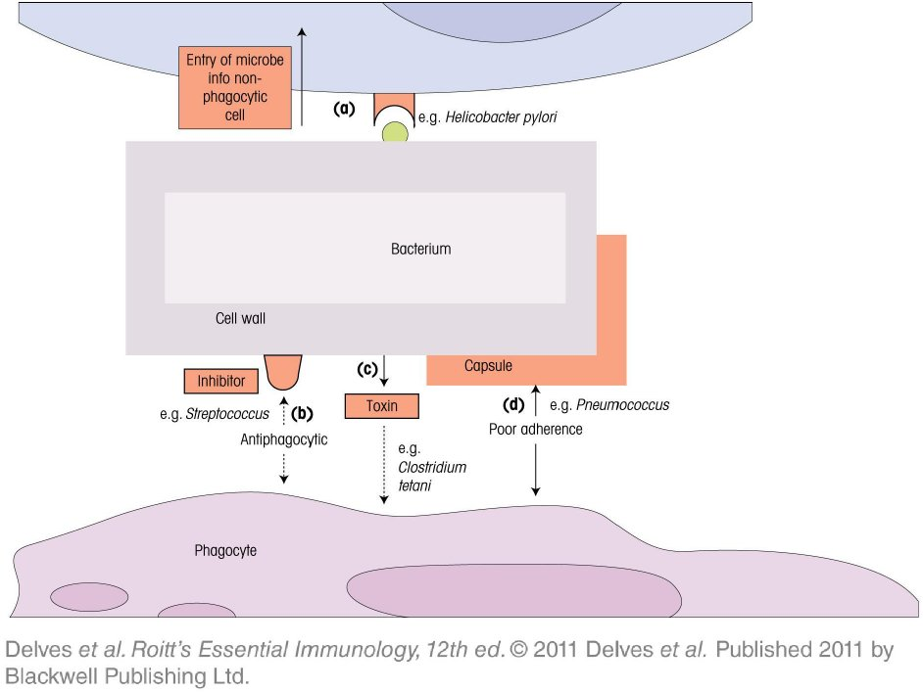
Chapter_12.indd 6
3/17/11 5:16 PM

Slide 7
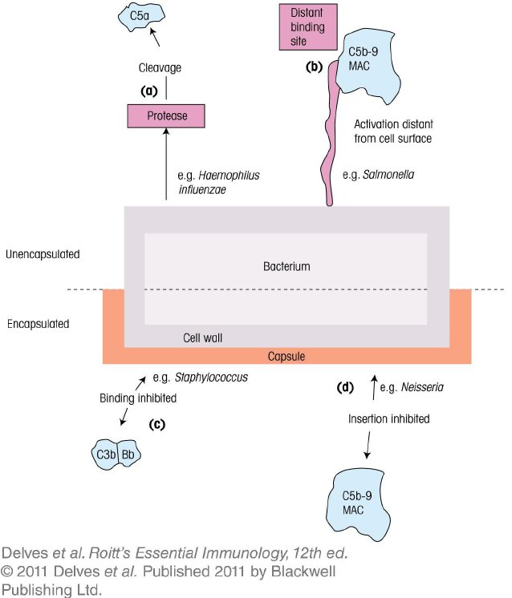
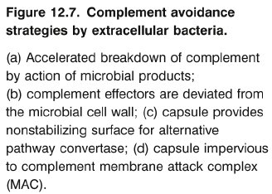
Chapter_12.indd 7
3/17/11 5:16 PM

Slide 8
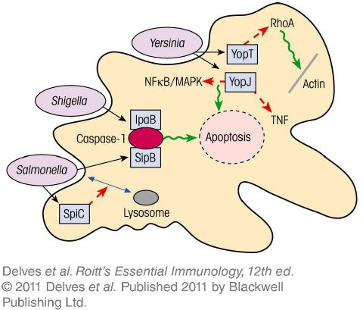
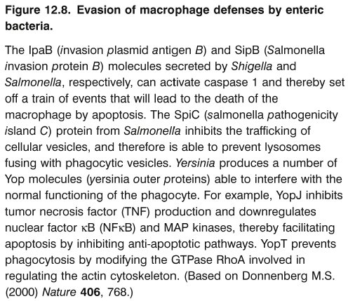
Chapter_12.indd 8
3/17/11 5:16 PM

Slide 9
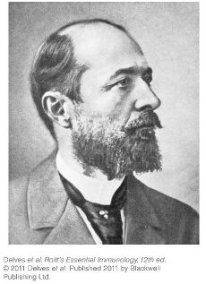
Chapter_12.indd 9
3/17/11 5:16 PM

Slide 10
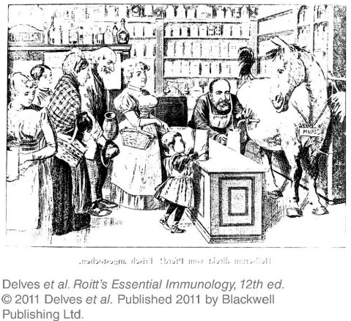
Chapter_12.indd 10
3/17/11 5:16 PM

Slide 11
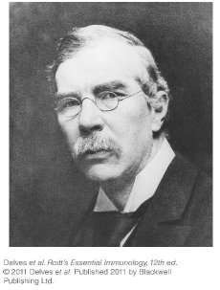
Chapter_12.indd 11
3/17/11 5:16 PM

Slide 12
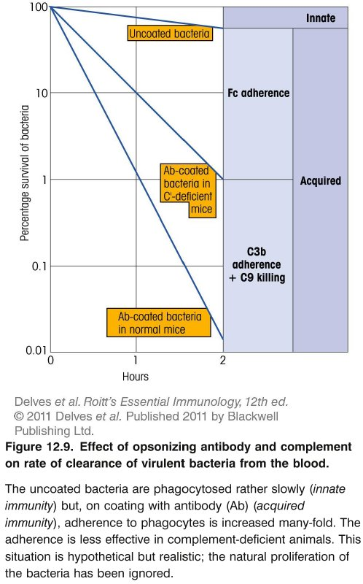
Chapter_12.indd 12
3/17/11 5:16 PM

Slide 13
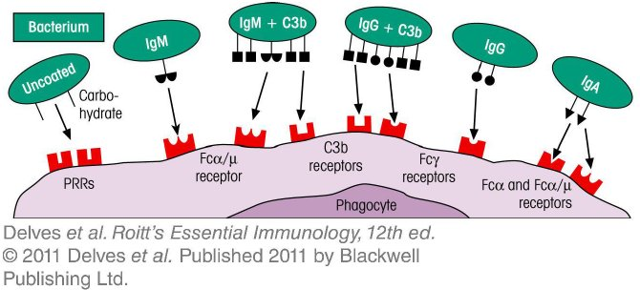
Chapter_12.indd 13
3/17/11 5:16 PM

Slide 14
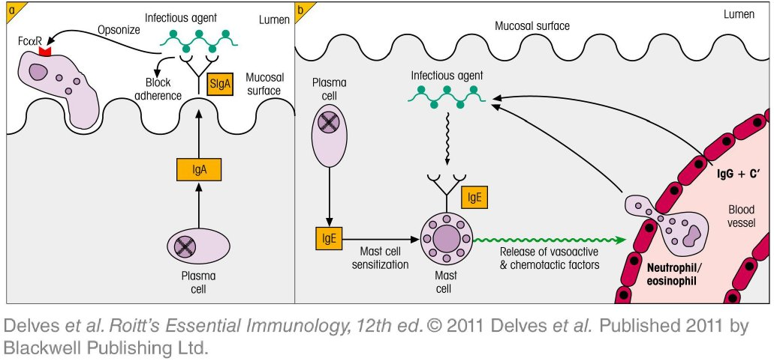
Chapter_12.indd 14
3/17/11 5:16 PM

Slide 15
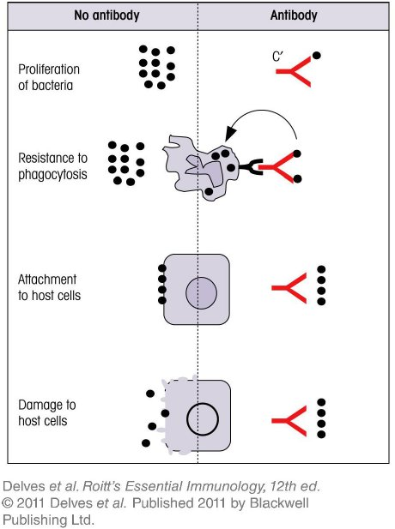
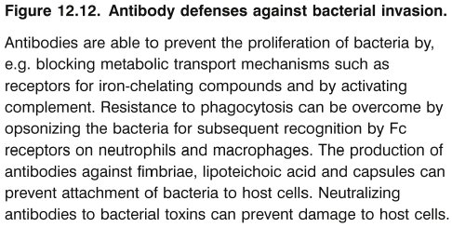
Chapter_12.indd 15
3/17/11 5:16 PM

Slide 16
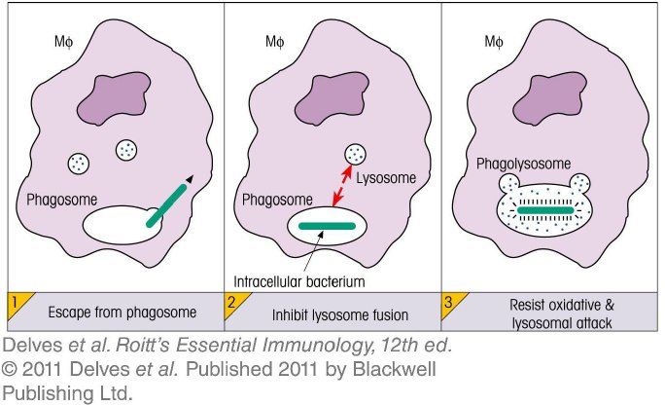
Chapter_12.indd 16
3/17/11 5:16 PM

Slide 17
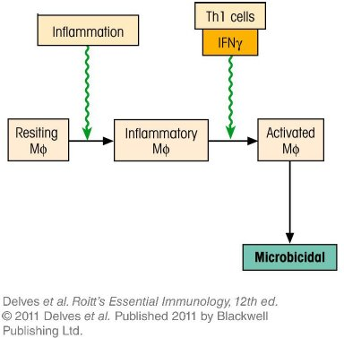
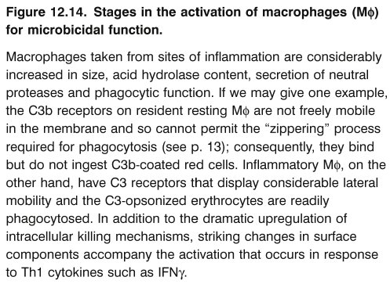
Chapter_12.indd 17
3/17/11 5:16 PM

Slide 18
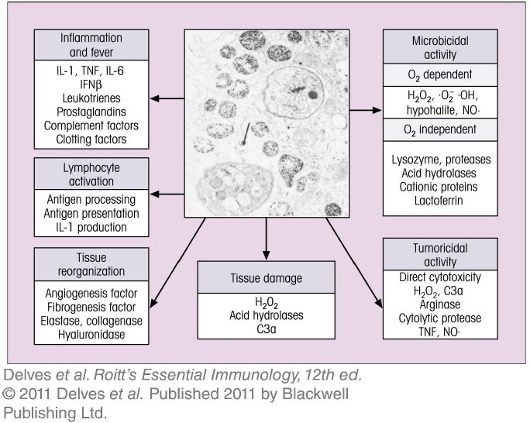
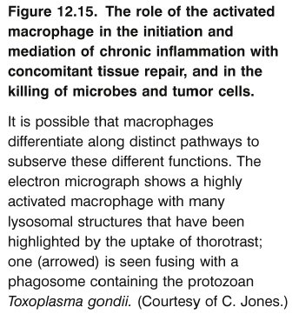
Chapter_12.indd 18
3/17/11 5:16 PM

Slide 19
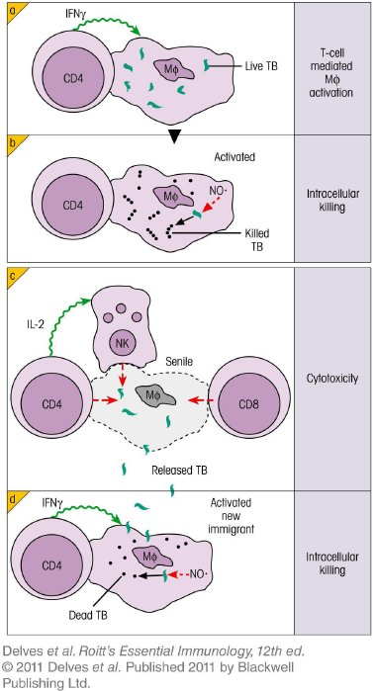
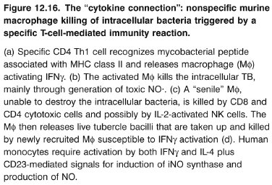
Chapter_12.indd 19
3/17/11 5:16 PM

Slide 20
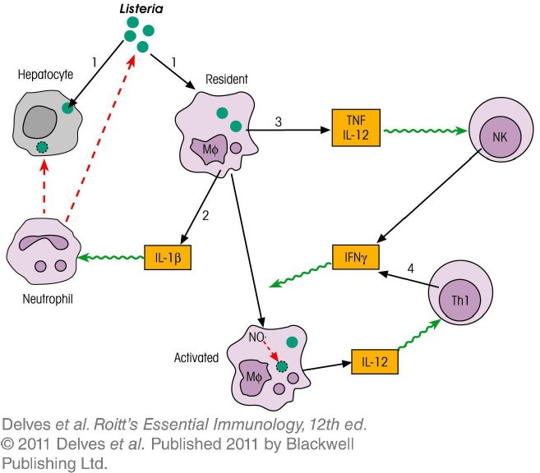
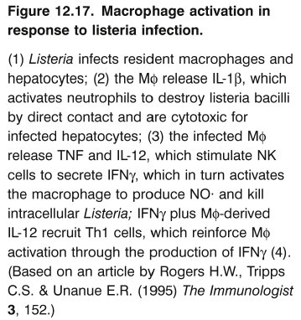
Chapter_12.indd 20
3/17/11 5:16 PM

Slide 21
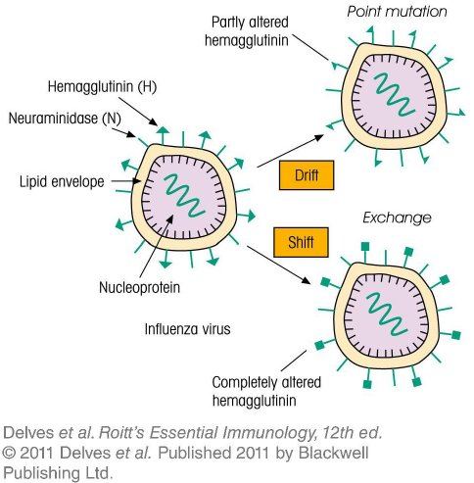
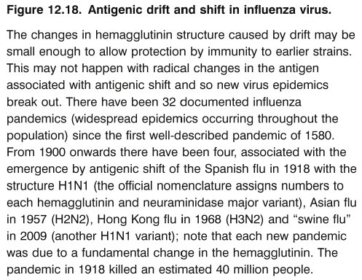
Chapter_12.indd 21
3/17/11 5:16 PM

Slide 22
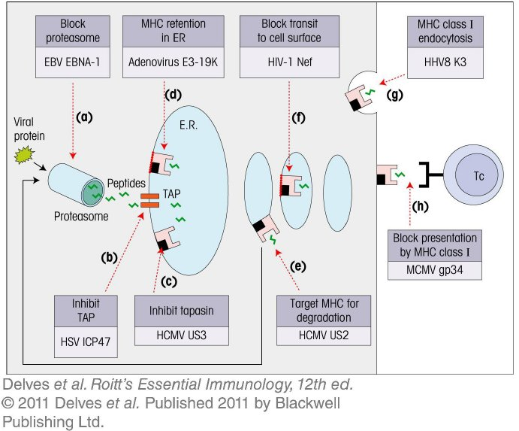
Chapter_12.indd 22
3/17/11 5:16 PM

Slide 23
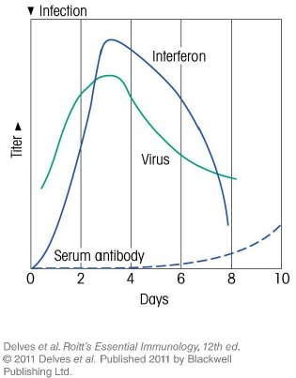
Chapter_12.indd 23
3/17/11 5:16 PM

Slide 24
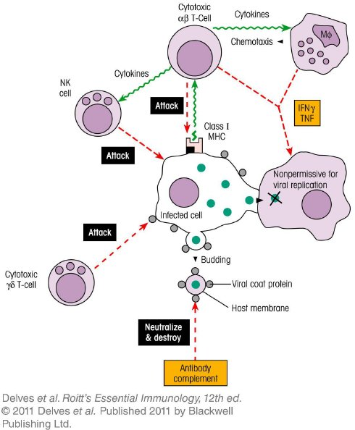
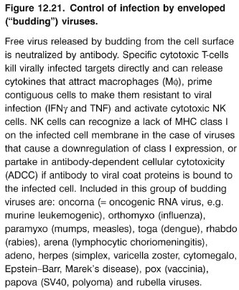
Chapter_12.indd 24
3/17/11 5:16 PM

Slide 25
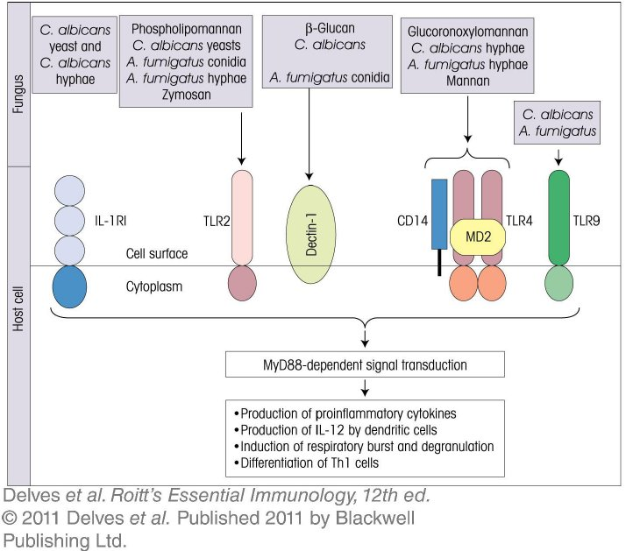
Chapter_12.indd 25
3/17/11 5:16 PM

Slide 26
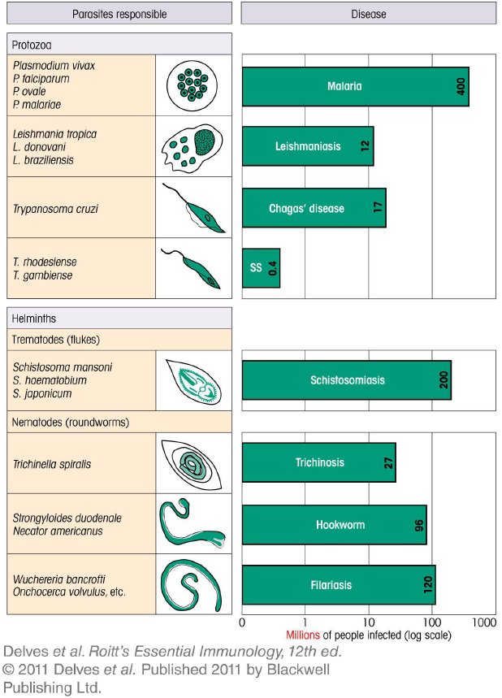
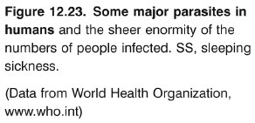
Chapter_12.indd 26
3/17/11 5:16 PM

Slide 27
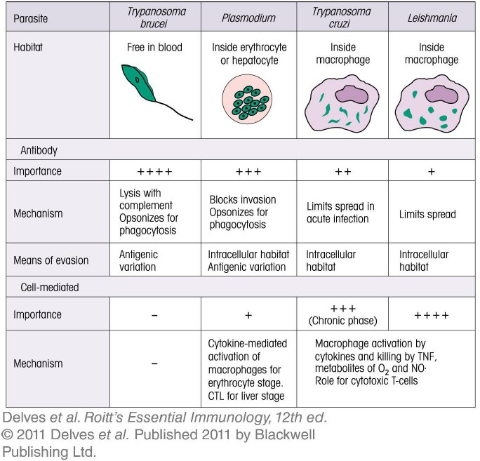
Chapter_12.indd 27
3/17/11 5:16 PM

Slide 28
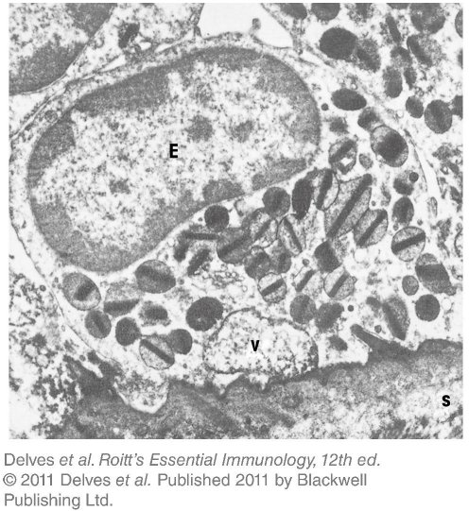
Chapter_12.indd 28
3/17/11 5:16 PM

Slide 29
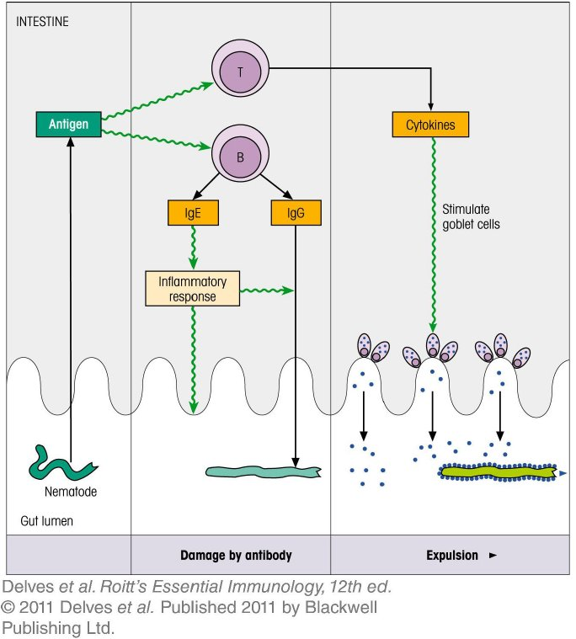
Chapter_12.indd 29
3/17/11 5:16 PM

Slide 30
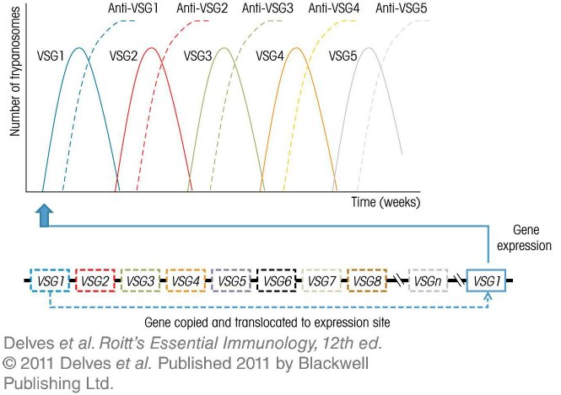
Chapter_12.indd 30
3/17/11 5:16 PM

Slide 31
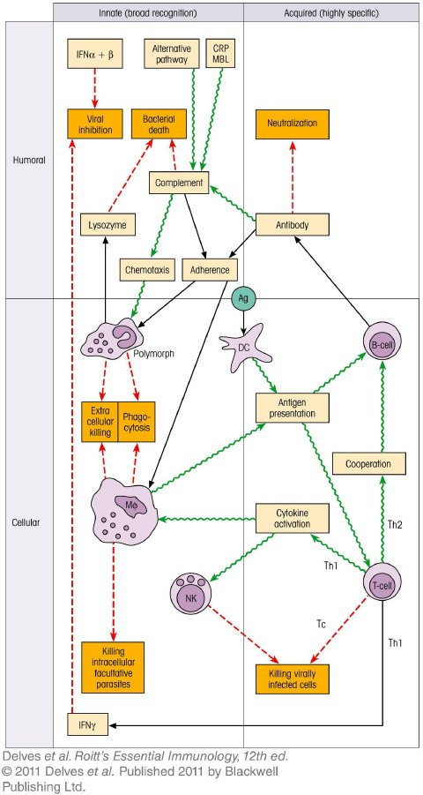
Chapter_12.indd 31
3/17/11 5:16 PM

