Slide 1
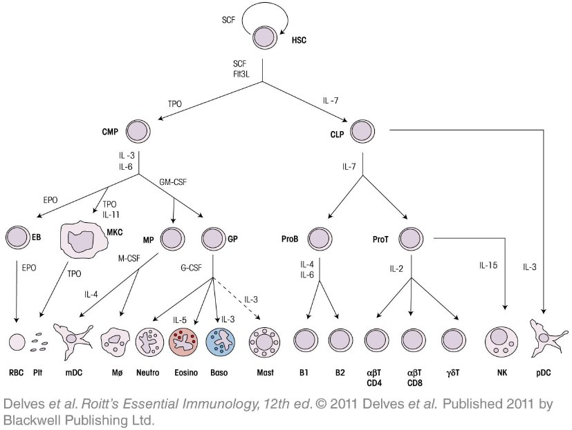
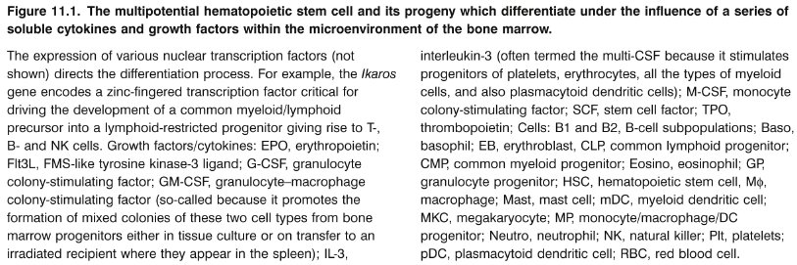
Chapter_11.indd 1
3/17/11 5:11 PM

Slide 2
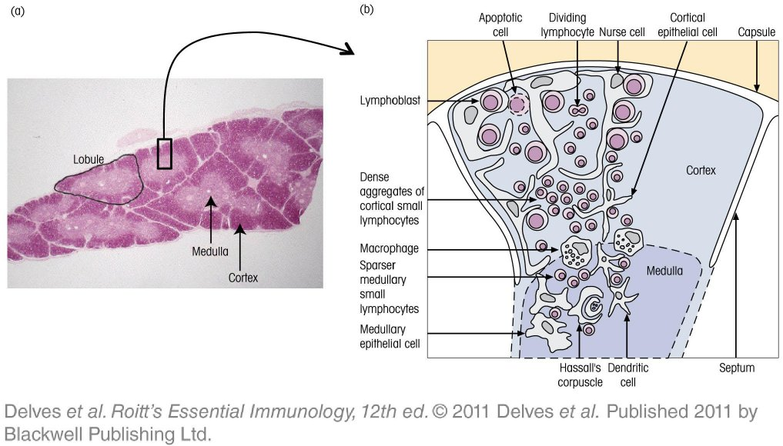
Chapter_11.indd 2
3/17/11 5:11 PM

Slide 3
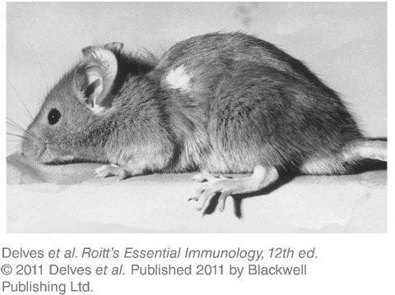
Chapter_11.indd 3
3/17/11 5:11 PM

Slide 4
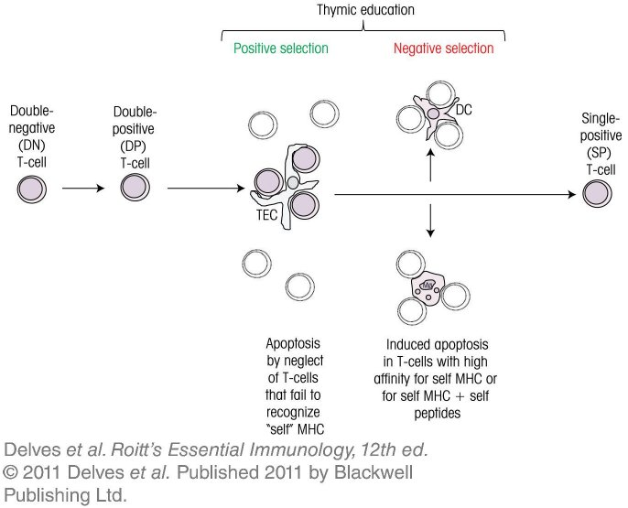
Chapter_11.indd 4
3/17/11 5:11 PM

Slide 5
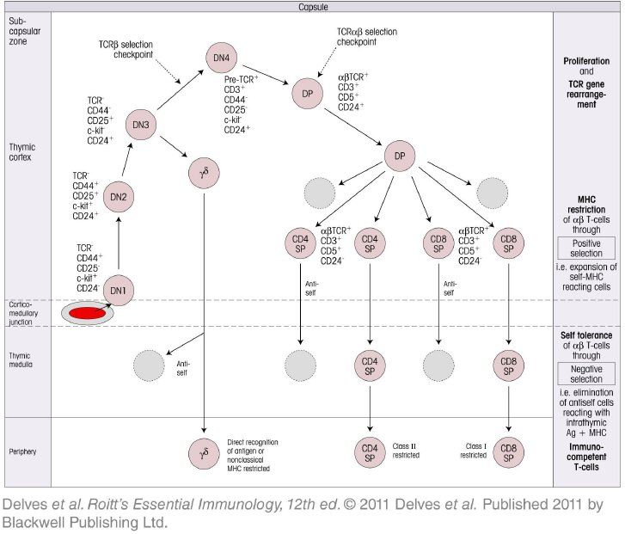
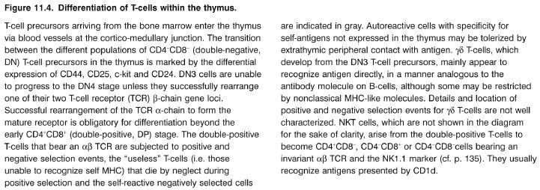
Chapter_11.indd 5
3/17/11 5:11 PM

Slide 6
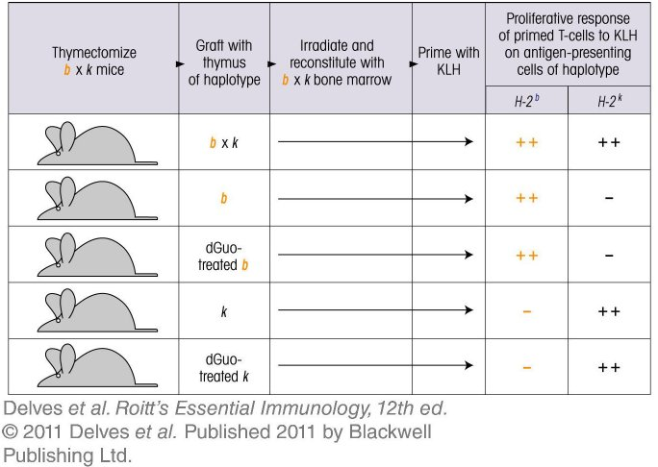
Chapter_11.indd 6
3/17/11 5:11 PM

Slide 7
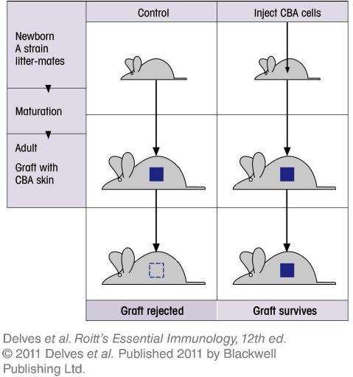
Chapter_11.indd 7
3/17/11 5:11 PM

Slide 8
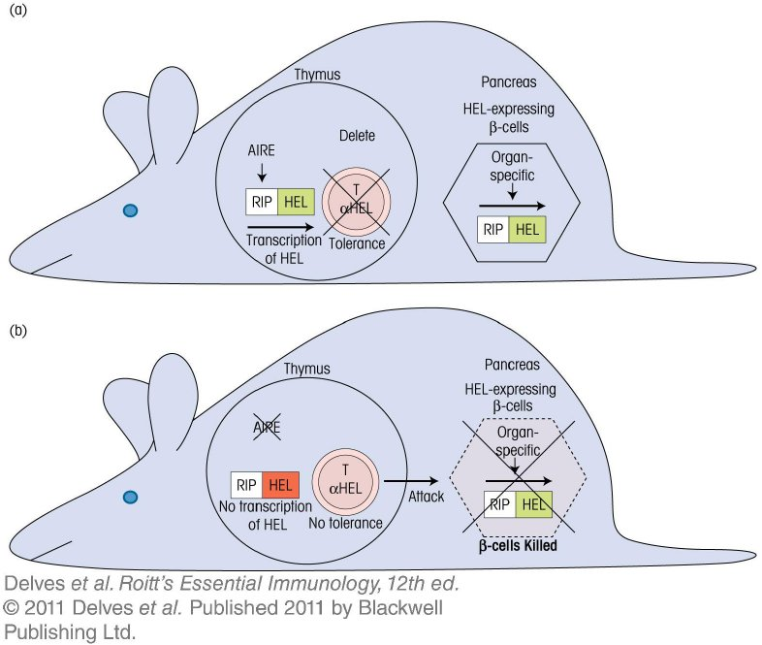
Chapter_11.indd 8
3/17/11 5:11 PM

Slide 9
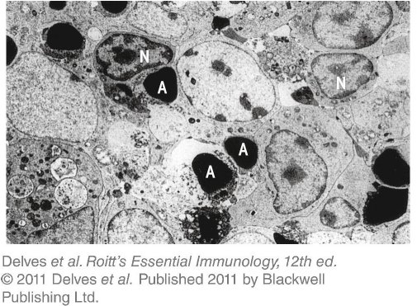
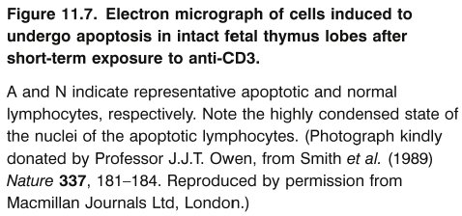
Chapter_11.indd 9
3/17/11 5:11 PM

Slide 10
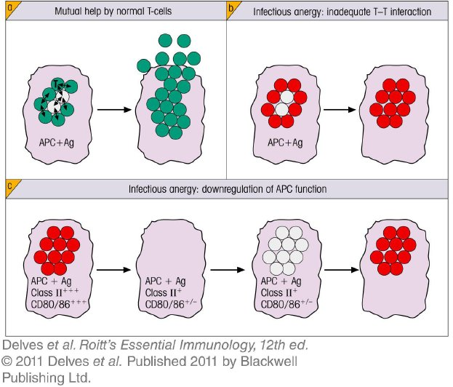
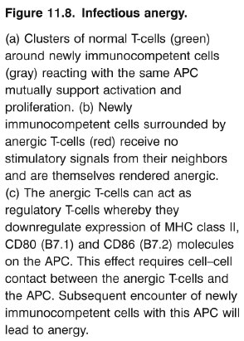
Chapter_11.indd 10
3/17/11 5:11 PM

Slide 11
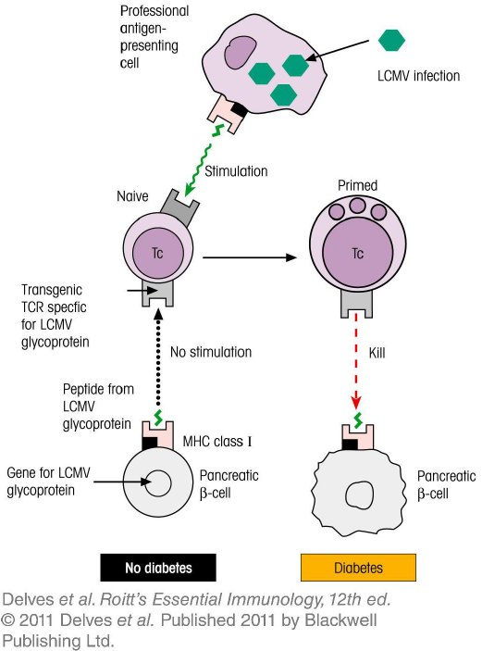
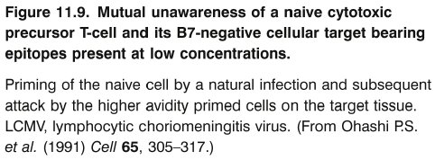
Chapter_11.indd 11
3/17/11 5:11 PM

Slide 12
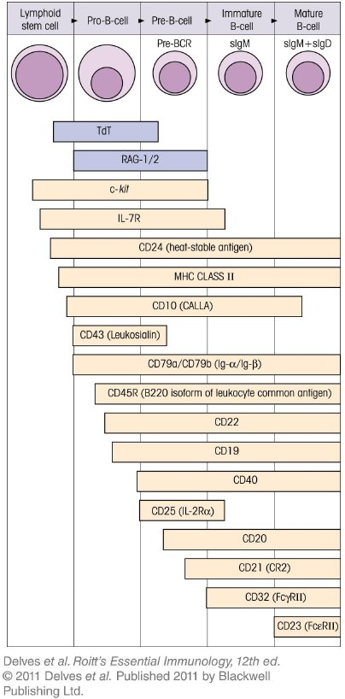
Chapter_11.indd 12
3/17/11 5:11 PM

Slide 13
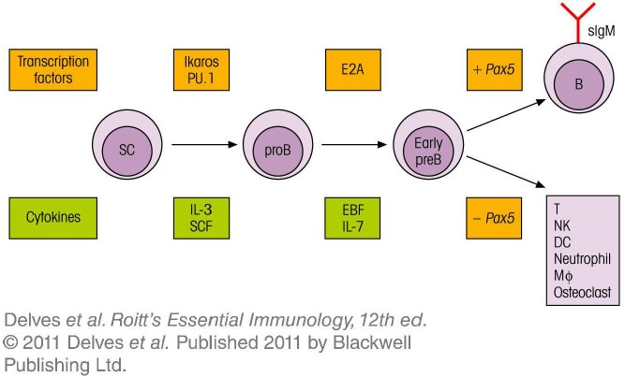
Chapter_11.indd 13
3/17/11 5:11 PM

Slide 14
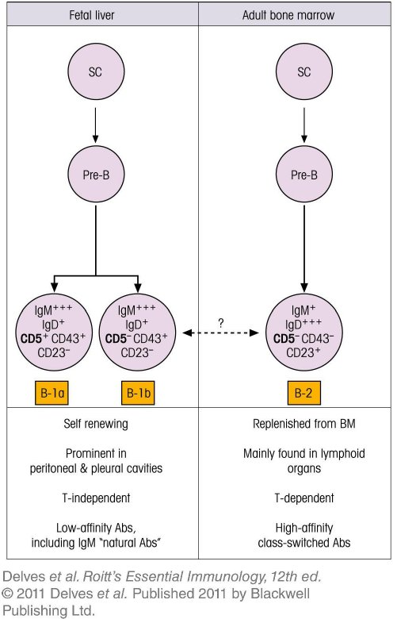
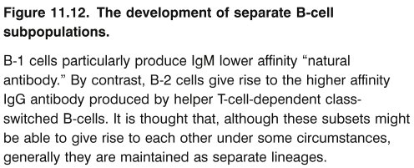
Chapter_11.indd 14
3/17/11 5:11 PM

Slide 15
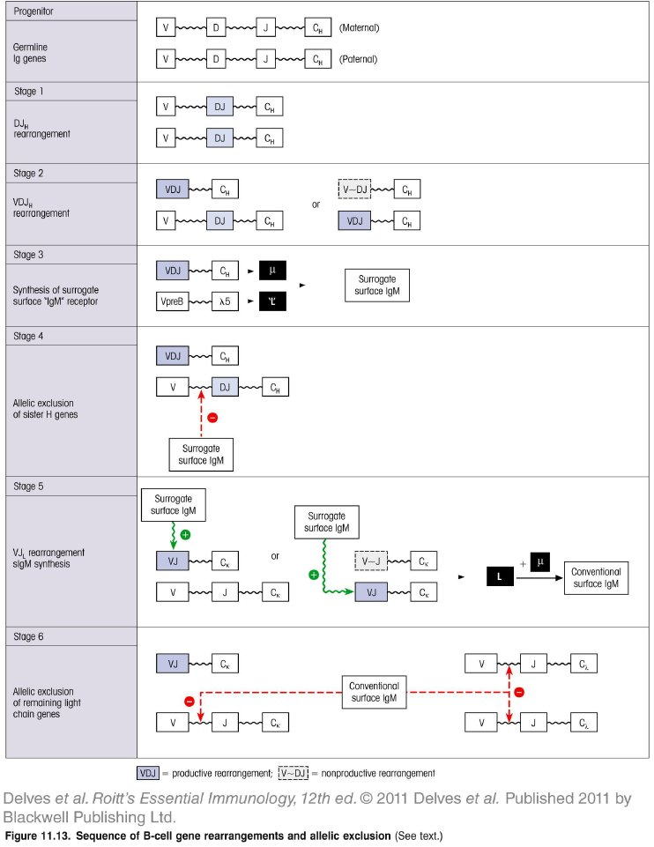
Chapter_11.indd 15
3/17/11 5:11 PM

Slide 16
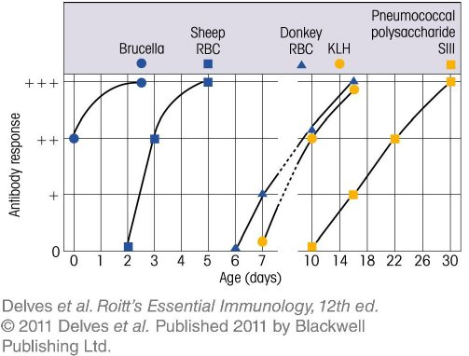
Chapter_11.indd 16
3/17/11 5:11 PM

Slide 17
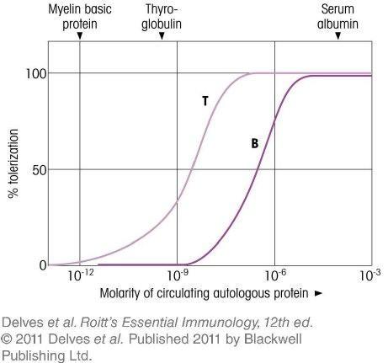
Chapter_11.indd 17
3/17/11 5:11 PM

Slide 18
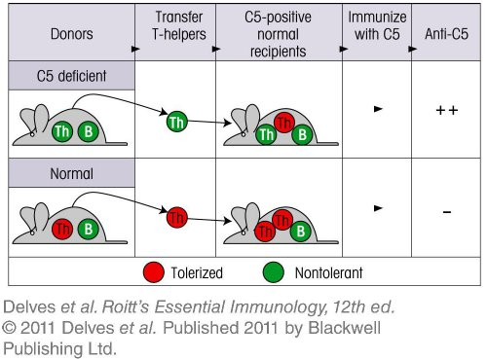
Chapter_11.indd 18
3/17/11 5:11 PM

Slide 19
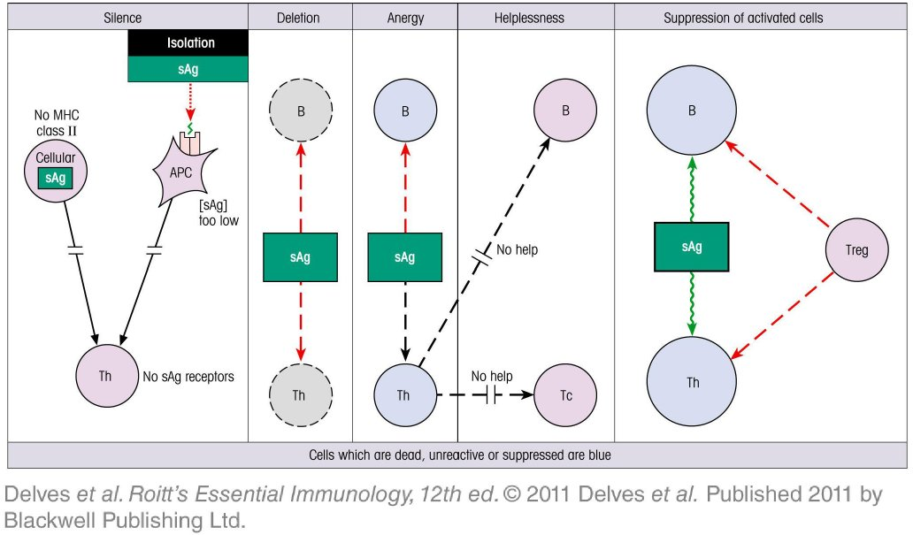
Chapter_11.indd 19
3/17/11 5:11 PM

Slide 20
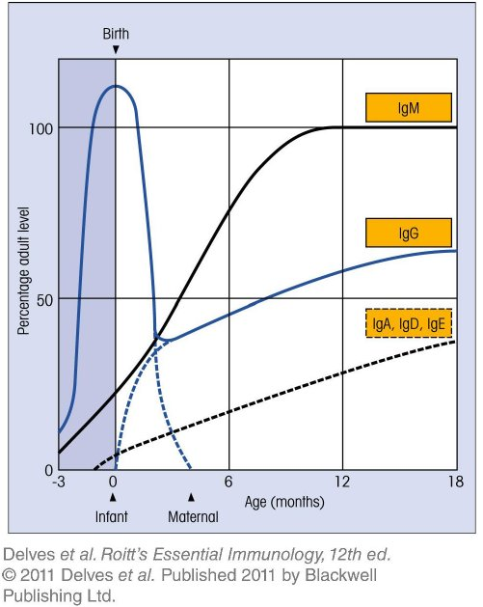
Chapter_11.indd 20
3/17/11 5:11 PM

Slide 21
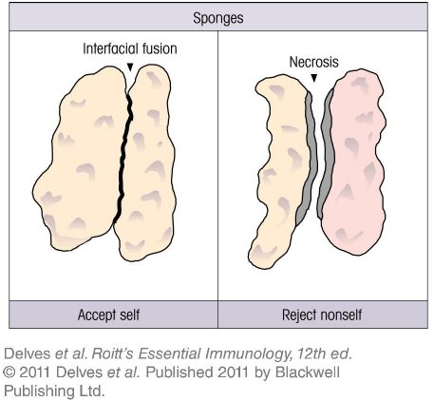
Chapter_11.indd 21
3/17/11 5:11 PM

Slide 22
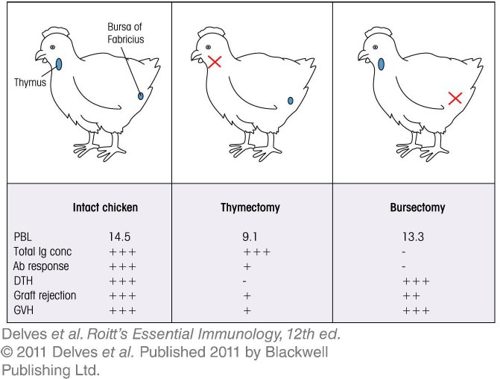
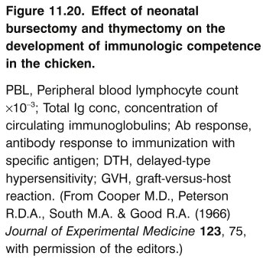
Chapter_11.indd 22
3/17/11 5:11 PM

Slide 23
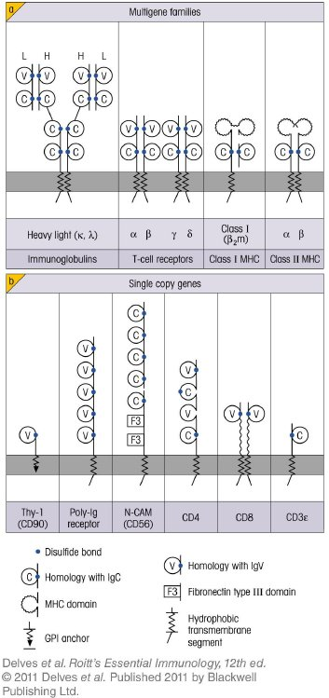
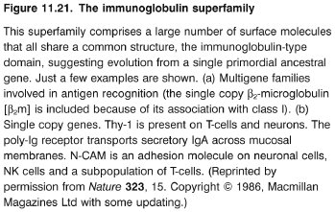
Chapter_11.indd 23
3/17/11 5:11 PM

Slide 24
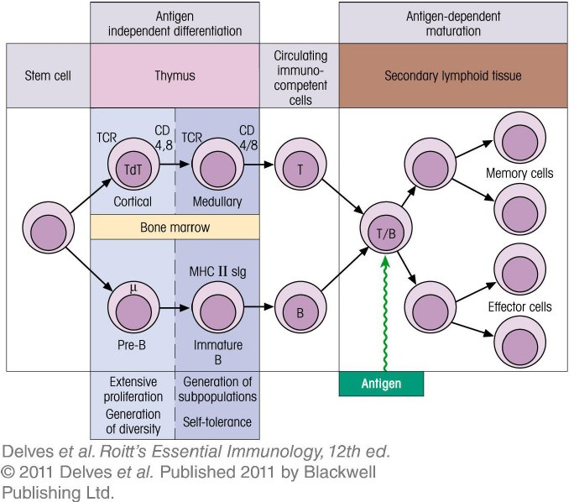
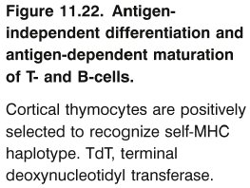
Chapter_11.indd 24
3/17/11 5:11 PM

