Slide 1
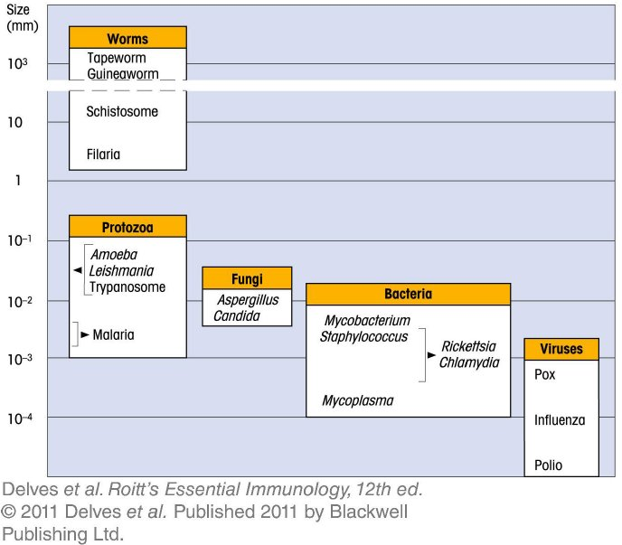
Chapter_1.indd 1
3/17/11 4:18 PM

Slide 2
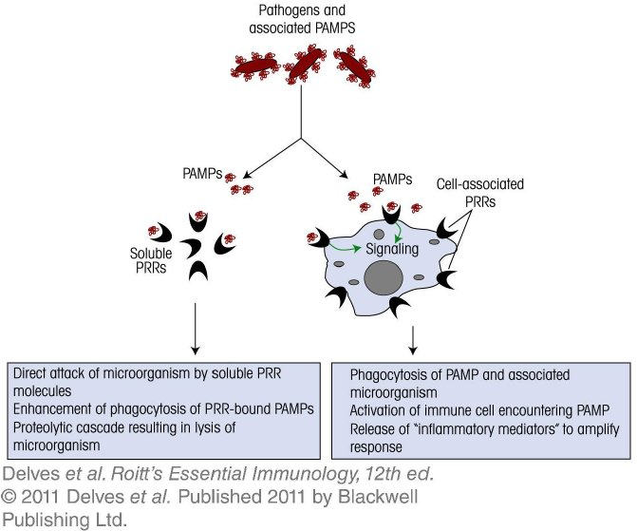
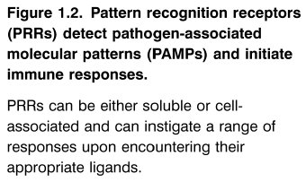
Chapter_1.indd 2
3/17/11 4:18 PM

Slide 3
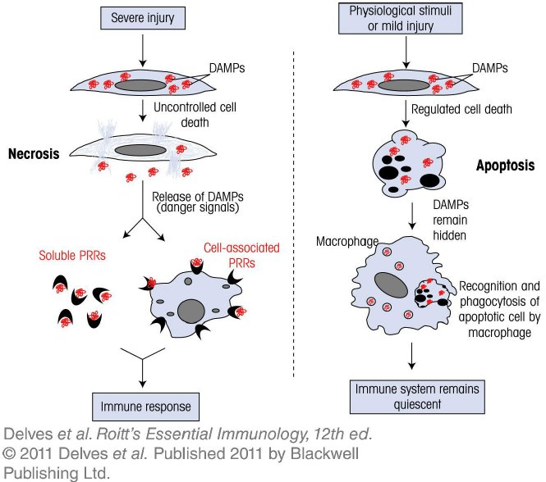
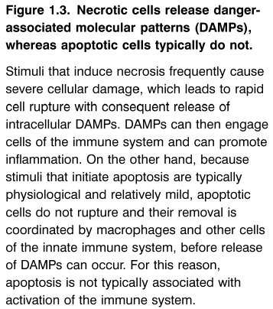
Chapter_1.indd 3
3/17/11 4:18 PM

Slide 4
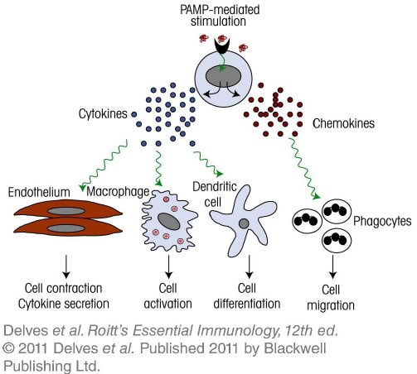
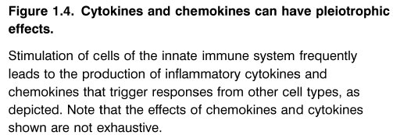
Chapter_1.indd 4
3/17/11 4:18 PM

Slide 5
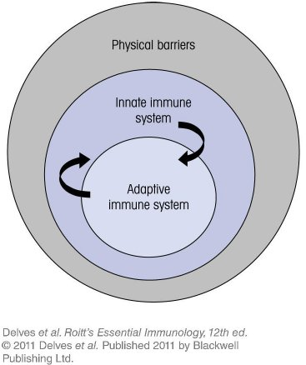
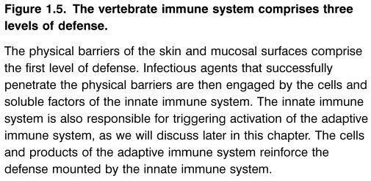
Chapter_1.indd 5
3/17/11 4:18 PM

Slide 6
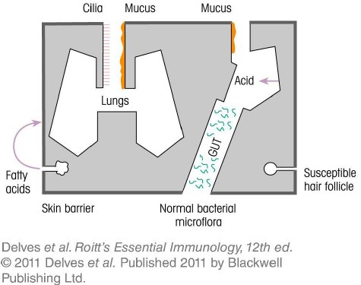
Chapter_1.indd 6
3/17/11 4:18 PM

Slide 7
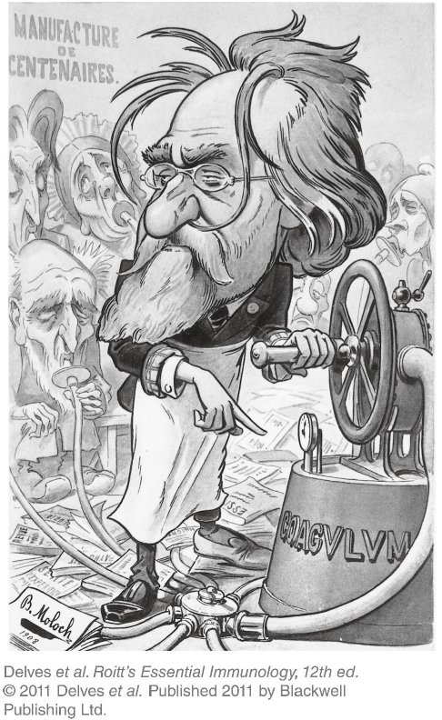
Chapter_1.indd 7
3/17/11 4:18 PM

Slide 8
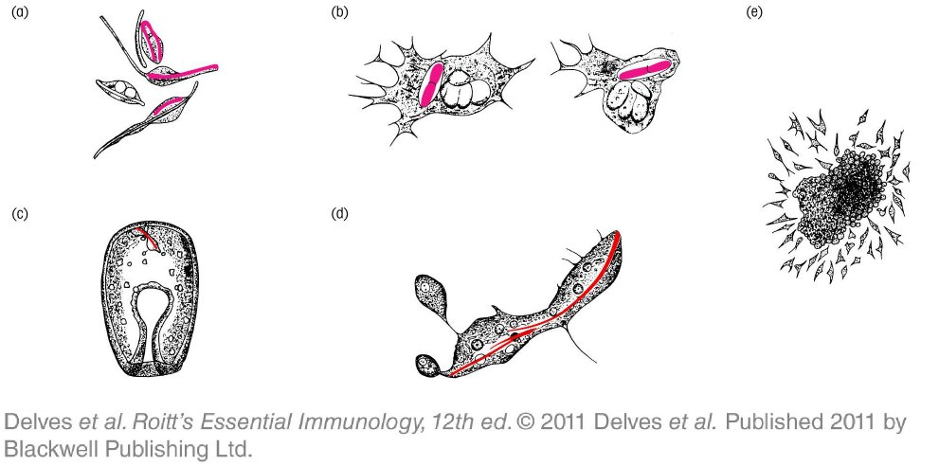
Chapter_1.indd 8
3/17/11 4:18 PM

Slide 9
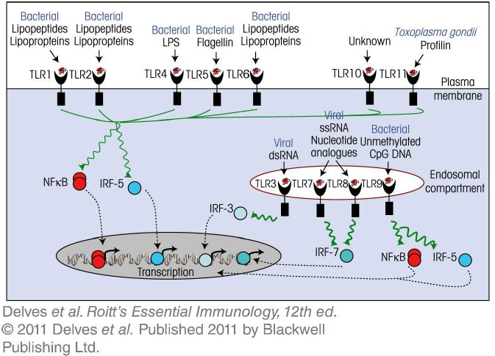
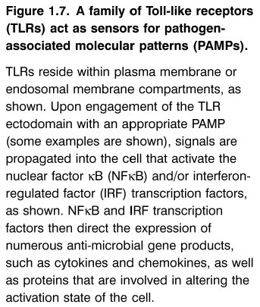
Chapter_1.indd 9
3/17/11 4:18 PM

Slide 10
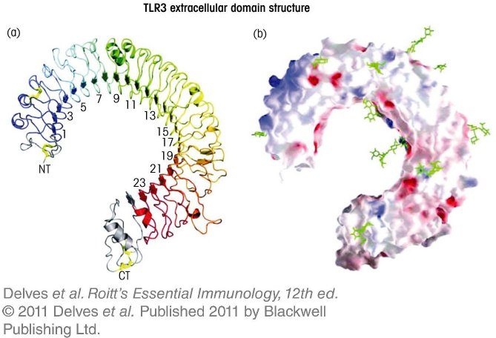
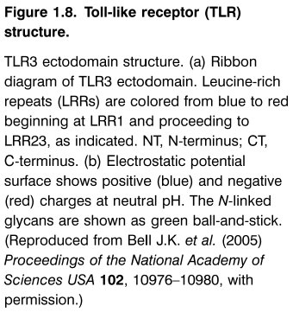
Chapter_1.indd 10
3/17/11 4:18 PM

Slide 11
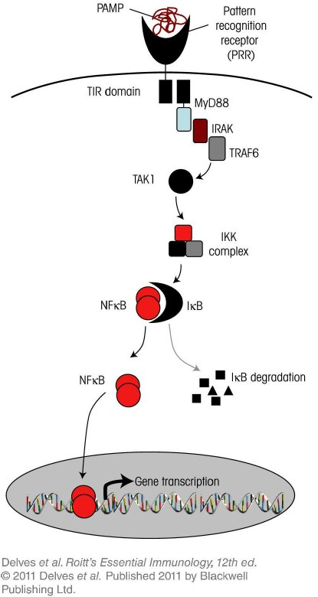
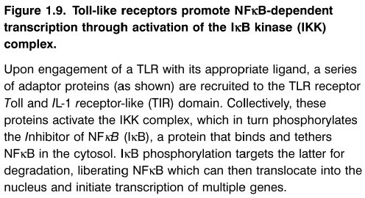
Chapter_1.indd 11
3/17/11 4:18 PM

Slide 12
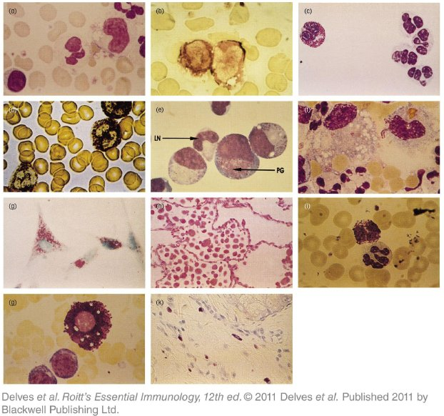
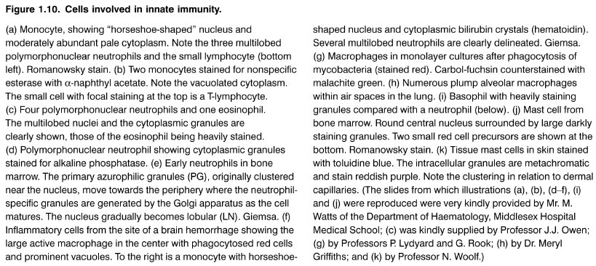
Chapter_1.indd 12
3/17/11 4:18 PM

Slide 13
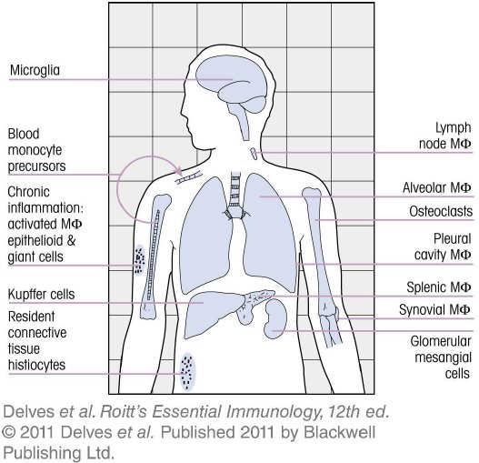
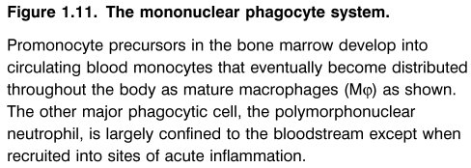
Chapter_1.indd 13
3/17/11 4:18 PM

Slide 14
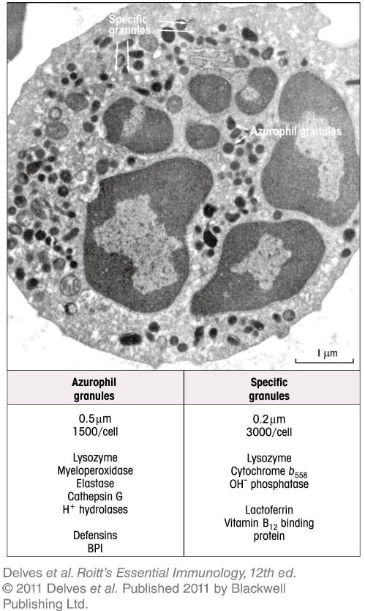
Chapter_1.indd 14
3/17/11 4:18 PM

Slide 15
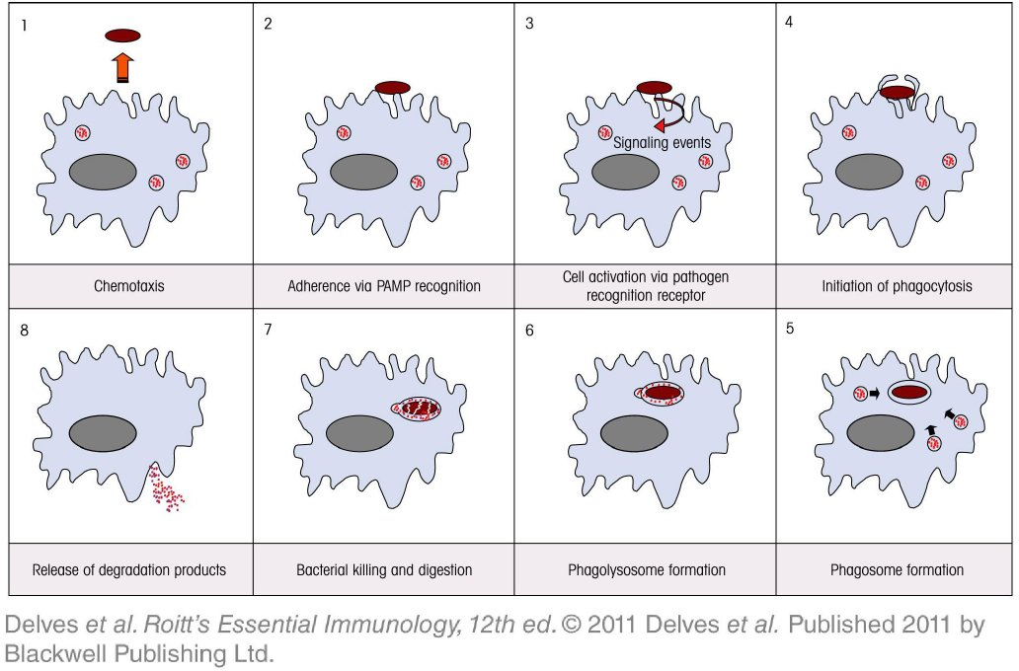
Chapter_1.indd 15
3/17/11 4:18 PM

Slide 16
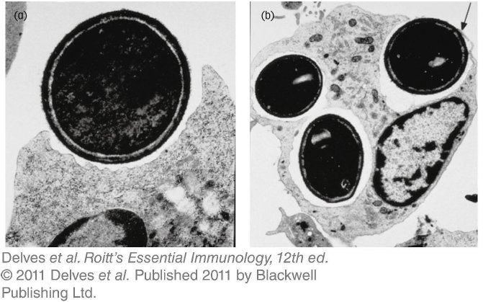
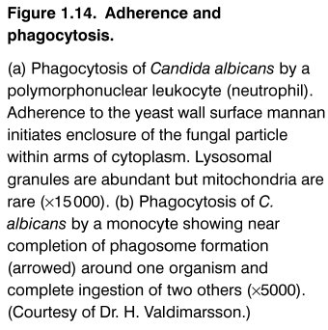
Chapter_1.indd 16
3/17/11 4:18 PM

Slide 17
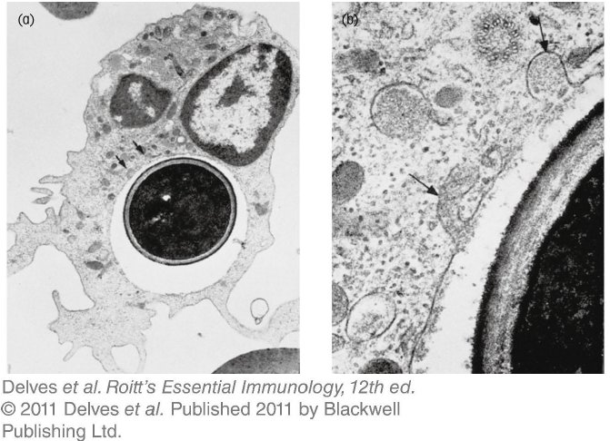
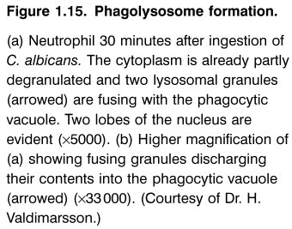
Chapter_1.indd 17
3/17/11 4:18 PM

Slide 18
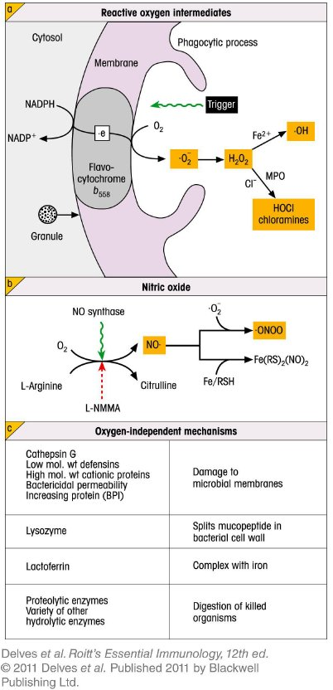
Chapter_1.indd 18
3/17/11 4:18 PM

Slide 19
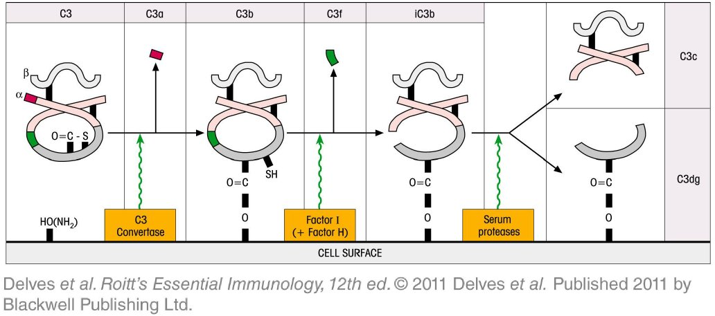
Chapter_1.indd 19
3/17/11 4:18 PM

Slide 20
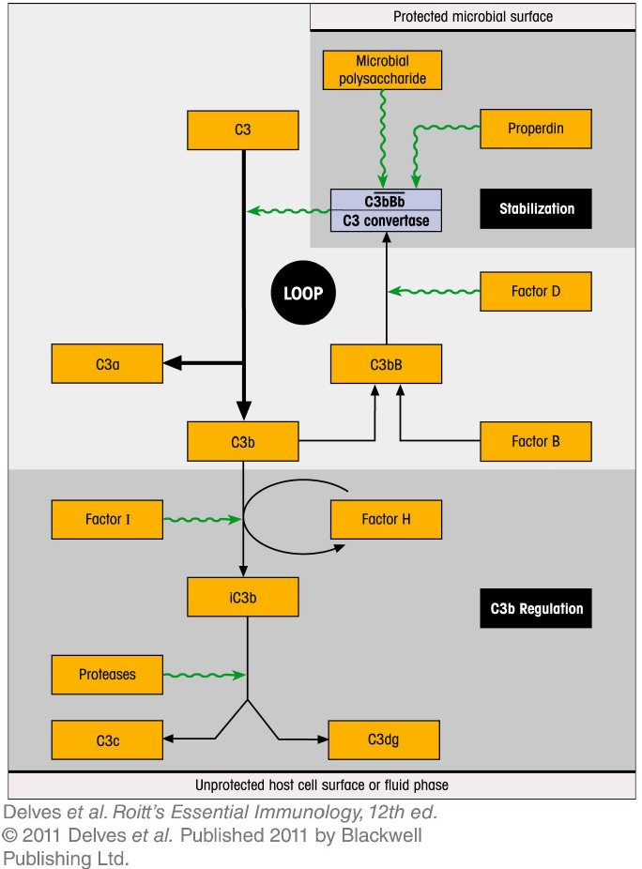
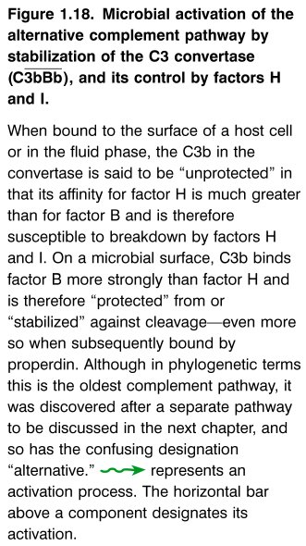
Chapter_1.indd 20
3/17/11 4:18 PM

Slide 21
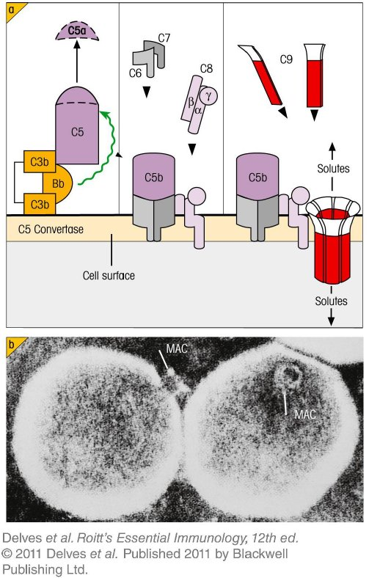
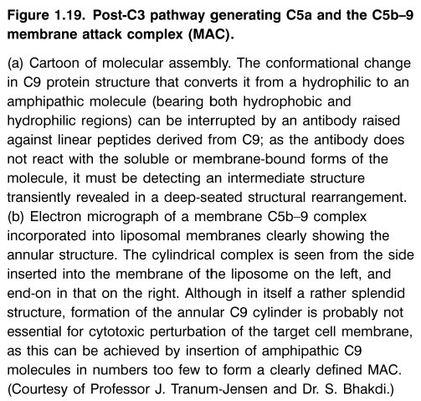
Chapter_1.indd 21
3/17/11 4:18 PM

Slide 22
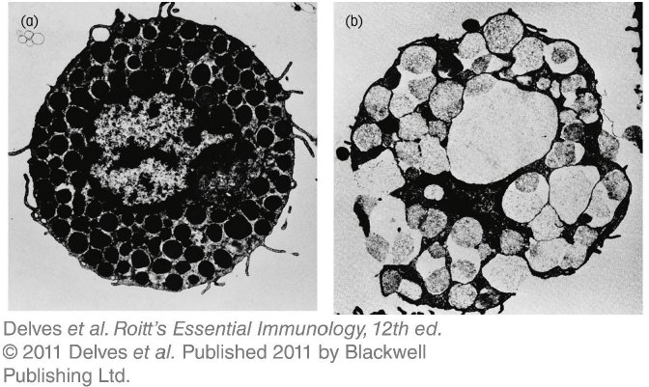
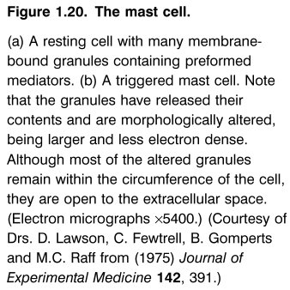
Chapter_1.indd 22
3/17/11 4:18 PM

Slide 23
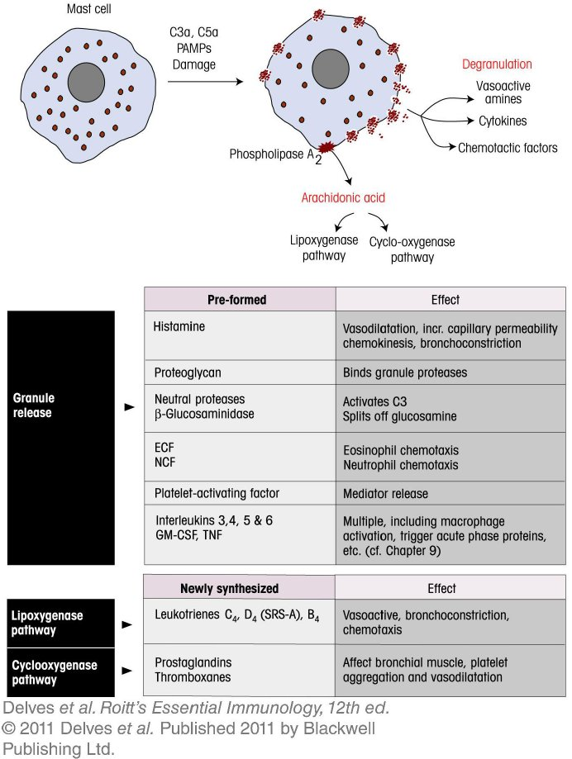
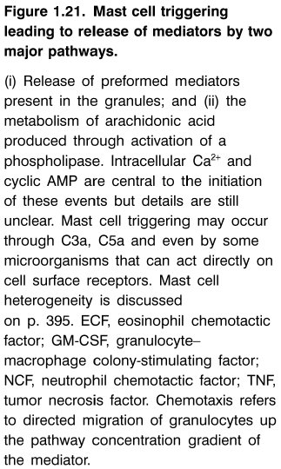
Chapter_1.indd 23
3/17/11 4:18 PM

Slide 24
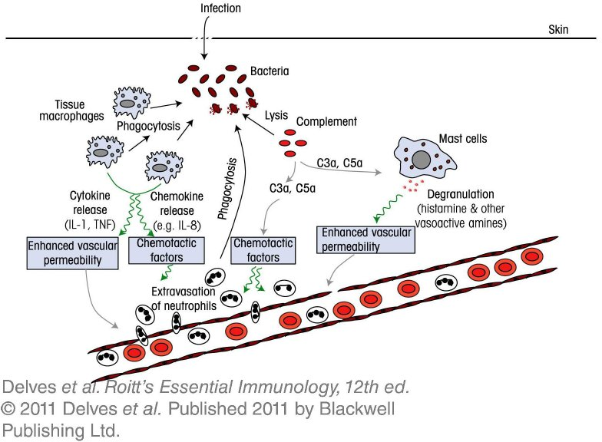
Chapter_1.indd 24
3/17/11 4:18 PM

Slide 25
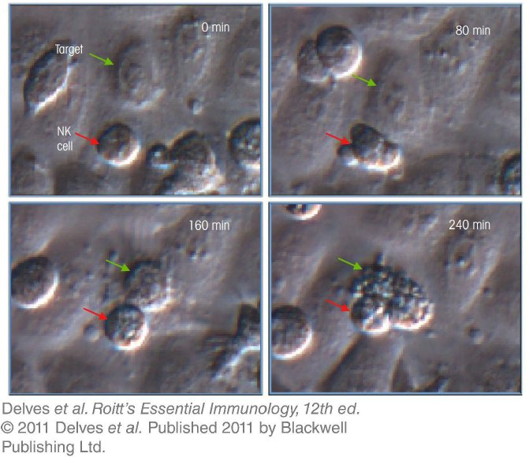
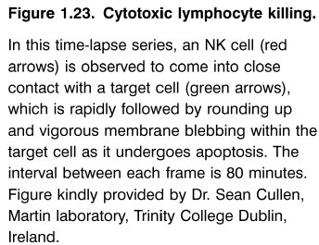
Chapter_1.indd 25
3/17/11 4:18 PM

Slide 26
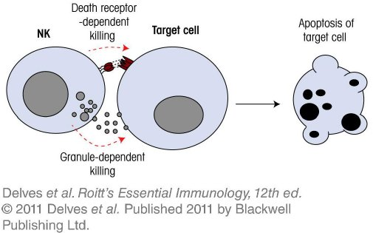
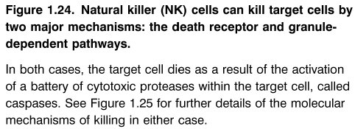
Chapter_1.indd 26
3/17/11 4:18 PM

Slide 27
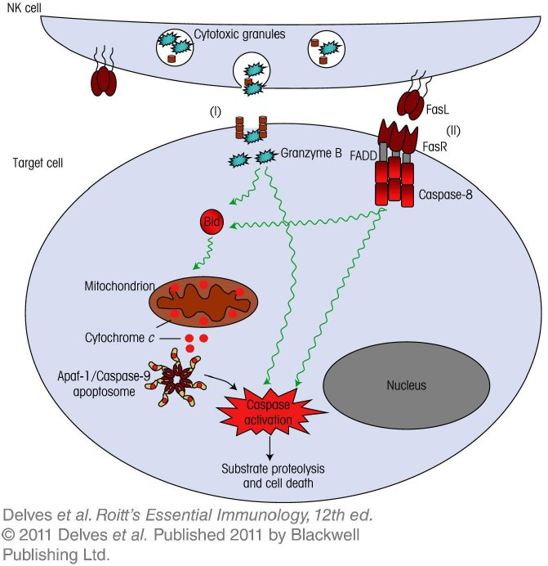
Chapter_1.indd 27
3/17/11 4:18 PM

Slide 28
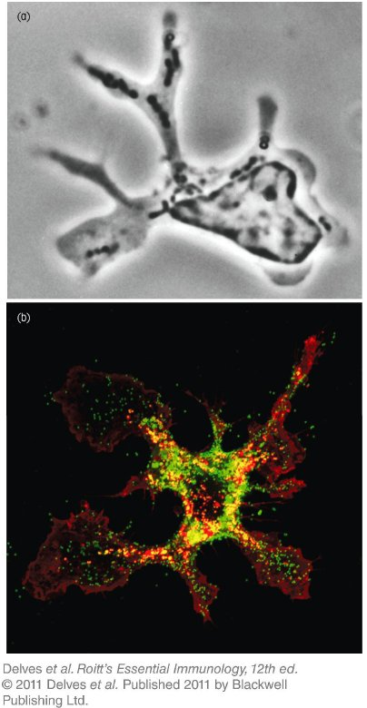
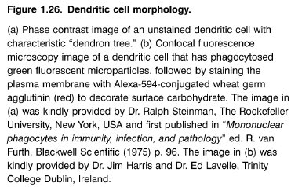
Chapter_1.indd 28
3/17/11 4:18 PM

Slide 29
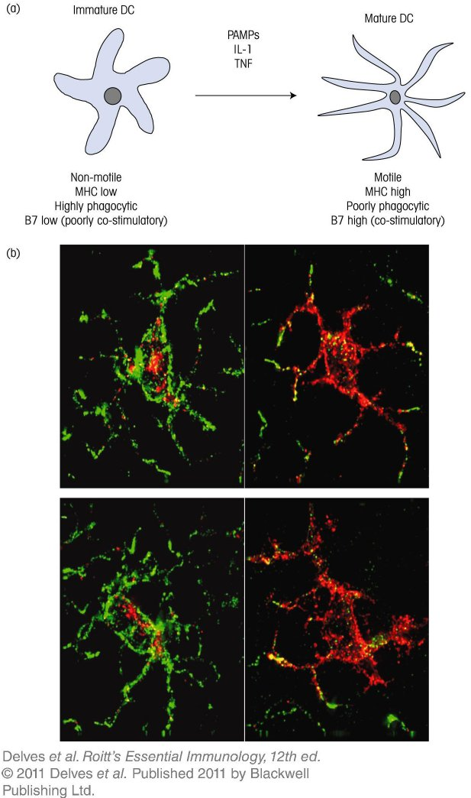
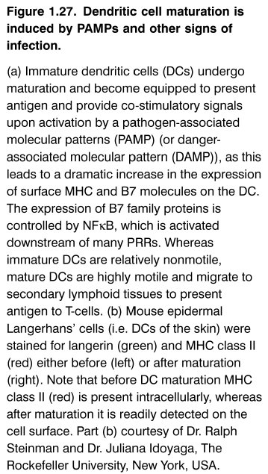
Chapter_1.indd 29
3/17/11 4:18 PM

Slide 30
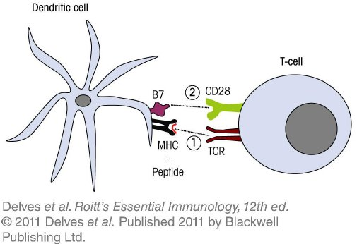
Chapter_1.indd 30
3/17/11 4:18 PM

